Slide 1
Medical Appointment Scheduler
Students: Dušan Todorović Nemanja Cvetić
Mentor: Tatjana Zrimec

Slide 2
Introduction
MARS
Motivation
Why do we need Medical Appointment Scheduler?
What does our system offer?

Slide 3
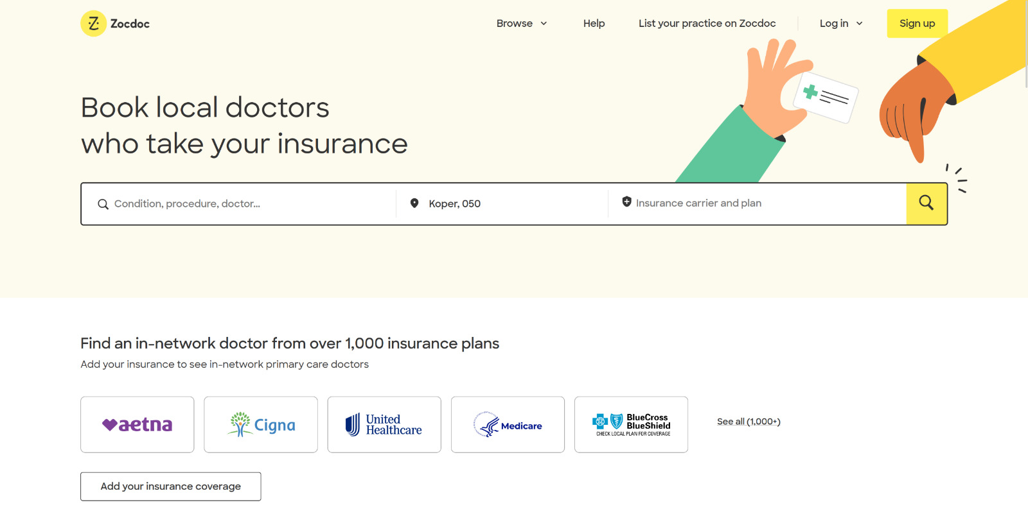
Example
https://www.zocdoc.com/

Slide 4
Technology
HTML/CSS
JIRA/GITHUB
Basic languages for frontend
These technologies we use for communication and planning
PYTHON
POSTGRESQL
One of best backend tools, we use Flask framework
We use Supabase with Postgresql engine

Slide 5
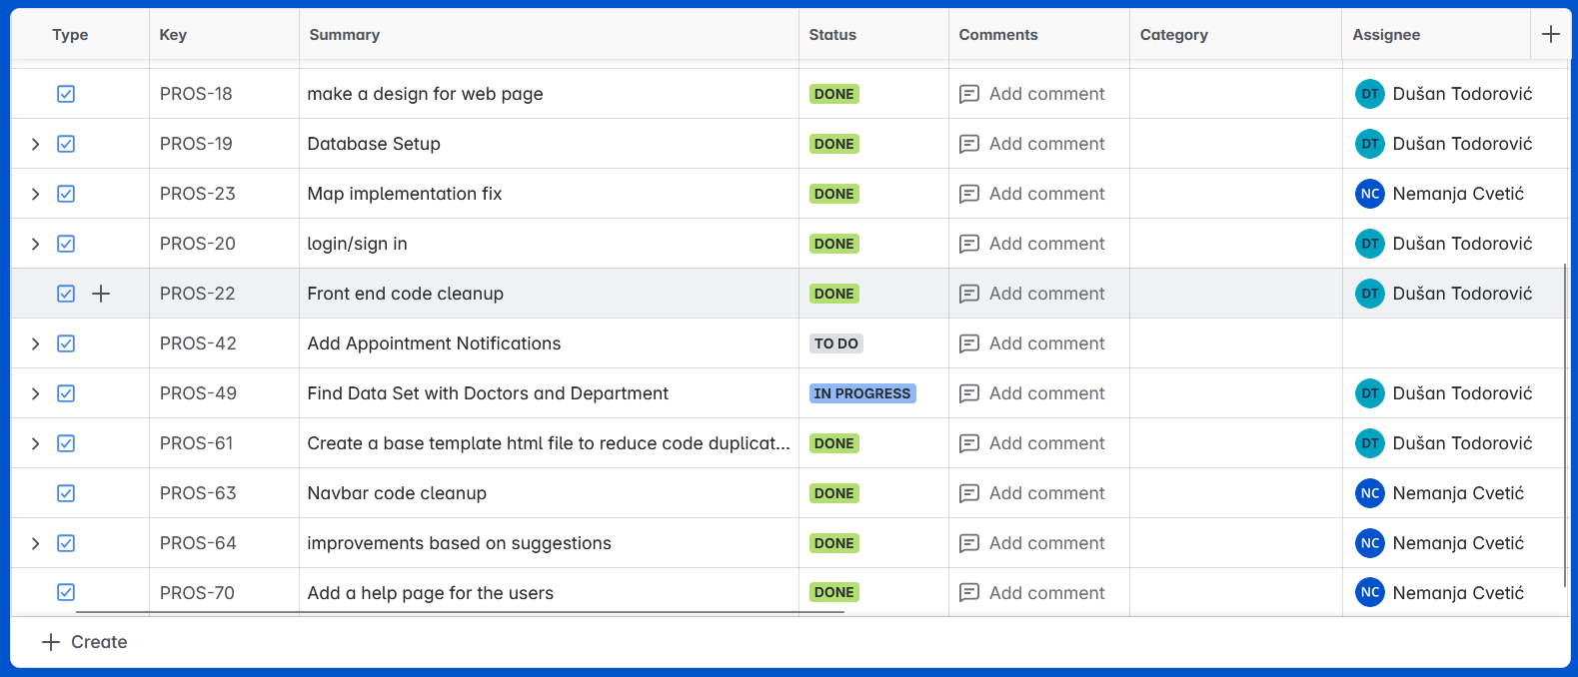
JIRA

Slide 6
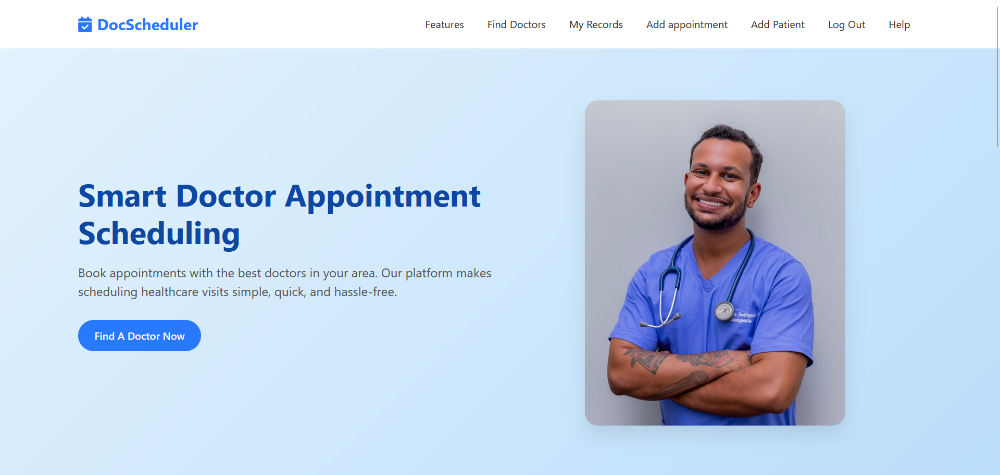
DEMO

Slide 7
FURTHER DEVELOPMENT
Delivering Notifications
Accessing the Family Profile
Adding a News Page
Enhancing System Security
Enables real-time user notifications about updates
Allows parents to view their children’s data and schedule appointments.
Provides a section for the latest information and app updates.
Strengthens data protection and ensures the security of user information.

Slide 8
Thank You
Questions?

