Slide 1
Machine Learning Models for Predicting Personal Loan Acquisition
Research seminar II
University of Primorska
Faculty of Mathematics, Natural Sciences
and Information Technologies
Pika Povh Mavrič
Mentor: Balázs Dávid
April 2025

Slide 2
Motivation
Importance for banks: profitability, customer targeting
Improving the existing customer loan prediction model

Slide 3
Problem statement
How can ML models predict which customers will take a loan?

Slide 4
Goal of research
Preparation of the data to a quality data set
Creation of the model

Slide 5
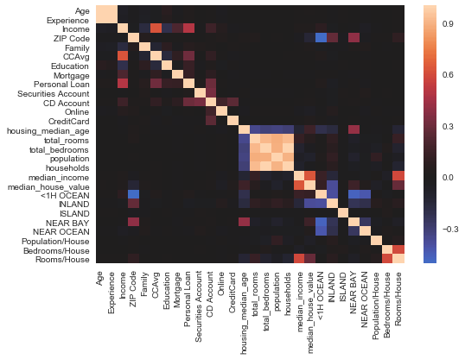
Dataset and Features
Heat Map of Variables
Online resources:
Bank Loan Modelling Dataset
California Housing Dataset
Bank‘s data
Source: https://www.datatobiz.com/blog/customer-analytics-in-banking/
Source:https://medium.com/@arman_hussain786/bank-loan-modelling-using-customer-data-to-optimise-banking-profits-697f43f06f3d

Slide 6
Existing models in banking
Research of existing models for prediction in banks
Churn model
Credit scoring
Loan default risks
Customer segmentation
Loan approval
Fraud detection

Slide 7
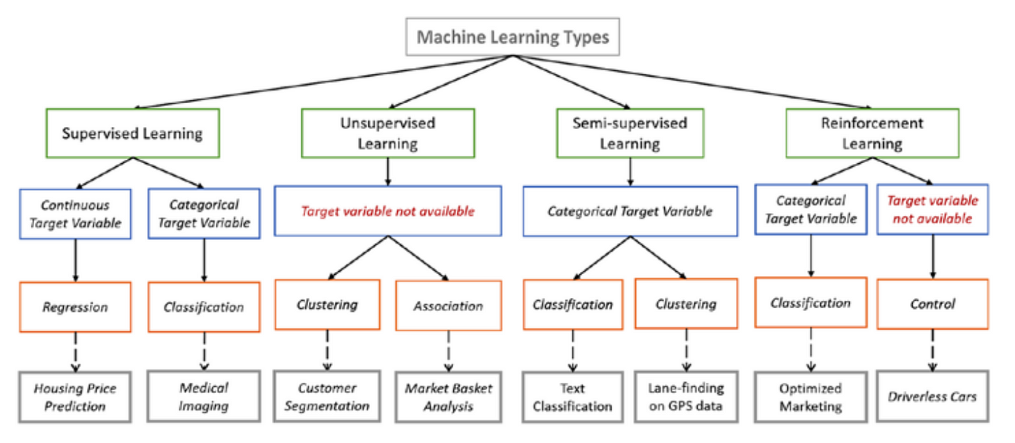
Predictive modeling
Machine learning types
Logistic Regression
Decision Trees
Random Forest
Gradient Boosting Machines
Support Vector Machines (SVM)
Neural Networks / Deep Learning
K-Nearest Neighbors (KNN)
Clustering (K-Means, Hierarchical)
https://medium.com/@codekalimi/list-of-machine-learning-models-61b51ad492f1

Slide 8
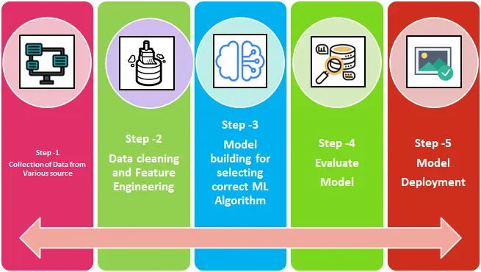
Steps of the research
Problem definition
Review of the existing work
Comparison of the existing models
Selecting the model method
The rest of the machine learning steps

Slide 9
Challenges
Data privacy & quality
Model interpretability

Slide 10
Thank you!

