Slide 1
Understanding Customer Behavior Through Data Analytics in the Banking Sector
Research seminar I
University of Primorska
Faculty of Mathematics, Natural Sciences
and Information Technologies
Pika Povh Mavrič
Mentor: Balázs Dávid
April 2025

Slide 2
Motivation
Understaning customer behaviour in banking
Example of not knowing their customer base:
Elderly and and digital transactions
Loan offers for customers with a fair amount of savings

Slide 3
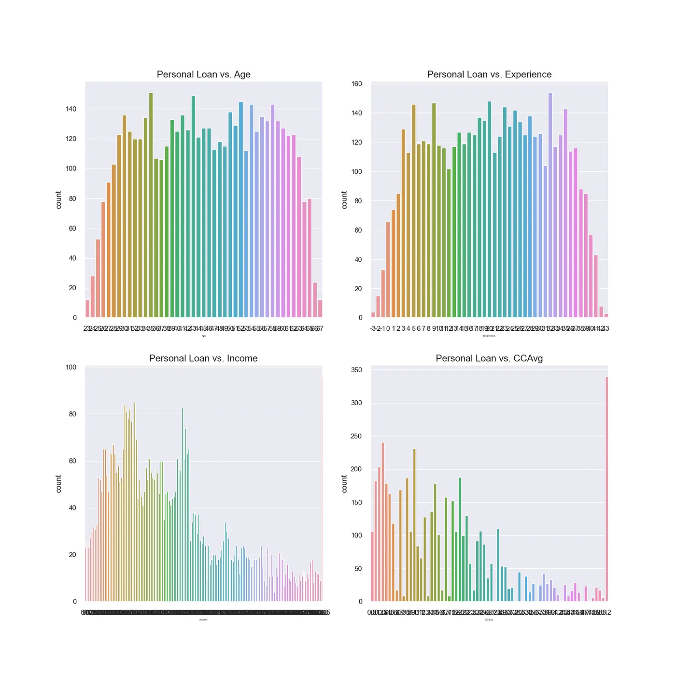
Source: Medium

Slide 4
Problem statement
Banks struggle to know which customers to target
Inefficient resource allocation without behaviour insight

Slide 5
Goal of research
Understand behavioural patterns
Identify relevant techniques in data analytics

Slide 6
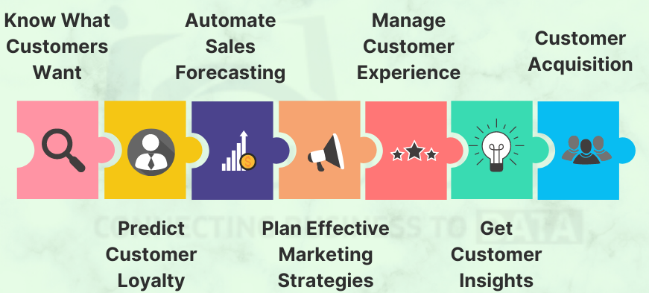
Customer Behavior in Banking
Customer analytics in Banking and Financial Sector
Source: https://www.datatobiz.com/blog/customer-analytics-in-banking/

Slide 7
Data analytics
the process of collecting, transforming, and organizing data in order to draw conclusions, make predictions, and drive informed decision making
Machine learning methods:
Supervised
Unsupervised
Semi-superwised

Slide 8
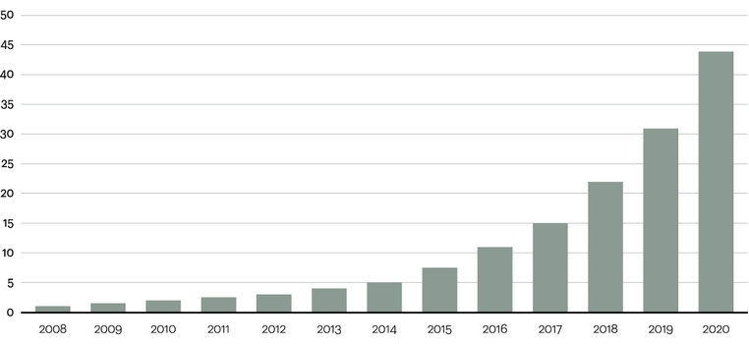
Data analytics
Data volume growth by year in zettabytes
Source: https://www.researchgate.net/figure/Data-volume-growth-by-year-in-zettabytes_fig2_313400371

Slide 9
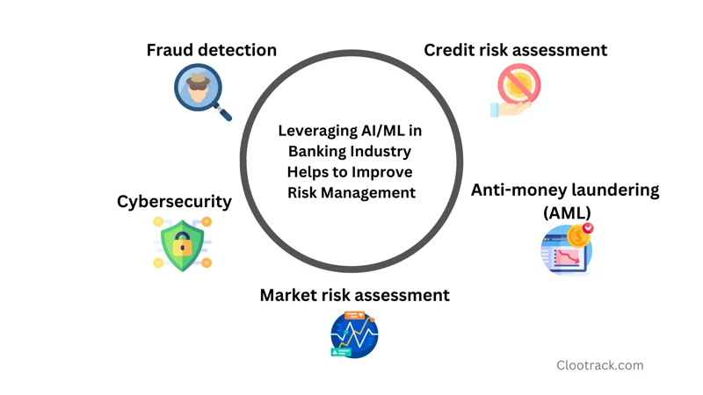
Customer Behavior in Banking

Slide 10
Challenges
Data privacy & quality
Model interpretability

Slide 11
What is next?
Models research of acutal use cases in Banks
Creation of a Predictiove model for personal loan aacqusition

