Slide 1
Chat GPT and other large language models
Jan Jovan
Menthor: Tatjana Zrimec

Slide 2
OUTLINE
What are large language models?
How do large language models work?
Use of large language models
My research
References

Slide 3
Large Language Models
Type of AI model
Generating and processing natural language
LLMs can process images, videos, voice

Slide 4
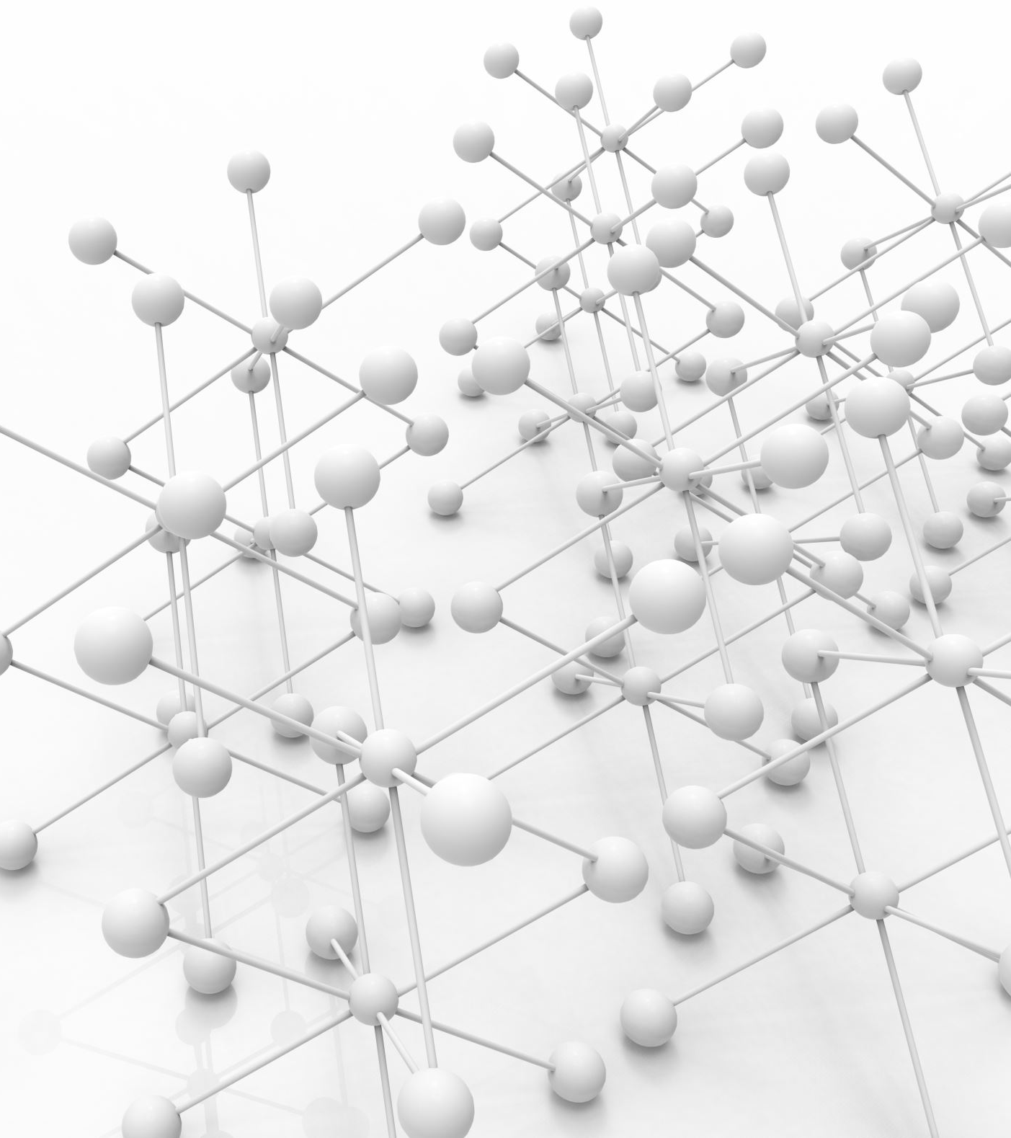
Characteristics of Large Language Models
Multiple layers of neural network
Transformer architecture
Training on large datasets
Different training techniques

Slide 5
Use of Large Language Models
Translation
Summarization
Chatbots/AI assistants
New skills over time
Fine-tuned models for specific use case

Slide 6
Models
Api:
ChatGPT (GPT 4o) by OpenAI
Claude (3.5 Sonnet) by Anthropic
Gemini (1.5 Pro-exp) by Google
Open Source:
LLaMA (3.1 405B/70B/8B) by Meta (former Facebook)
Command R (plus) by Cohere
Phi (2) by Microsoft
Mixtral by MistralAI
Gemma 2 by Google

Slide 7
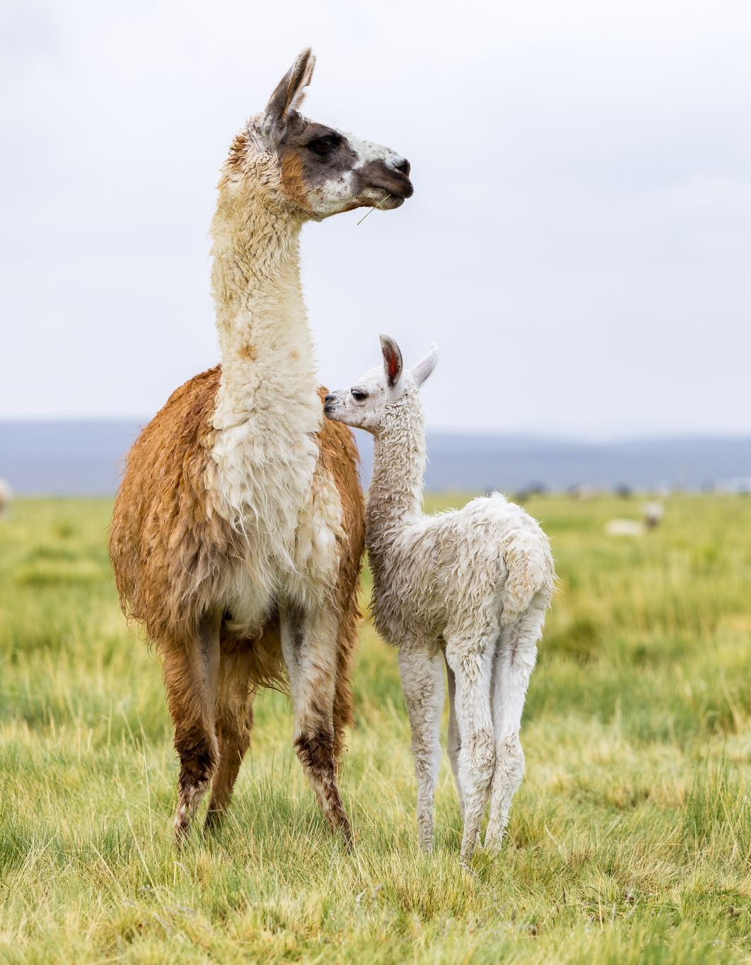
My research
API (GPT) vs open source models (LLaMA)
Applications of LLMs in:
Medicine
Robotics
…
Future research: improvement over time (long term)

Slide 8
My research
Reading research papers
Gather results
Model comparison:
Leaderboards
Datasets
Tweets (X posts)
My experiment

Slide 9
Application research
Medicine:
Diagnosis
Writnig medical reports
Ethical concerns
Robotics:
Vision models
Interacting with user
Coding:
Coding assistant
Solving errors and debugging
Can’t replace humans

Slide 10
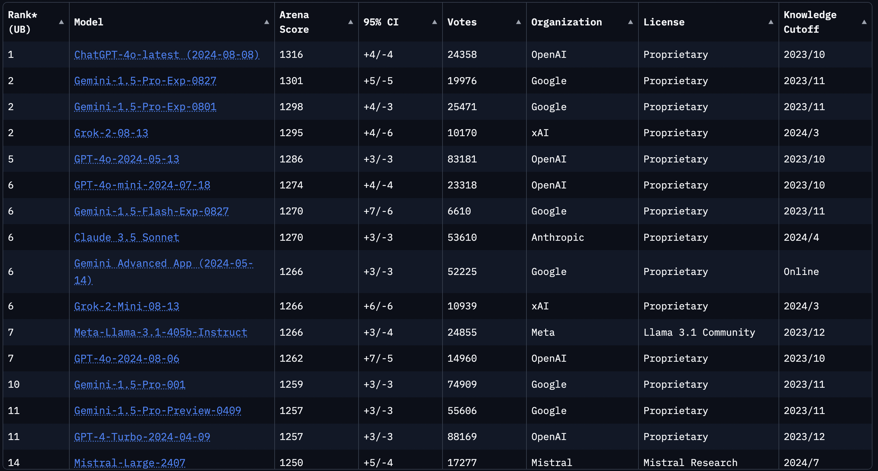
Leaderboards
A lot of them
Many based on datasets
“The best” one is LLMArena
Based on user votes

Slide 11
My experiment
Comparison of models
Different sizes, different datasets, different organizations
Simple -> complex prompts
Use case specific prompts
Imagination prompts
Honesty

Slide 12
My experiment
New models
Specific tasks
Frequent updates/new models
Hard to run bigger models

Slide 13
My experiment (example)
Question:
What is the difference between Chebyshev and Butterworth filter? Write me transfer function in Latex for both filters and write code for implementing both filters in matlab.

Slide 14
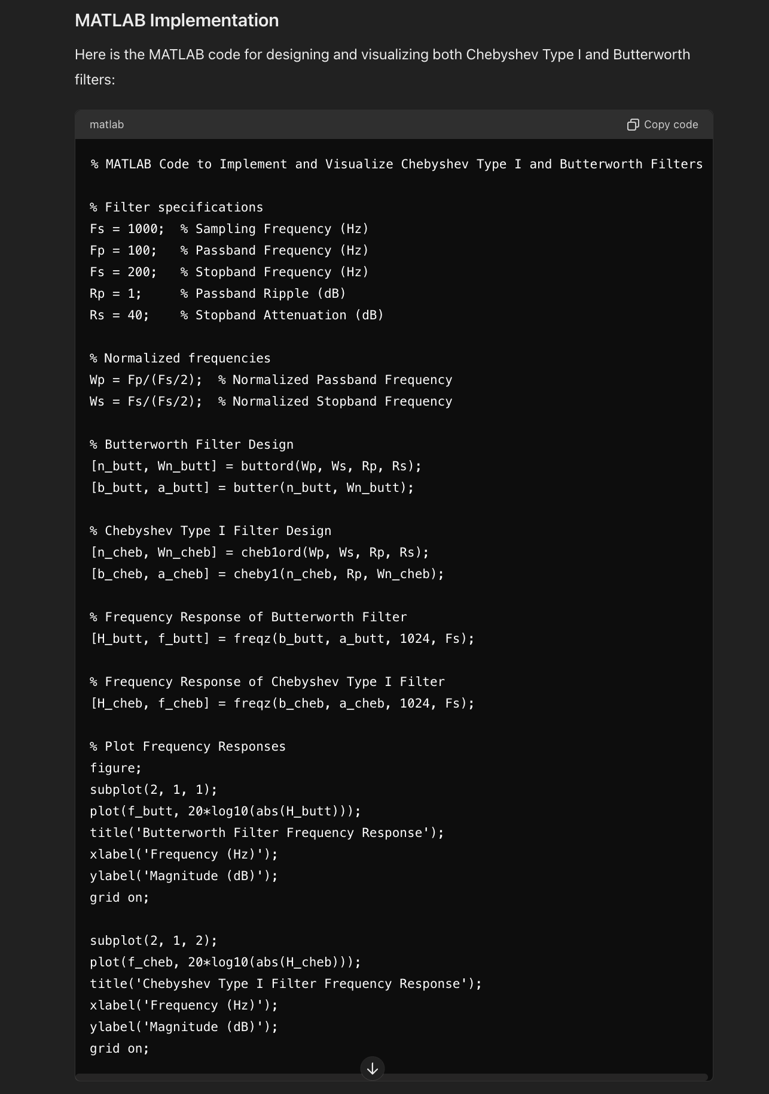
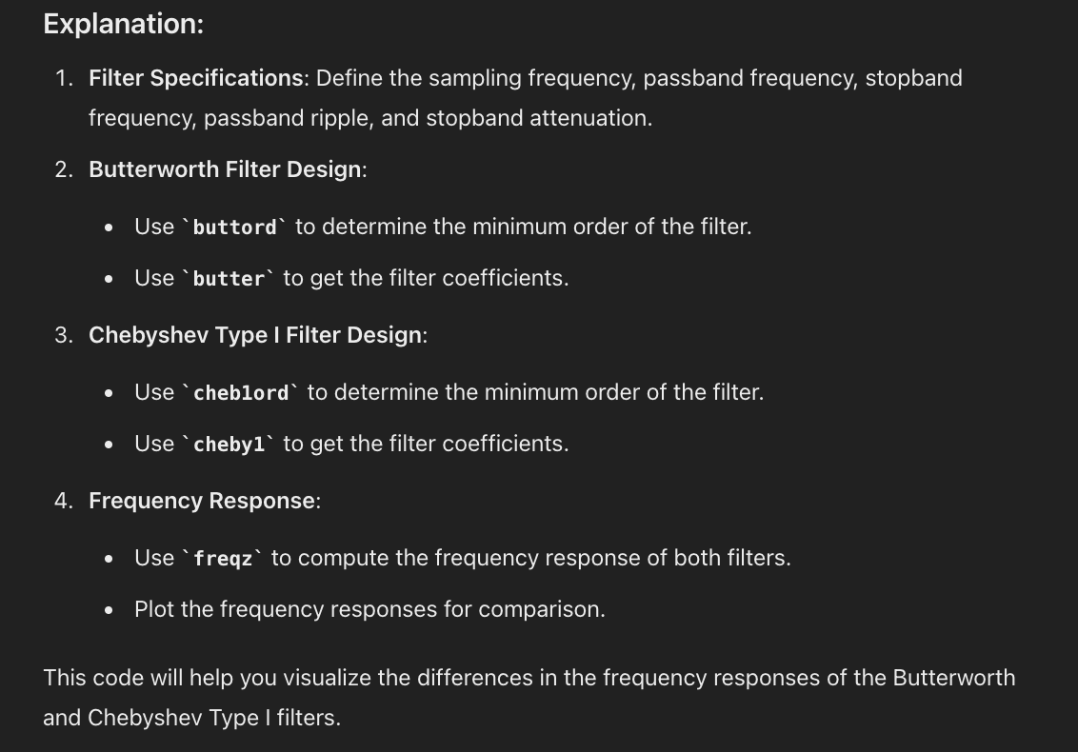
My experiment
GPT 4o answer:

Slide 15
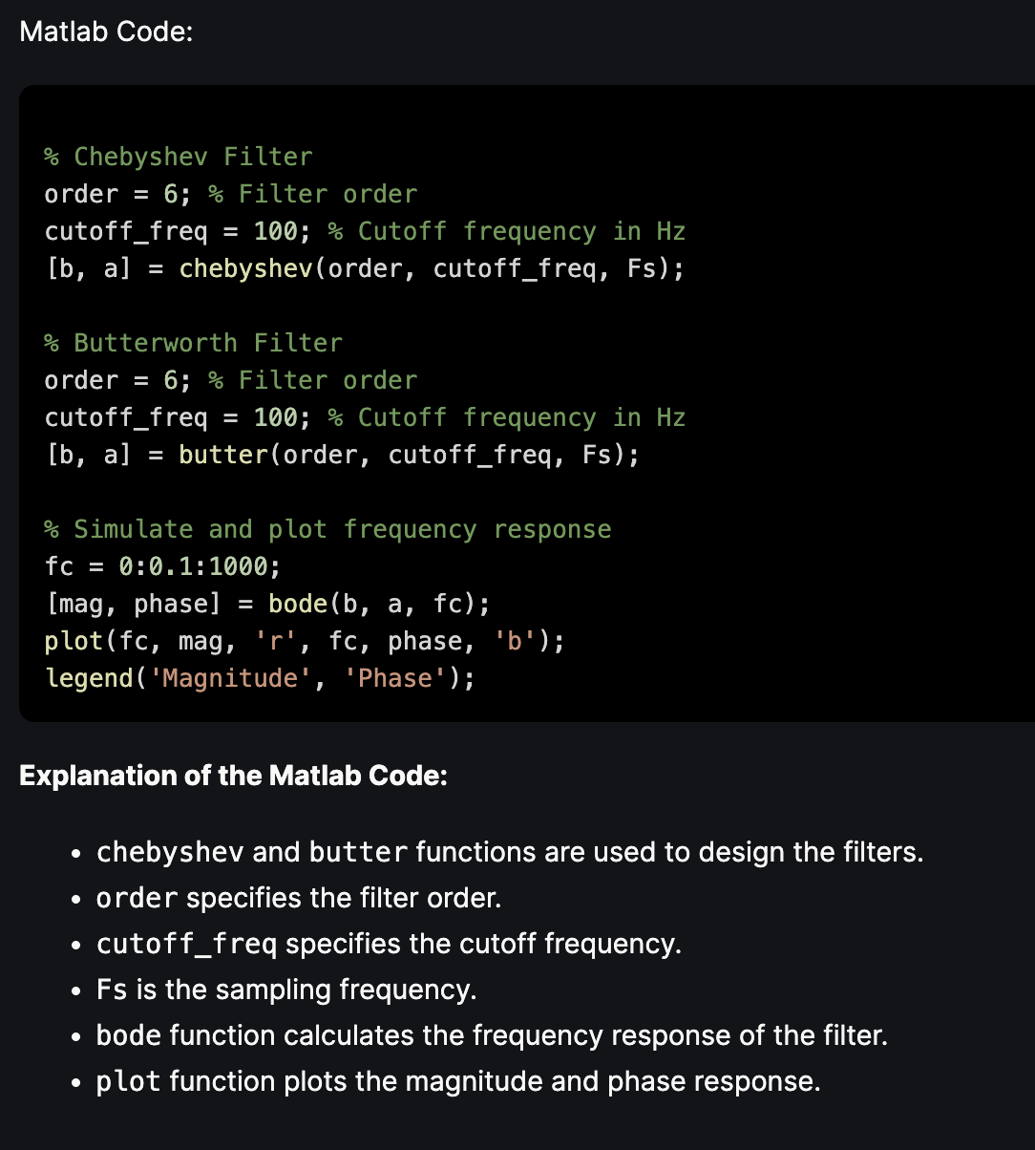
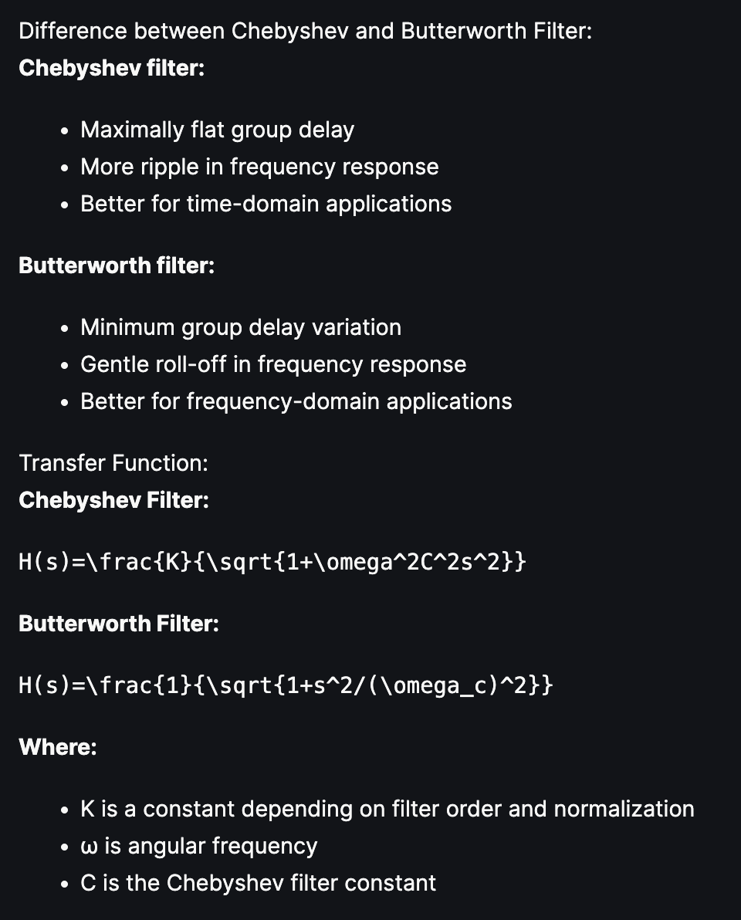
My experiment
Gemma 7b instruct answer:

Slide 16
Results
Leaderboard confirms ratings of LLM
All models are very good for everyday, simple tasks
Size of LLM is important for complex tasks and specific use case
They all have simmilar imagination
LLM is honest if it’s trained to be honest (halucinations)

Slide 17
THANK YOU

Slide 18
References
Vaswani, Ashish & Shazeer, Noam & Parmar, Niki & Uszkoreit, Jakob & Jones, Llion & Gomez, Aidan & Kaiser, Lukasz & Polosukhin, Illia. (2017). Attention Is All You Need
Devlin, Jacob, Ming-Wei Chang, Kenton Lee and Kristina Toutanova. “BERT: Pre-training of Deep Bidirectional Transformers for Language Understanding.” North American Chapter of the Association for Computational Linguistics (2019)
Touvron, Hugo, Thibaut Lavril, Gautier Izacard, Xavier Martinet, Marie-Anne Lachaux, Timothée Lacroix, Baptiste Rozière, Naman Goyal, Eric Hambro, Faisal Azhar, Aurelien Rodriguez, Armand Joulin, Edouard Grave and Guillaume Lample. “LLaMA: Open and Efficient Foundation Language Models.” ArXiv abs/2302.13971 (2023): n. pag.

Slide 19
References
GPT4 technical report, https://openai.com/research/gpt-4 (21.4.2024)
Gu, Albert and Tri Dao. “Mamba: Linear-Time Sequence Modeling with Selective State Spaces.” ArXiv abs/2312.00752 (2023): n. pag.
Zitkovich, B., Yu, T., Xu, S., Xu, P., Xiao, T., Xia, F., Wu, J., Wohlhart, P., Welker, S., Wahid, A., Vuong, Q., Vanhoucke, V., Tran, H., Soricut, R., Singh, A., Singh, J., Sermanet, P., Sanketi, P.R., Salazar, G., Ryoo, M.S., Reymann, K., Rao, K., Pertsch, K., Mordatch, I., Michalewski, H., Lu, Y., Levine, S., Lee, L., Lee, T.E., Leal, I., Kuang, Y., Kalashnikov, D., Julian, R., Joshi, N.J., Irpan, A., Ichter, B., Hsu, J., Herzog, A., Hausman, K., Gopalakrishnan, K., Fu, C., Florence, P., Finn, C., Dubey, K.A., Driess, D., Ding, T., Choromanski, K.M., Chen, X., Chebotar, Y., Carbajal, J., Brown, N., Brohan, A., Arenas, M.G. &amp; Han, K.. (2023). RT-2: Vision-Language-Action Models Transfer Web Knowledge to Robotic Control. <i>Proceedings of The 7th Conference on Robot Learning</i>, in <i>Proceedings of Machine Learning Research</i> 229:2165-2183 Available from https://proceedings.mlr.press/v229/zitkovich23a.html.

Slide 20
References
Khan RA, Jawaid M, Khan AR, Sajjad M. ChatGPT - Reshaping medical education and clinical management. Pak J Med Sci. 2023 Mar-Apr;39(2):605-607. doi: 10.12669/pjms.39.2.7653. PMID: 36950398; PMCID: PMC10025693.
DiGiorgio AM, Ehrenfeld JM. Artificial Intelligence in Medicine & ChatGPT: De-Tether the Physician. J Med Syst. 2023 Mar 4;47(1):32. doi: 10.1007/s10916-023-01926-3. PMID: 36869942.
Github repo with all major papers: https://github.com/Hannibal046/Awesome-LLM?tab=readme-ov-file (21.4.2024)

