Slide 1


Gaze2AOI: Harnessing
Deep-Neural Networks for
Area of Interest Annotation in
Eye Tracking Research
Presenter: Karolina Trajkovska
Mentors: dr. Klen Čopič Pucihar, dr. Matjaž Kljun

Slide 2
Overview
EYE-tracking
and AOI
GAZE2aoi
Future work
System Architecture,
Functionalities, Interface
Space for Improvement and Limitations
Introduction
Automation of AOI
Application & IOTOK
Related Work and
Gap in Literature
Gaze2AOI for Interactive Documentaries

Slide 3
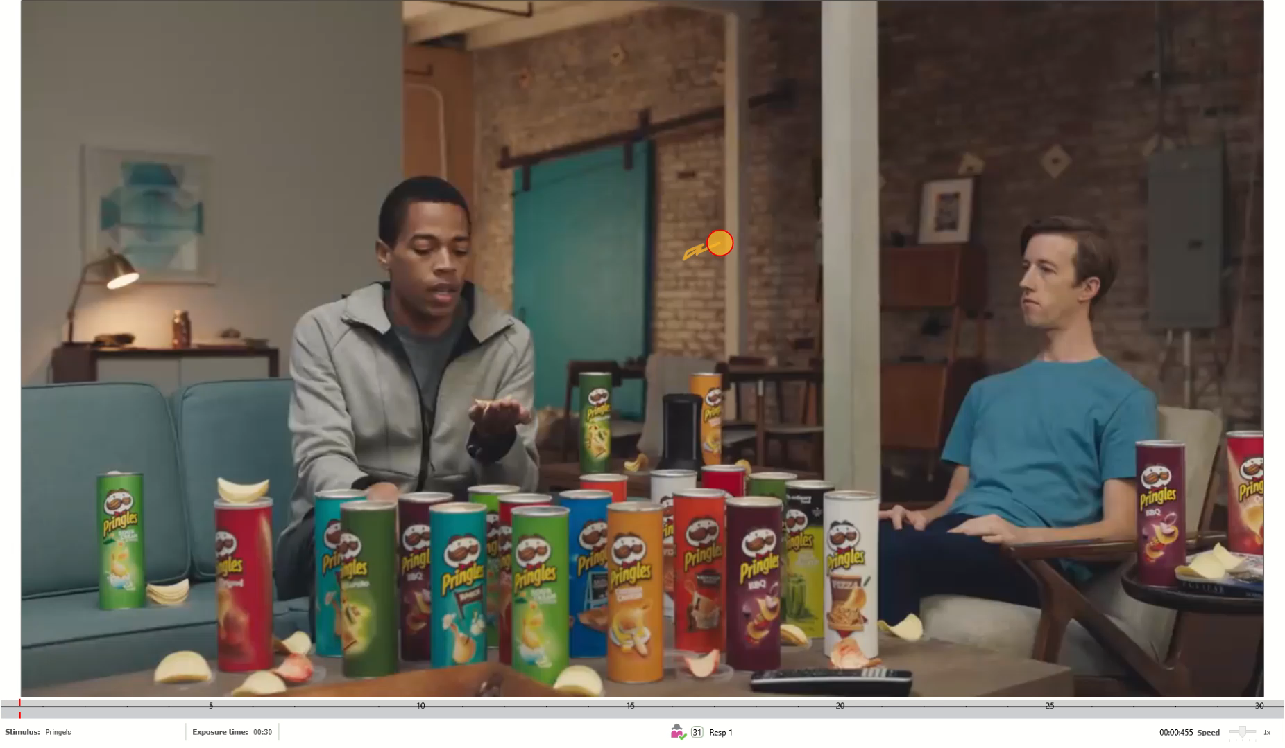
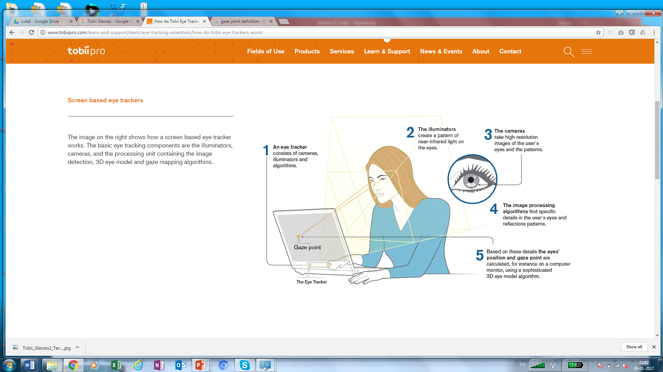
WHAT IS EYE TRACKING?

Slide 4

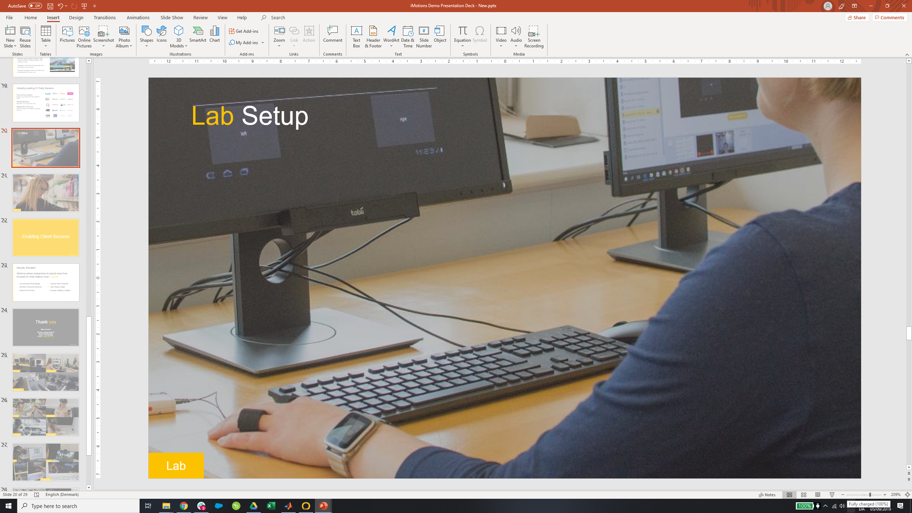
WHAT IS EYE TRACKING?
Source: www.tobiipro.com/learn-and-support

Slide 5
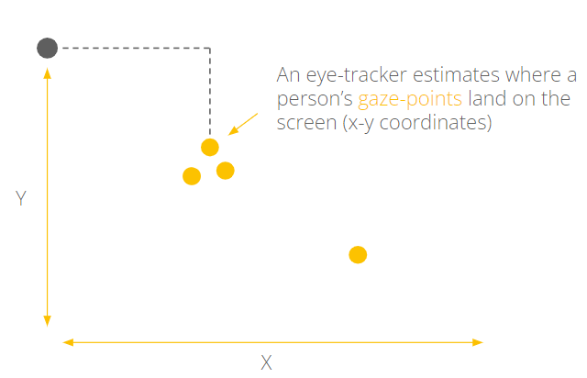
A measurement of visual attention
An eye-tracker estimates where a person’s gaze-points land on the screen (x-y coordinates)

Slide 6

An eye-tracker estimates where a person’s gaze-points land on the screen (x-y coordinates)
Signal-processing
algorithms
A fixation

Slide 7
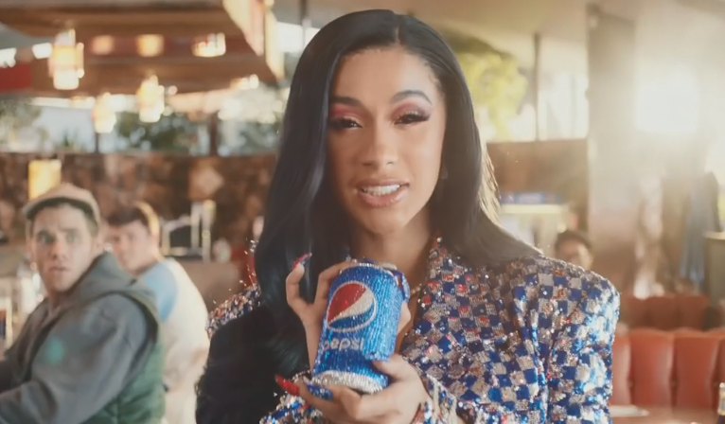
Why eye-tracking data?
What part of the visual information was noticed first?
Was an important part of the visual information overlooked?
What part of the visual information was looked at longest?
Etc.

Slide 8
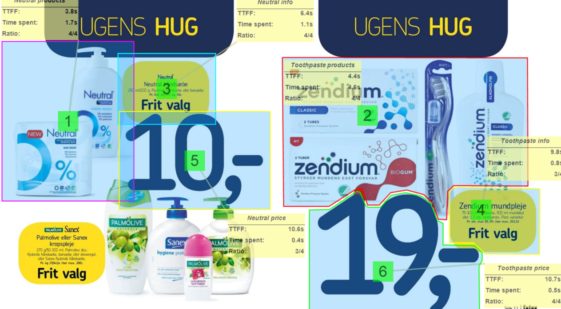
Area of interest (AOI)
Give semantic meaning to the data
Manual annotation and analysis is time consuming

Slide 9

Automated AOI
Use of object detection, segmentation or image classification to automatically define the AOI and check whether an AOI contains fixation point or not
DNNs era sparked this area of research
Pringles, 0.93
AOI Bounding Box:
(x, y, w, h)
Fixation Point:
(x, y)
Object Detection algorithm
Eye-tracker +

Slide 10
RELATED WORK
Image Processing techniques (e.g. Canny edge detection, Haar Features)
Region based Convolution Neural Network (R-CNNs)
Fast Segmentation Convolutional Neural Networks (Fast – SCNN)
You Only Look Once (YOLO) v2, v3, v4
Exploring and comparing methods and algorithms
[2, 6, 7, 8, 9, 10]

Slide 11
RELATED WORK
Analyzing students' attention [12]
Artistic heuristics for face detection: tracking gaze when looking at faces [3]
Augmented Reality warning systems for onsite construction workers [11]
Implementing case specific algorithm

Slide 12
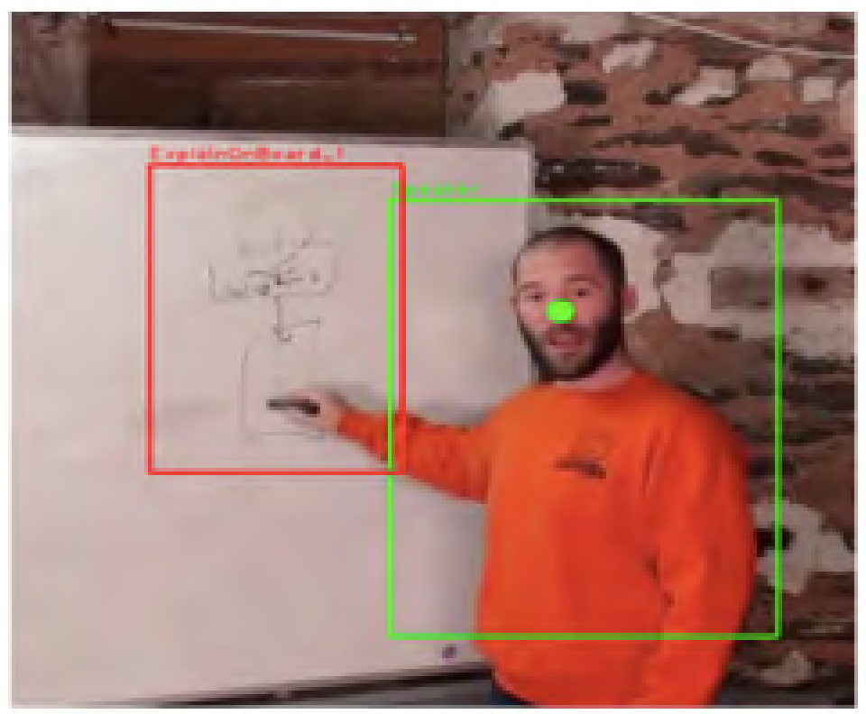
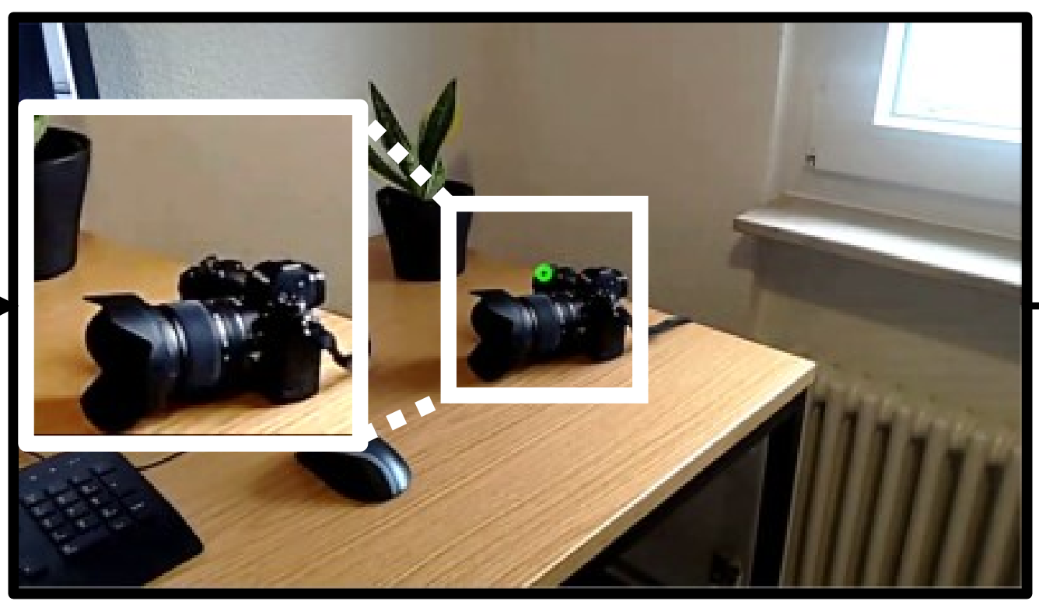
RELATED WORK
Develop publicly available tools
1.
VLEYE: A Complete System for Analysis of Video Lecture Based on Eye Tracking (2018) [1]
EyeNotate Tool: Interactive Fixation-to-AOI Mapping for Mobile Eye Tracking Data based on Few-Shot Image Classification (2023) [13]
2.

Slide 13
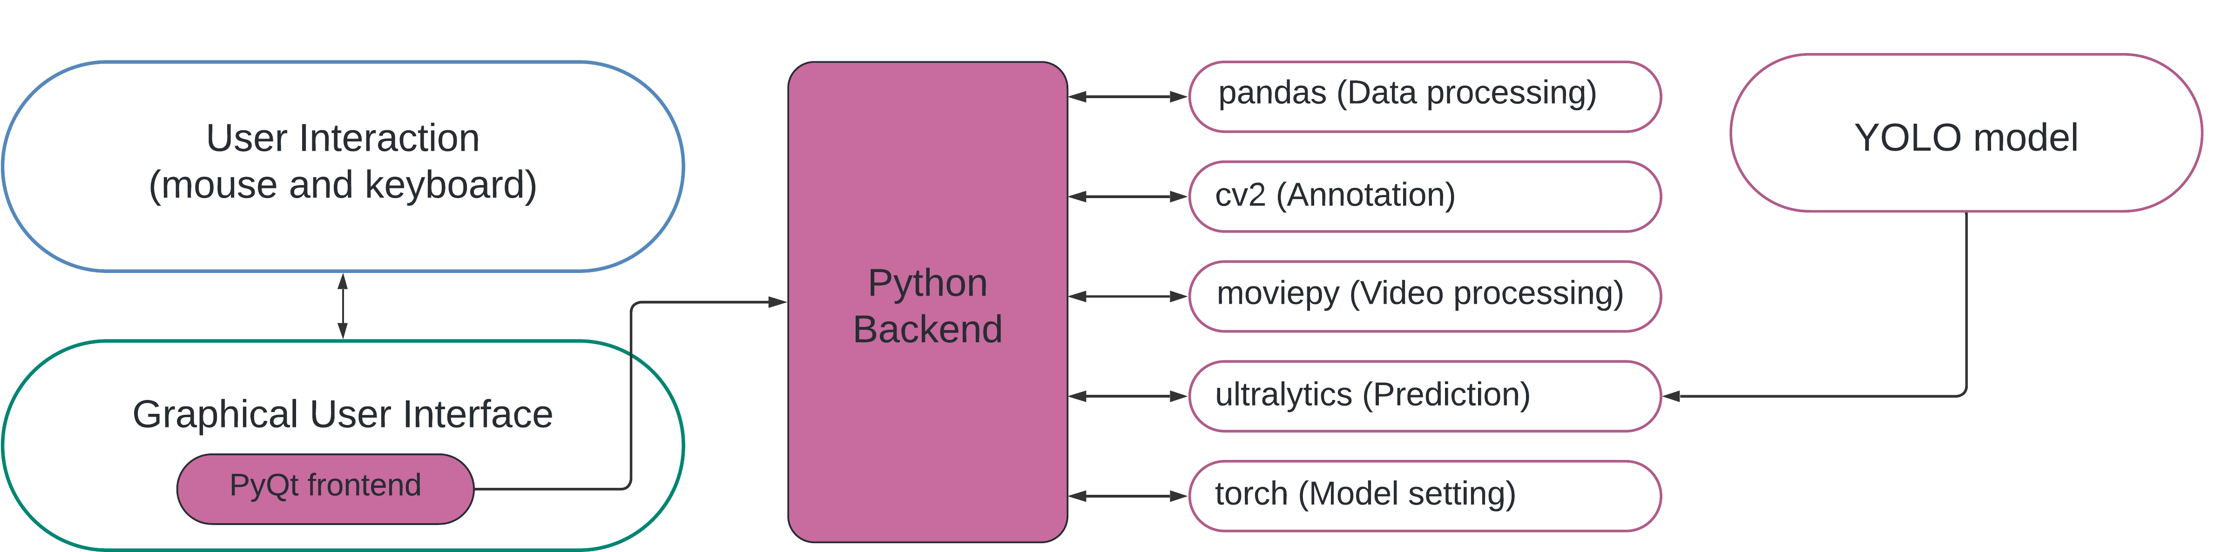
GAZE2AOI
Version 8
Dataset: OpenImages v7
Automatic AOI for 600 different object classes for the whole image / frame
Additional customized labeling
Calculation of metrics like time to first fixation, AOI revisits, total time per AOI
Open source

Slide 14
System architecture
Version 8
Dataset: OpenImages v7

Slide 15
Interface and functionalities
INPUT:
Eye-tracking data (CSV)
3. Video
(currently .MP4)
2. AOI predictions
(CSV, optional)

Slide 16
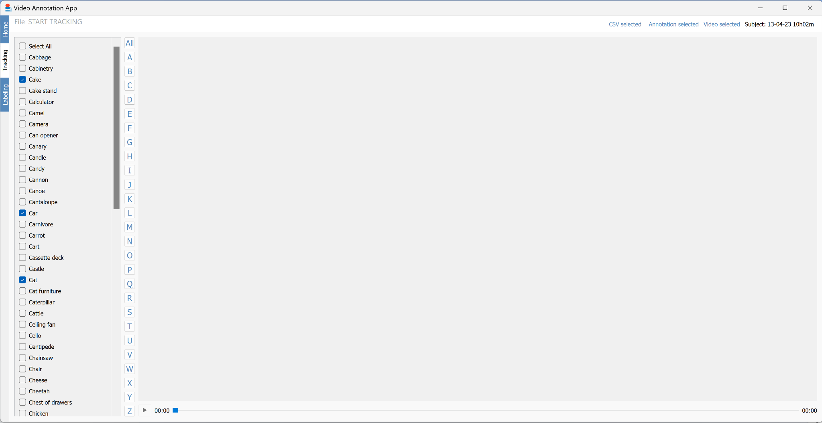
Select CSV file of eye tracking data and the acording video of the same subject.
If predictions were run in advance and now you want to annotate for specific classes, select CSV file with annotations (predictions)

Slide 17
Check if the files are compatible

Slide 18
Select desired object classes to be tracked and press START

Slide 19
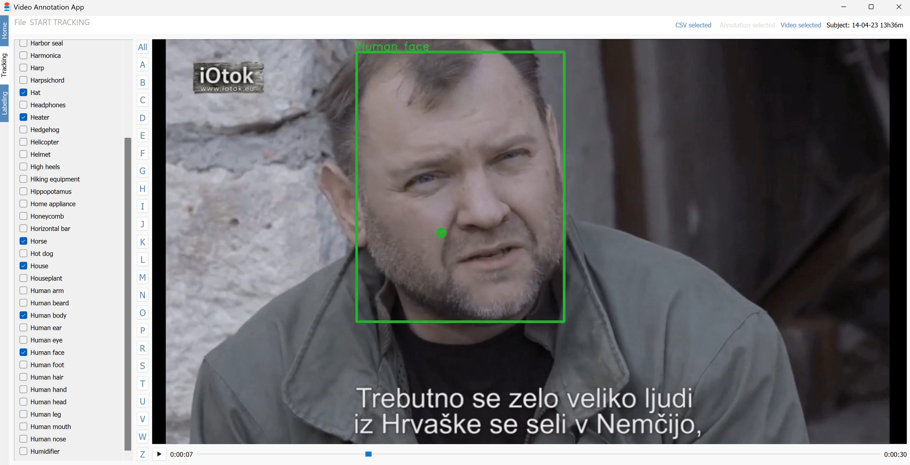
Preview the annotated video including the fixation point

Slide 20
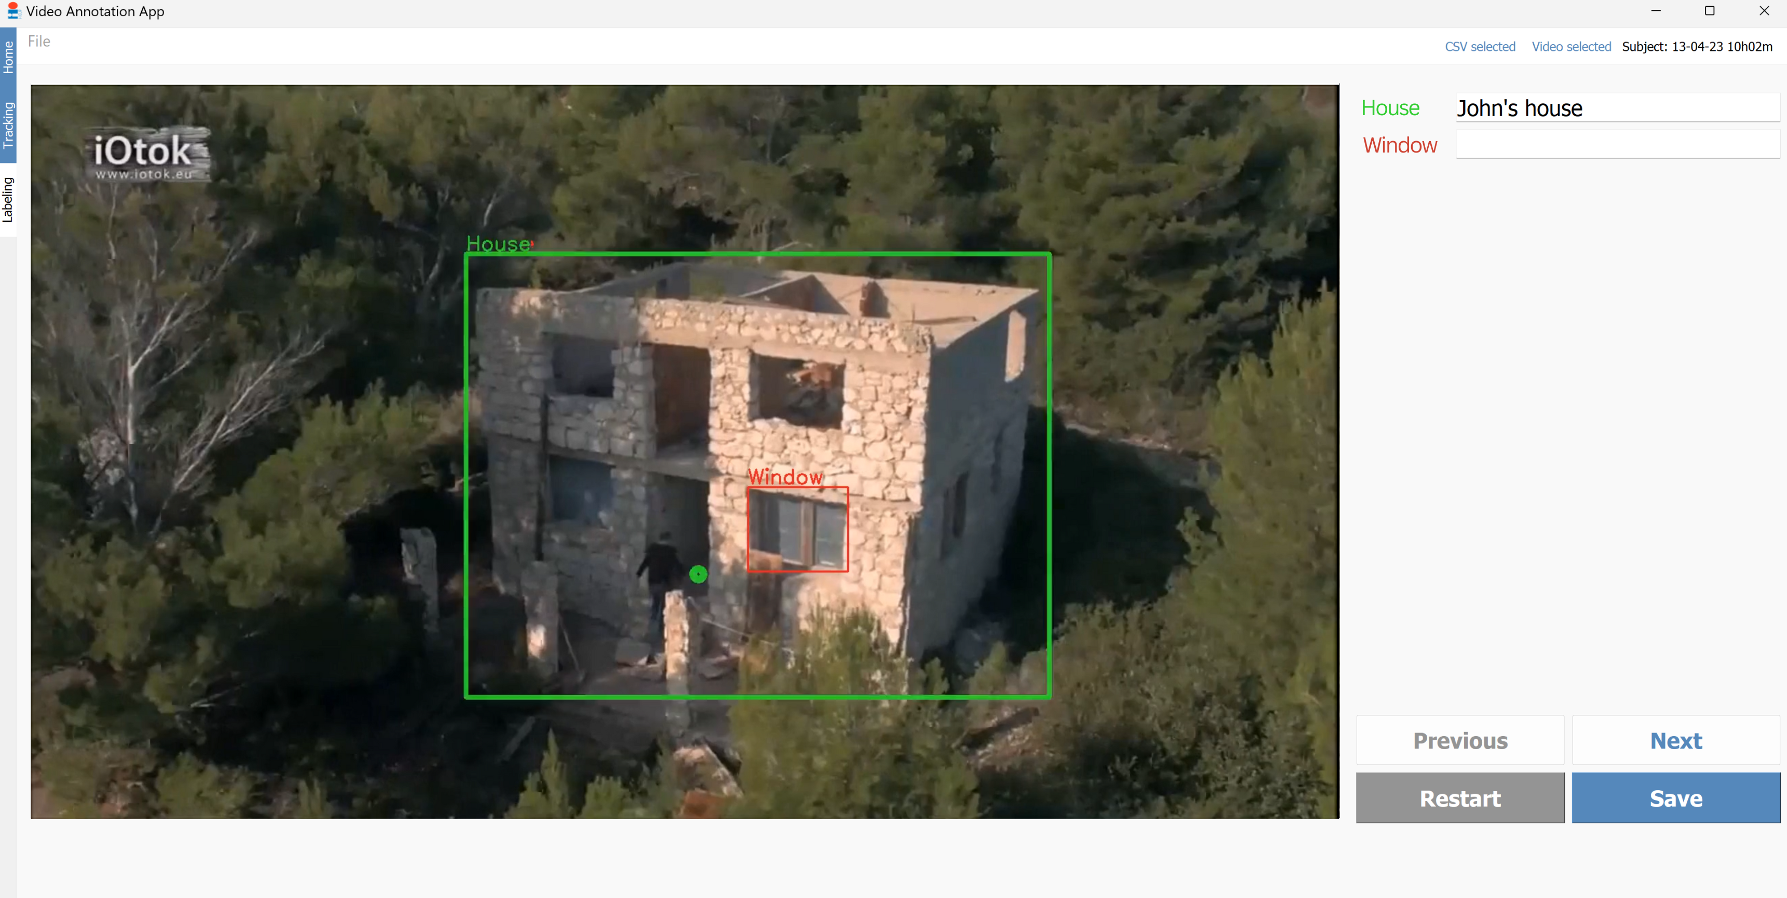
Select labeling tab and files that were saved in the previous task after tracking was finished

Slide 21
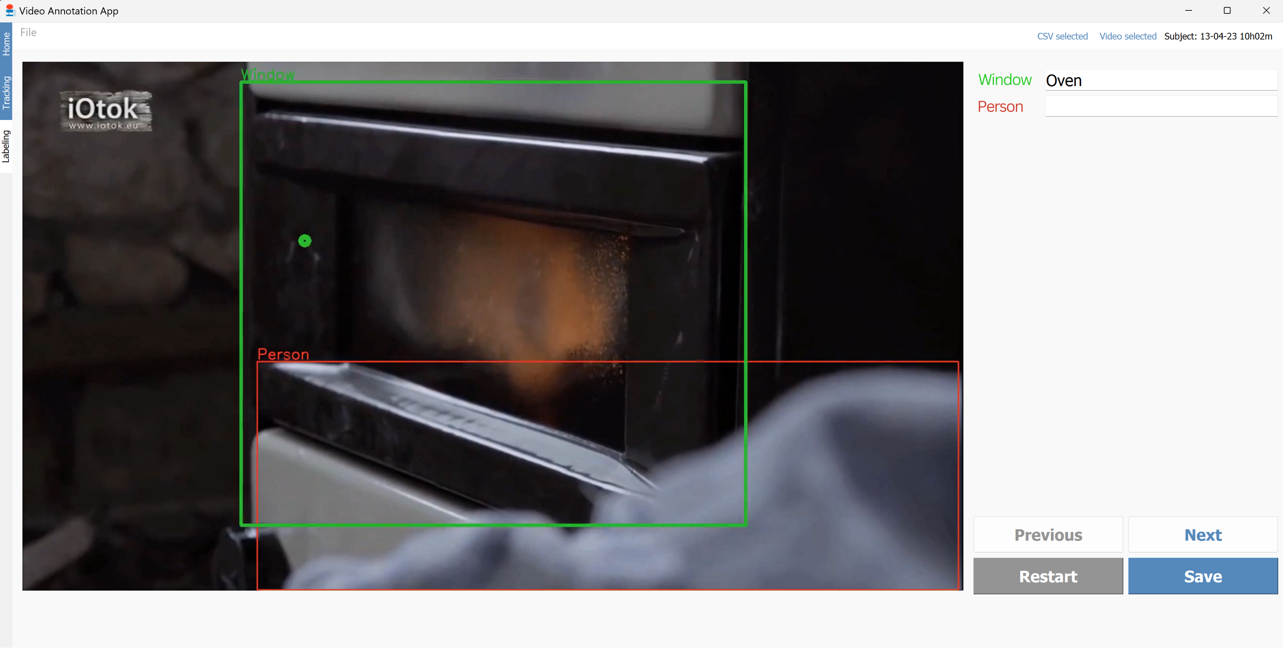
Detected objects will appear here. Insert the desired label and go to next frame (next fixation).
At the last frame, save the file.

Slide 22
Output:
Detected, Gazed upon, Fixated AOI (CSV)
2. AOI position data
(CSV)
3. Annotated Video
(currently .MP4)

Slide 23


Application - Iotok
Documentary with interactive elements [4, 5]
Some people quit the web portal before reaching the core video: was it a lack of interest or was the interface not intuitive enough?
Currently running predictions with Gaze2AOI
Calculate: TTFF, AOI revisits, gazing time spent on interactive elements before leaving the site

Slide 24
FUTURE WORK
Complete predictions and statistics for IOTOK
Try YOLO WORLD – prompt to detection
Similarity networks
Segmentation instead detection

Slide 25
References
[1] Barz M, Sonntag D. Automatic Visual Attention Detection for Mobile Eye Tracking Using Pre-Trained Computer Vision Models and Human Gaze. Sensors. 2021; 21(12):4143.
[2] Batliner, Martin, et al. "Automated areas of interest analysis for usability studies of tangible screen-based user interfaces using mobile eye tracking." AI EDAM 34.4 (2020): 505-514.
[3] Duchowski, Andrew T., et al. "Art facing science: Artistic heuristics for face detection: tracking gaze when looking at faces." Proceedings of the 11th ACM symposium on eye tracking research & applications. 2019.
[4] Ducasse, J., Kljun, M., Attygalle, N. T., & Pucihar, K. Č. (2022). Interactive Web Documentaries: A Case Study of Video Viewing Behaviour on iOtok. International Journal of Human–Computer Interaction, 38(10), 949–972.
[5] Ducasse, J., Kljun, M., & Čopič Pucihar, K. (2020). Interactive Web Documentaries: A Case Study of Audience Reception and User Engagement on iOtok. International Journal of Human–Computer Interaction, 36(16), 1558–1584.
[6] Jayawardena, Gavindya, and Sampath Jayarathna. "Automated filtering of eye gaze metrics from dynamic areas of interest." 2020 IEEE 21st International Conference on Information Reuse and Integration for Data Science (IRI). IEEE, 2020.
[7] Kumari N, Ruf V, Mukhametov S, Schmidt A, Kuhn J, Küchemann S. Mobile Eye-Tracking Data Analysis Using Object Detection via YOLO v4. Sensors. 2021; 21(22):7668.
[8] Lagmay, Ezekiel Adriel D., and Maria Mercedes T. Rodrigo. "Enhanced Automatic Areas of Interest (AOI) Bounding Boxes Estimation Algorithm for Dynamic Eye-Tracking Stimuli." APSIPA Transactions on Signal and Information Processing 11.1 (2022).

Slide 26
[9] Ryabinin, Konstantin, Svetlana Alexeeva, and Tatiana Petrova. "Automatic Areas of Interest Detector for Mobile Eye Trackers." Graphicon-Conference on Computer Graphics and Vision. Vol. 32. 2022.
[10] Wang, Felix Sihan. Algorithmic Gaze Measure Development for Application in Real-World Scenarios. Diss. ETH Zurich, 2023.
[11] Wu, Shaoze, et al. "Measuring the impact of Augmented Reality warning systems on onsite construction workers using object detection and eye-tracking." Proceedings of the 28th EG-ICE International Workshop on Intelligent Computing in Engineering, EG-ICE 2021. 2021.
[12] Xu, Hui, et al. "Analyzing students' attention by gaze tracking and object detection in classroom teaching." Data Technologies and Applications 57.5 (2023): 643-667.
[13] Zhang, Xuebai, et al. "A complete system for analysis of video lecture based on eye tracking." Ieee Access 6 (2018): 49056-49066.

Slide 27


thank YOU!
https://gitlab.com/karlyy/i-otok
trajkovskakarolina@gmail.com

Slide 28
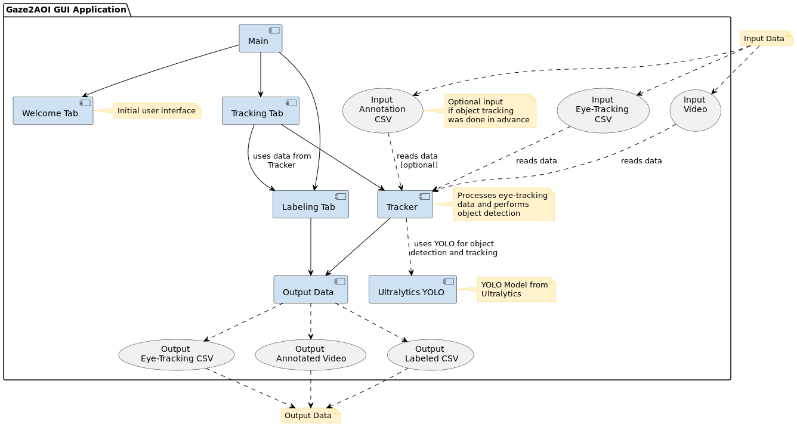
UML Component diagram

