Slide 1
Web application for a restaurant
Students:Dušan Todorović
Nemanja Cvetić
Mentor:Tatjana Zrimec

Slide 2
Introducton
Home page
Menu
Contact
Online ordering

Slide 3
Technologies
Python
Flask
mySQL
HTML5, CSS, Botsrtap

Slide 4
Roles
Administrator
User/Customer
Guest

Slide 5
Administrator
Changing the contents of menu
Creating/deleting/changing user profiles

Slide 6
User/customer
Updating a profile
Ordering food
Checking the order status
Canceling the order

Slide 7
Guest
Browsing the menu
Creating a profile

Slide 8
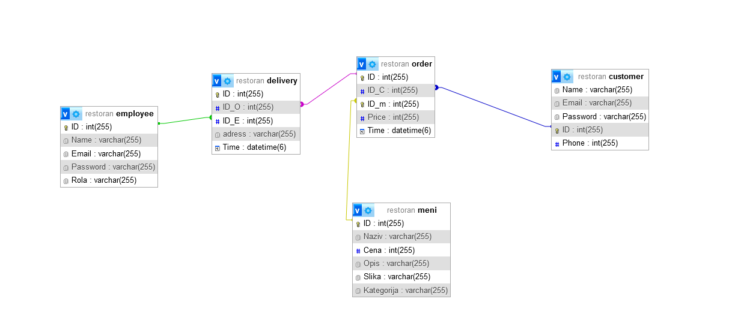
Database schema

Slide 9
TIMELINE
Project Initiation and Design (Week 1-2):
Define project scope and gather resources. Design wireframes, mockups, and finalize UI/UX elements.
Frontend Development (Week 3):
Implement Bootstrap framework for frontend. Create responsive frontend components such as navigation bar and menu display.
Backend Development (Week 4):
Set up Flask environment and database. Develop backend logic for user authentication and basic functionality.
Integration and Testing (Week 5):
Integrate backend and frontend components. Conduct testing for functionality, cross-browser compatibility, and responsiveness.
Content Population and Finalization (Week 6):
Populate website with content including menu items and descriptions. Perform final testing and adjustments based on feedback.
Deployment and Post-launch Maintenance (Week 7):
Deploy website to a web server. Monitor performance, address any issues, and make improvements based on feedback.

