Slide 1
Web RTC & Analysis of a system for student mutual assistance
Matevž Mak, PRIN2

Slide 2
Presentation overview
Project Idea
Project features
Project screenshoots
Analysis Participants
Potencial system users group analysis
results
Expert group
results
SUS questionnaire
Features that users liked
Web RTC

Slide 3
Project Idea
As students we are using a lot of systems during education (Facebook, Microsoft Teams, Discord, Google drive …)
Data gets lost or its difficult to find
Developed my own e-classroom with functionality of other systems
We wanted to find out if our system met the requirements, so people would use it

Slide 4
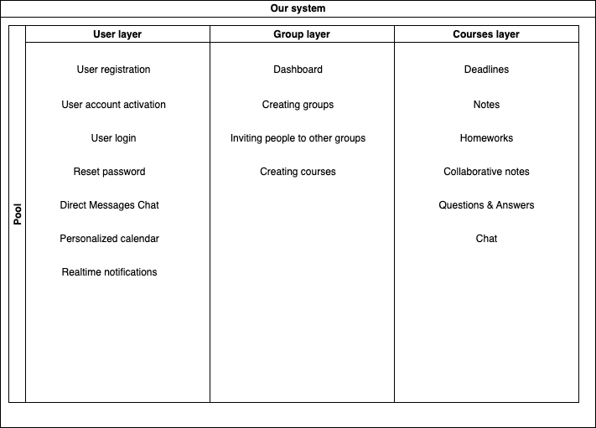

Slide 5
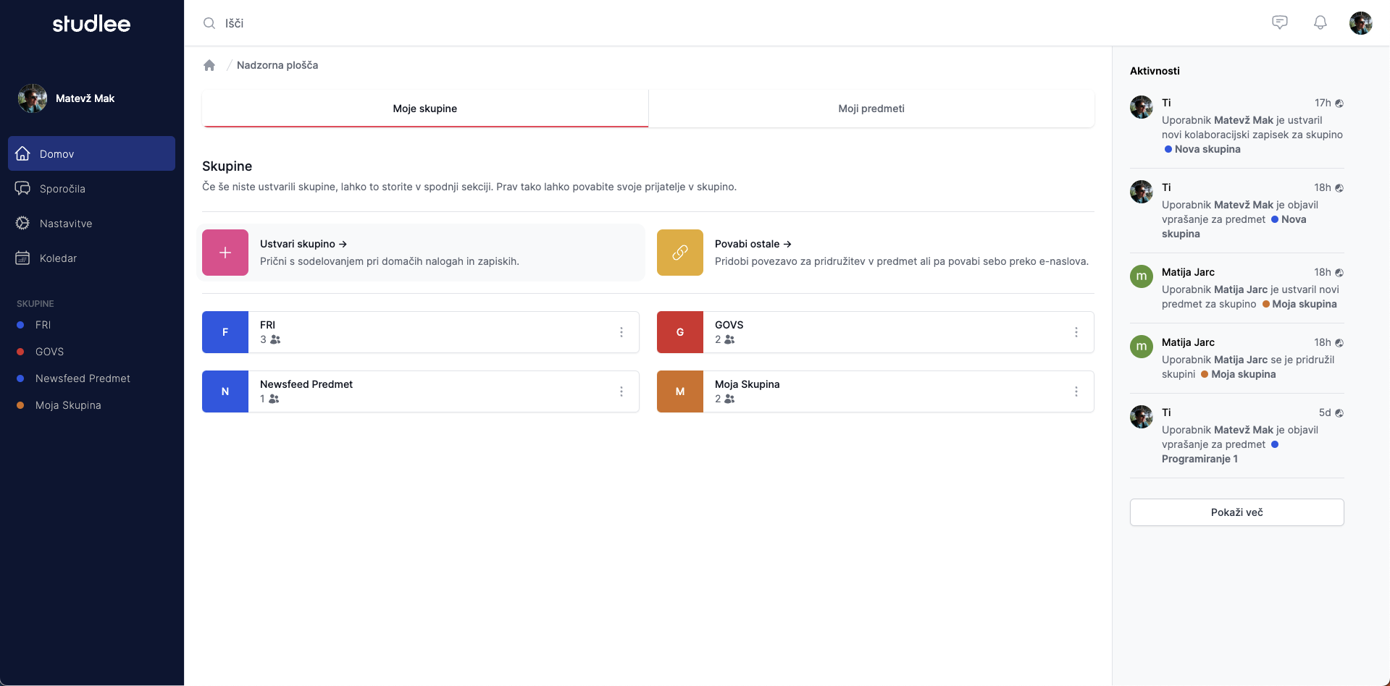

Slide 6
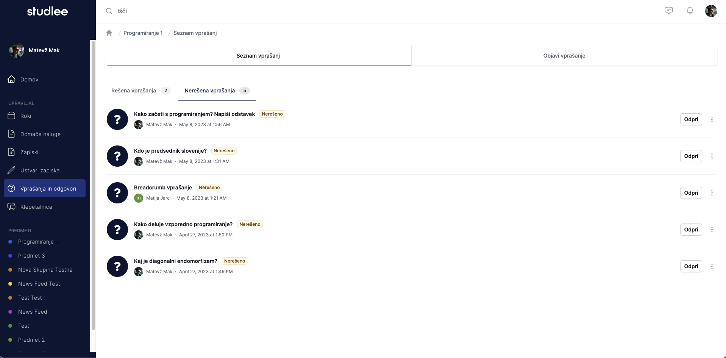

Slide 7
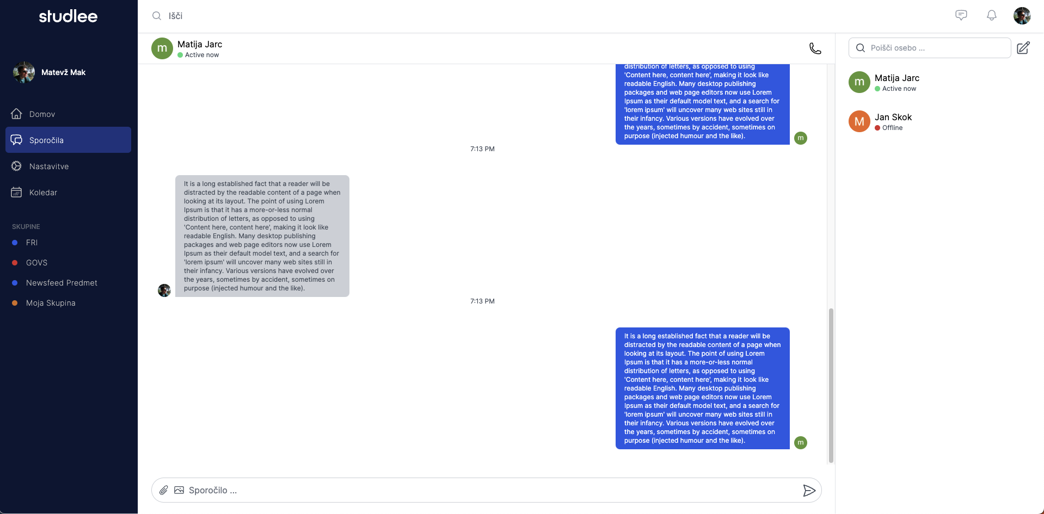

Slide 8
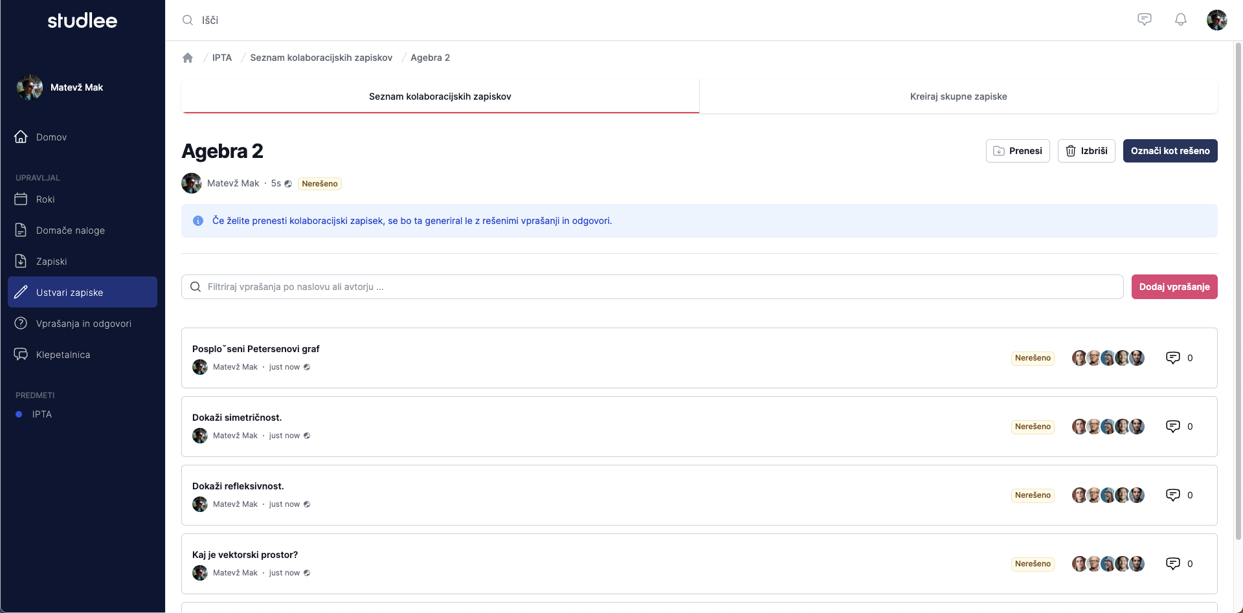

Slide 9
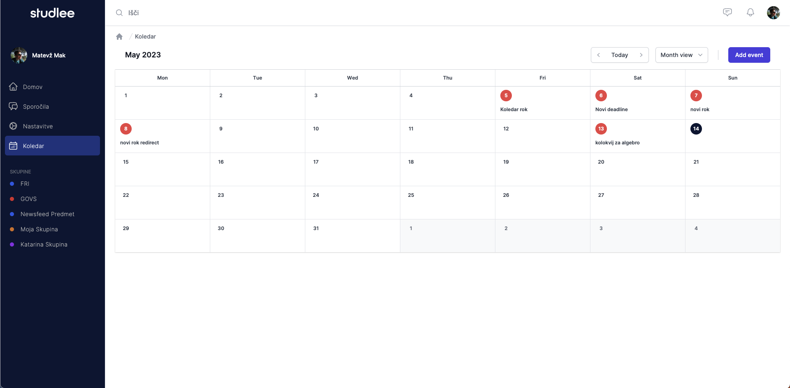

Slide 10
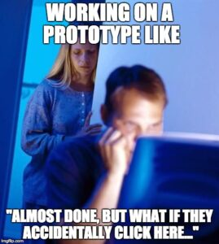

Slide 11
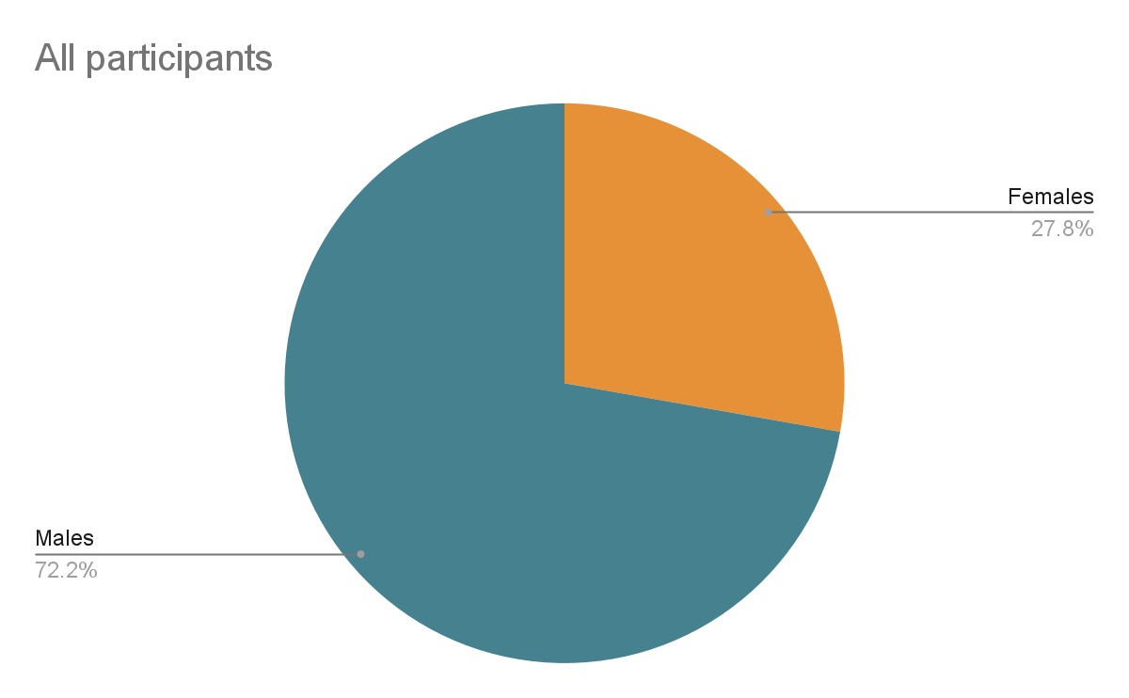
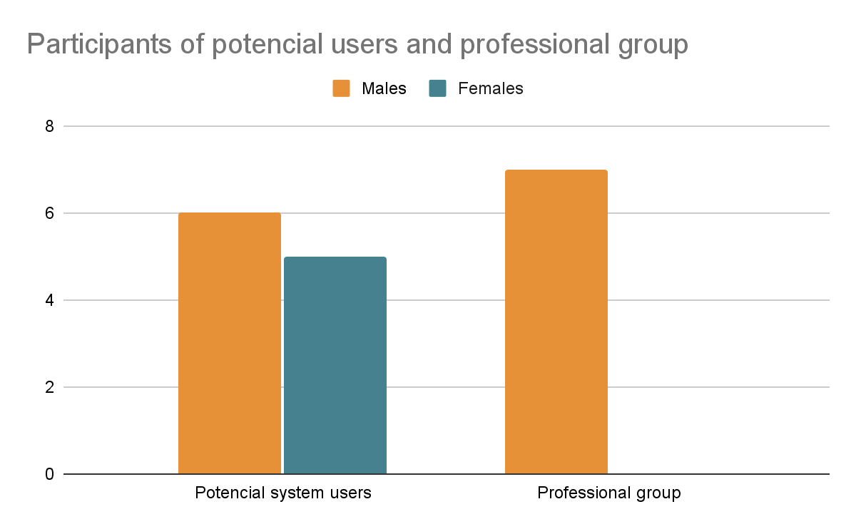
2. Participants
Total participants 18
27.8% Females, 72.2% males
Divided the analysis into 2 groups
Potential system users (55% males, 45% females)
Expert group (100% males)

Slide 12
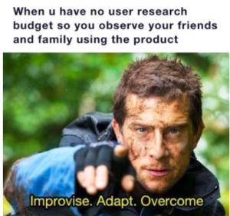

Slide 13
3. Analysis methods - potential users group
Each participants performed 8 tasks (Task analysis & Task flow analysis)
Comparing systems to our system for performing the same task
Fill the system usability scale questionnaire (SUS)

Slide 14
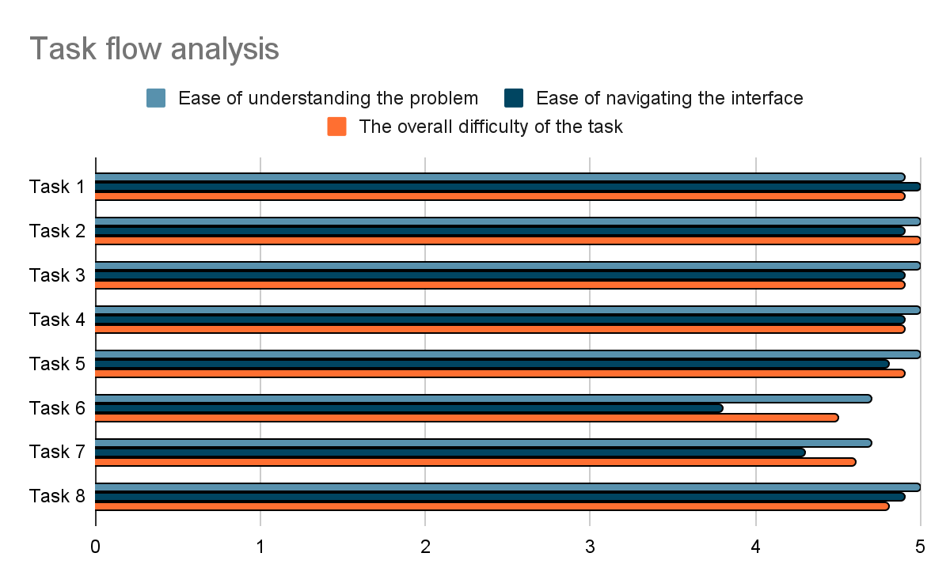
Tasks
1. Creating a group (ex. Famnit 2022 / 2023)
2. Inviting people to newly created group
3. Accepting the invite for another group
4. Creating a course in a newly created group (Programiranje 1)
5. Uploading notes
6. Adding a question to a collaborative note
7. Solving the question
8. Downloading collaborative note
Task 6 had 2.6 mistakes per Participant

Slide 16
Tasks | Missing functionality that other systems have (MS Teams, Facebook, Google Drive, Dropbox, Discord …)
1. Creating a group (ex. Famnit 2022 / 2023) | Instead of choosing a group color, you could upload an image.
2. Inviting people to newly created group | Invite link for fast joining Inviting multiple people at once
3. Accepting the invite for another group | Followed the standards
4. Creating a course in a newly created group (Programiranje 1) | Followed the standards
5. Uploading notes | Drag and drop functionality
6. Adding a question to a collaborative note | Followed the standards
7. Solving the question | Top rated correct answers should be on the top Reply system
8. Downloading collaborative note | Export as PDF or Word document

Slide 17
4. Analysis methods - group of experts
Each participants performed 8 tasks
Asking sub questions from 10 usability heuristics
Fill the system usability scale questionnaire (SUS)

Slide 18
10 usability heuristics
Visibility of system status
Match between system and the real world
User control and freedom
Consistency and standards
Error prevention
Recognition rather recall
Flexibility and efficiency of use
Aesthetic and minimalist design
Help users recognize, diagnose and recover from Error
Help and documentation

Slide 19
4. Expert group results
Define primary and secondary buttons
Despite breadcrumbs each page should have a button “go back”
Some actions should redirect the user to a certain place
Reducing steps, reducing user actions for finishing the tasks
Remove tab layout and take use of call to action buttons

Slide 20
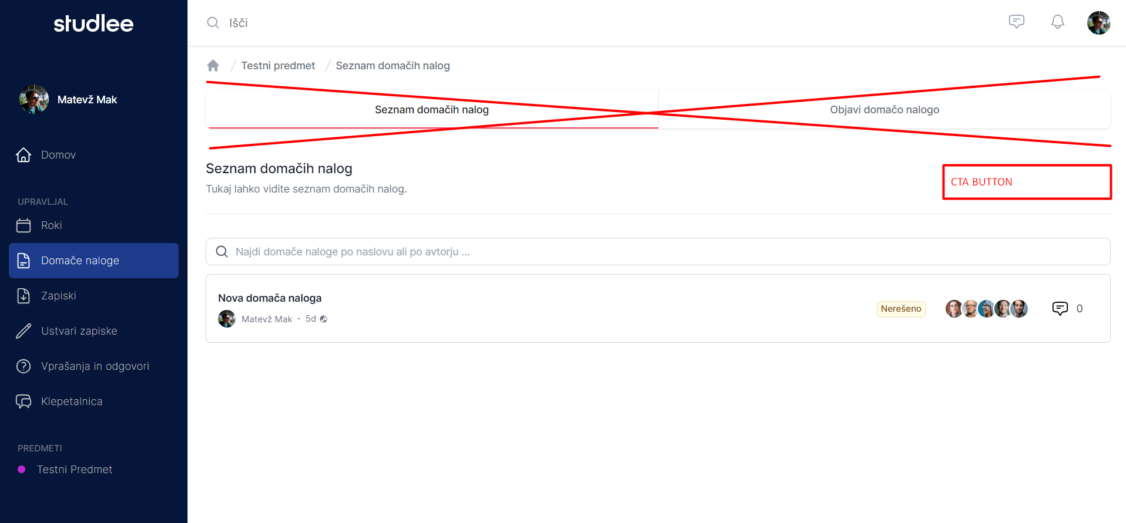
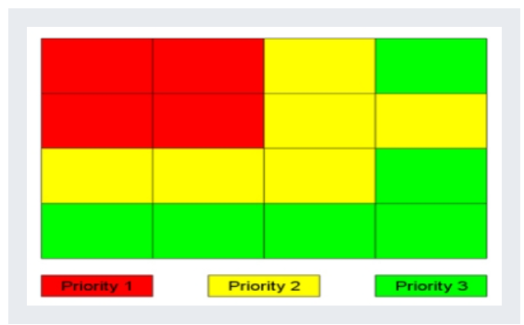

Slide 21
5. System usability scale (SUS) questionnaire
I think that I would like to use this website frequently.
I found the website unnecessarily complex.
I thought the website was easy to use.
I think that I would need the support of a technical person to be able to use this website.
I found the various functions in this website were well integrated.
I thought there was too much inconsistency in this website.
I would imagine that most people would learn to use this website very quickly.
I found the website very cumbersome to use.
I felt very confident using the website.
I needed to learn a lot of things before I could get going with this system.

Slide 22
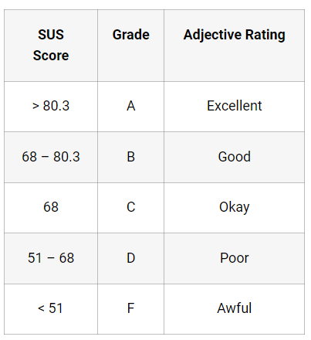
5. SUS results
They needed to answer questions from 1 - strongly disagree to 5 - strongly agree
X = sum of the points for all odd questions - 5
Y = 25 - sum of the point for all even questions
SUS score = (X + Y) x 2.5
Group of potential users | Group of experts | Sum
94.75 ± 3.2 | 85 ± 8.16 | 90.7 ± 7.4

Slide 23
6. What features did they like?

Slide 24
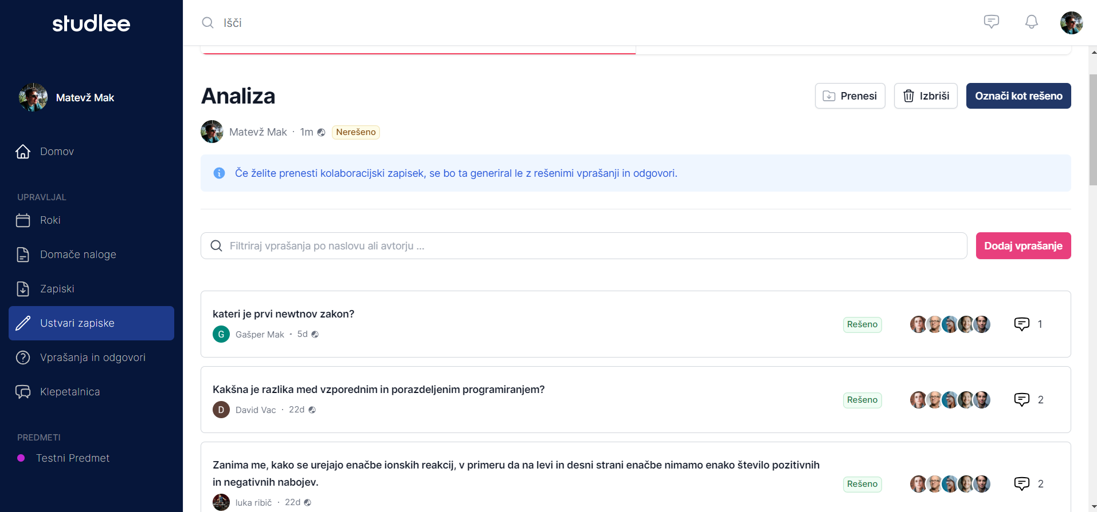

Slide 26
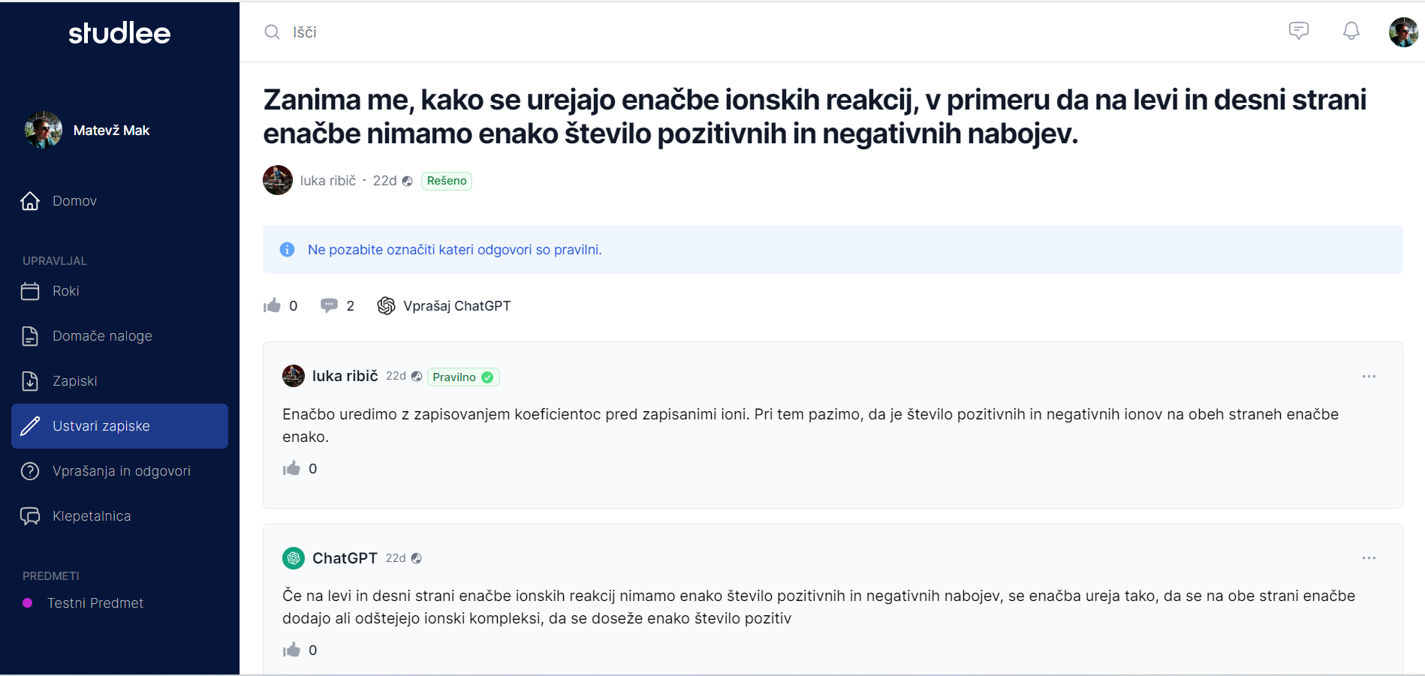

Slide 27
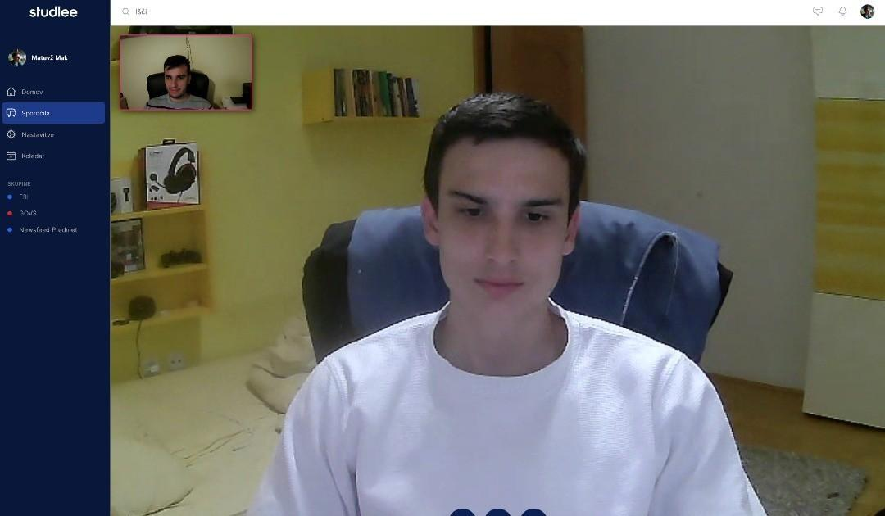

Slide 28
7.Web RTC
Real time audio video chat
Peer to peer connection between two browsers
UDP protocol (good for non-sensitive data)
Build in JavaScript API
Supported by all modern browsers
How to establish connection between 2 browsers?

Slide 29
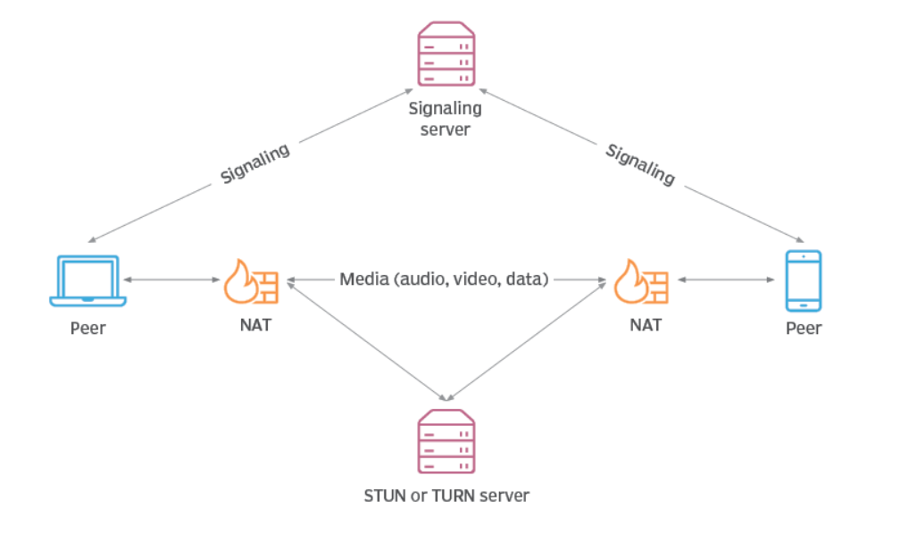
7. Web RTC - establishing a connection
Sending SDP (Session description Protocol)
Firewall
STUN server
ICE (Interactive Connectivity Establishment)

Slide 30
Questions?

