Slide 1
ESN Ticketing App
Students:
Milan Milivojčević, Karolina Trajkovska
Mentor: dr. Domen Šoberl

Slide 2
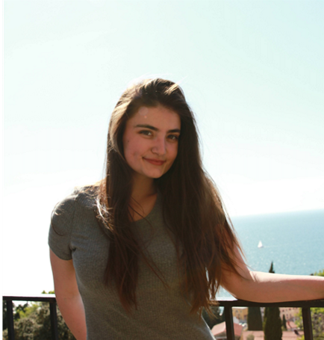
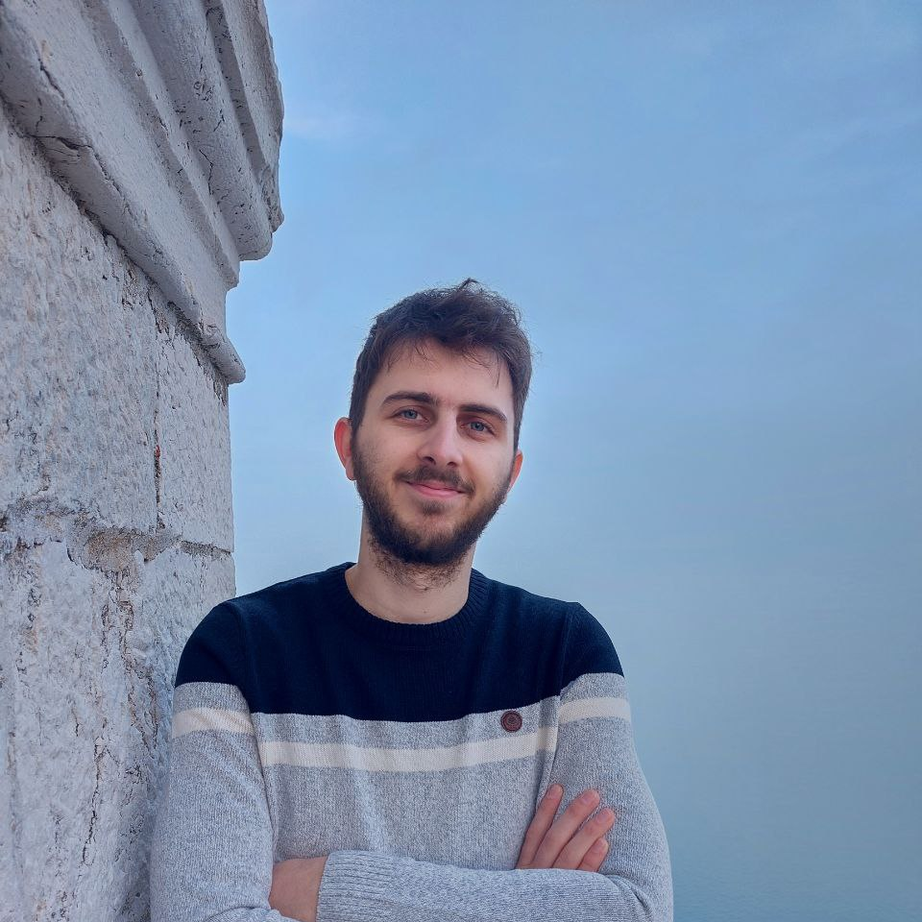
Meet the team
Milan Milivojčević, Karolina Trajkovska
First year Master students
BSc in Computer Science
Volunteers at ESN Primorska and ESN Slovenia
Dr. Domen Šoberl
Department of Information Sciences and Technologies
Research: Artificial Intelligence, Machine Learning

Slide 3
Briefly on ESN
Erasmus Student Network (ESN) is one of the biggest student associations in Europe.
Three levels:
local sections, national sections, international board
Works in the interest of international students
Works to improve the social and practical integration of international students
Motivates students to study abroad
Organizes different activities
(events, trips, workshops etc.)
Source: https://esn.org/about

Slide 4
Motivation for ESN Ticketing App
ESN has many tools, but there is no app that could aid the registration process. Yet, there are a lot of events.
ESN Awards – IT category

Slide 5
Problem definition
Current Event Registering process:
Registering to event
Payment
Save payment
Confirm payment
Microsoft Forms
In person
Excel Sheet
Check Excel Sheet

Slide 6
Problem definition
Current Event Registering process:
Registering to event
Payment
Save payment
Confirm payment
Microsoft Forms
In person
Excel Sheet
Check Excel Sheet
Data gets lost
Time inefficient
A lot of manual work
Can't reuse the data

Slide 7
Problem definition
Current Event Registering process:
Registering to event
Payment
Save payment
Confirm payment
Microsoft Forms
In person
Excel Sheet
Check Excel Sheet
Data gets lost
Time inefficient
A lot of manual work
Can't reuse the data

Slide 8
Current Solutions
Don't satisfy requirements
Limited (Paid)
No personalization
Manual input
No option for section account
Limited tickets
Time limitations
"Unlock Feature"

Slide 9
Current Solutions
Don't satisfy requirements
Limited (Paid)
No personalization
Manual input
No option for section account
Limited tickets
Time limitations
"Unlock Feature"
00,00 $

Slide 10
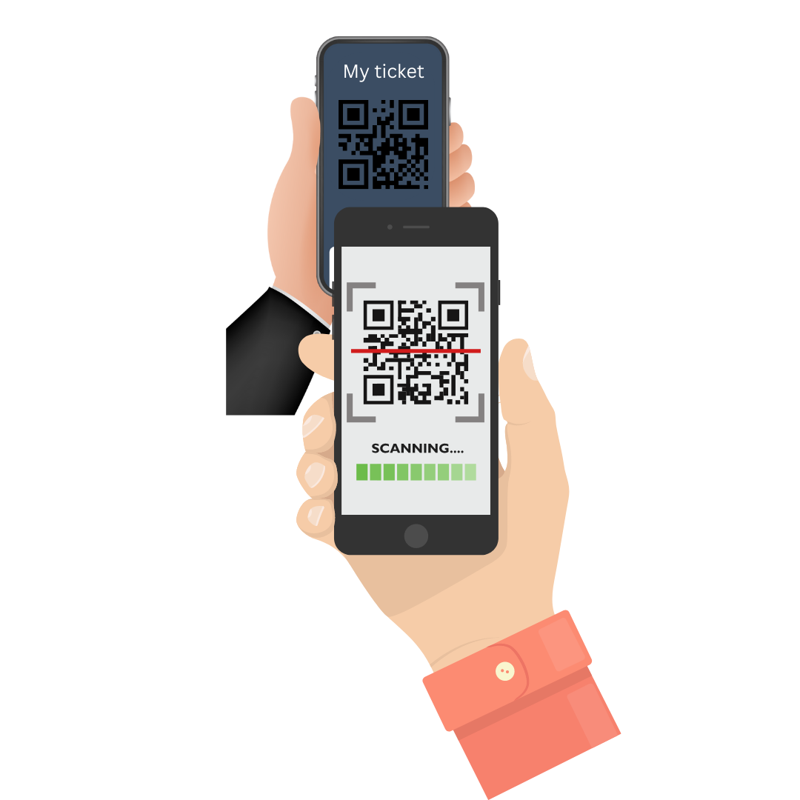
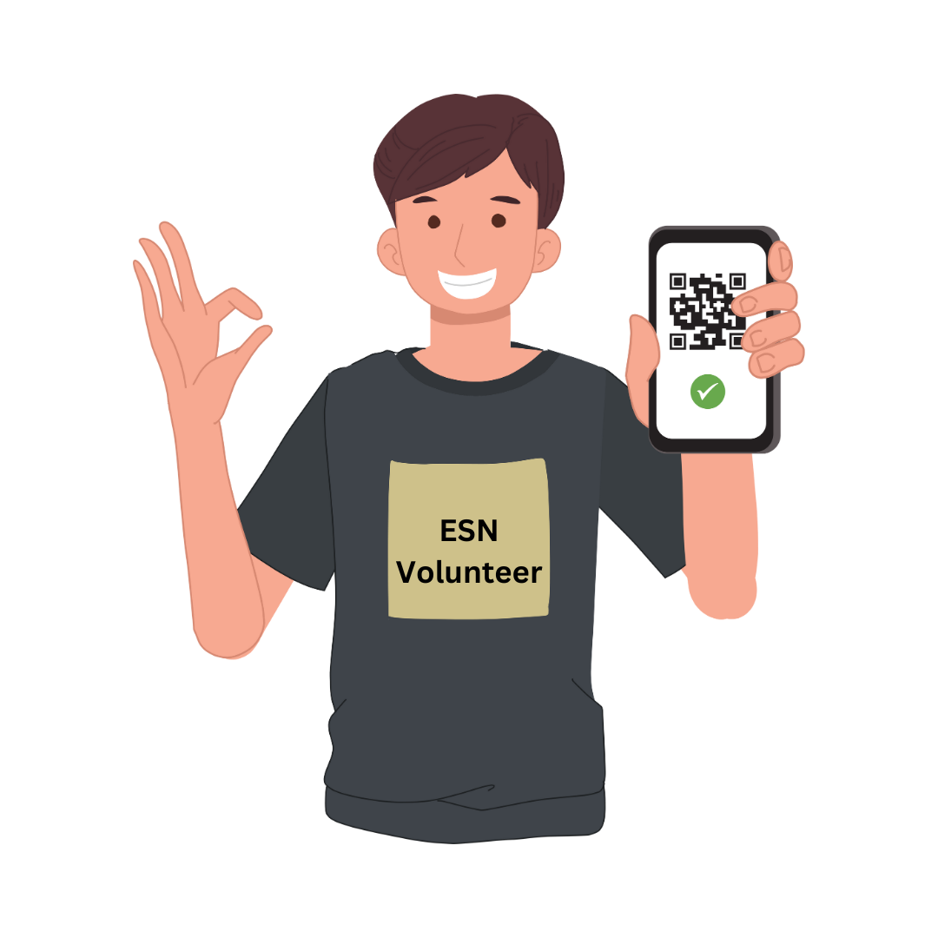
Our Solution (web-app)
Erasmus Student
Local/National Section
Create account
See list of events
Register to event
Use ticket
Create account
Create event
View registrations
Issue tickets
Scan ticket
Future:
Leave feedback
Future:
Overview feedback
See statistics
See recommendations

Slide 11
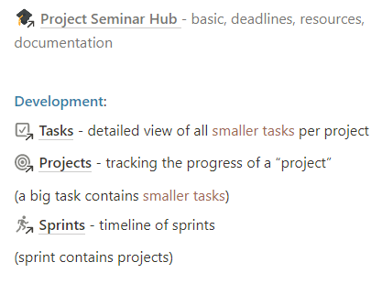
Work Plan

Slide 12
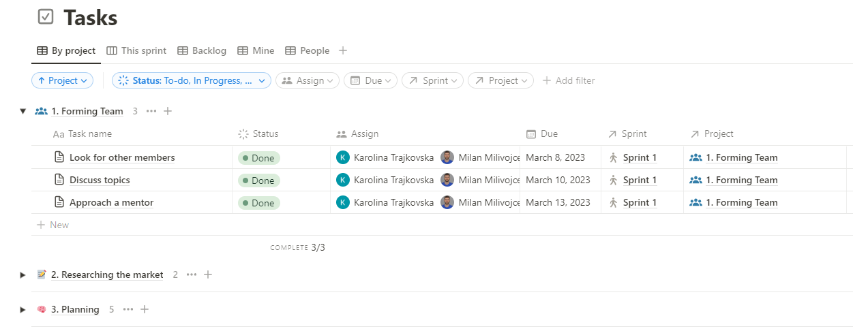

Slide 13
Technologies
More tools

Slide 14
Architecture
Ticketing app
React Js Client
Spring Boot backend
Database

Slide 15
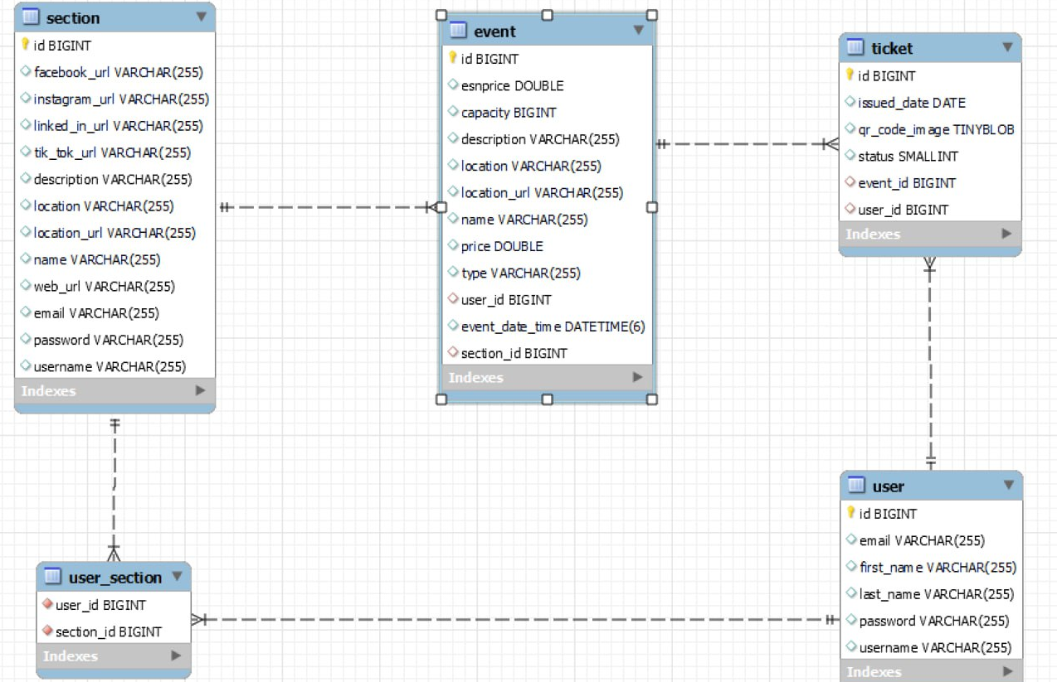

Slide 16
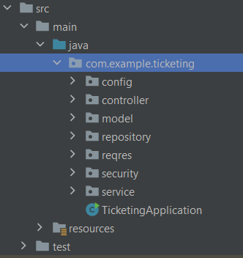
Implementation
Backend
User CRUD
Section CRUD
Event CRUD
Ticket CRUD
Authorization
Authentication

Slide 17
Implementation
Frontend
Student
ESN section
Login/Register
My profile
Events page
Ticket Wallet
Scan Ticket
Update name, password, follow ESN sections
See events of sections I follow, select and register to event
Open QR tickets to events I am registered to and eligible to attend
Update name, password, location,
social media…
See events of my section,
create event, select and update event, see registrations
Scan student ticket
Get status of ticket

Slide 18
Future Work
Improve User Experience
Online Payment
Deploy
Event statistics
Testing & Evaluation

Slide 19
Demo Video
Link to video

Slide 20
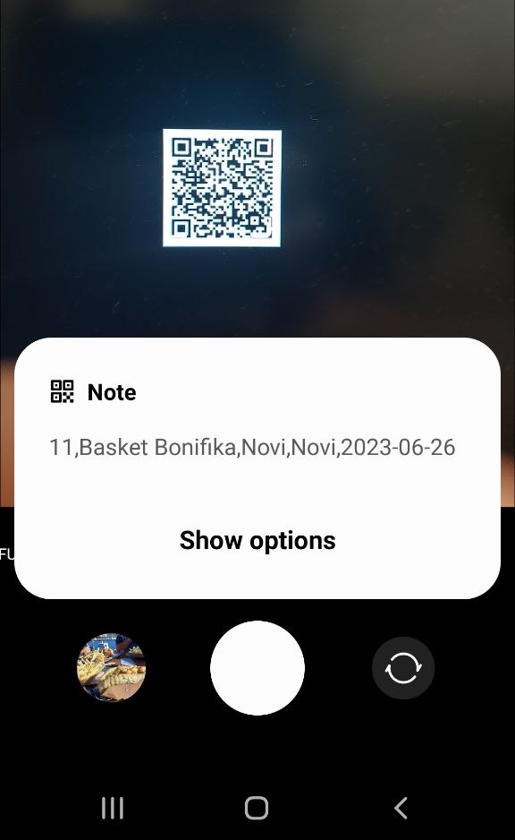
Phone view
updates

Slide 21
Thank you!
Q&A

