Slide 1
Web RTC & analysis of a system for student mutual assistance
Matevž Mak, PRIN2
Mentor: dr. Matjaž Kljun

Slide 2
Presentation overview
Project overview
Analysis methods
Task analysis & Task flow analysis
10 usability heuristics
System usability scale
Project status
Web RTC

Slide 3
Project overview
Students use a lot of platforms during education (Facebook, Drive, Discord, Zoom, Microsoft teams, Google e-classroom …)
I wanted to organize the content and wrap everything on one platform
So I implemented my own e-classroom for student mutual assistance
Find out if I met the requirements from other platforms (if my system is sufficient enough)
Expert group (System usability scale, task analysis, task flow analysis with 10 usability heuristics)
Normal (casual) group (task analysis, task flow analysis)

Slide 4
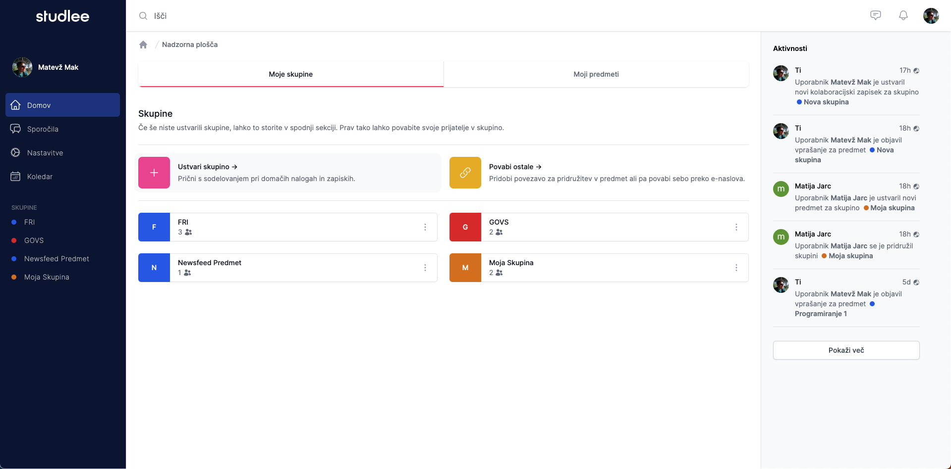
Screenshots of the system

Slide 5
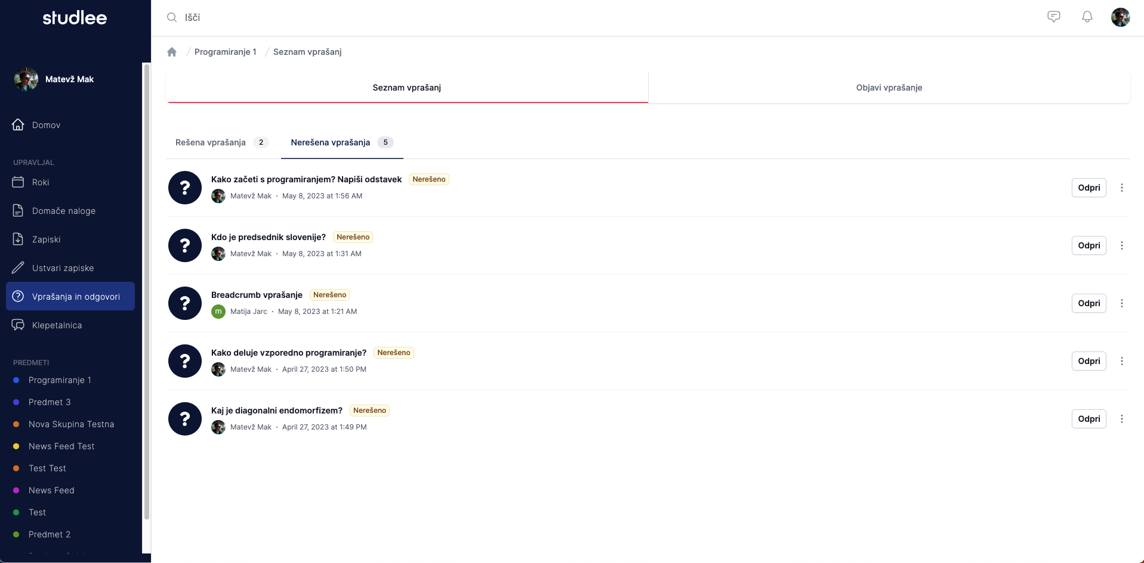

Slide 6
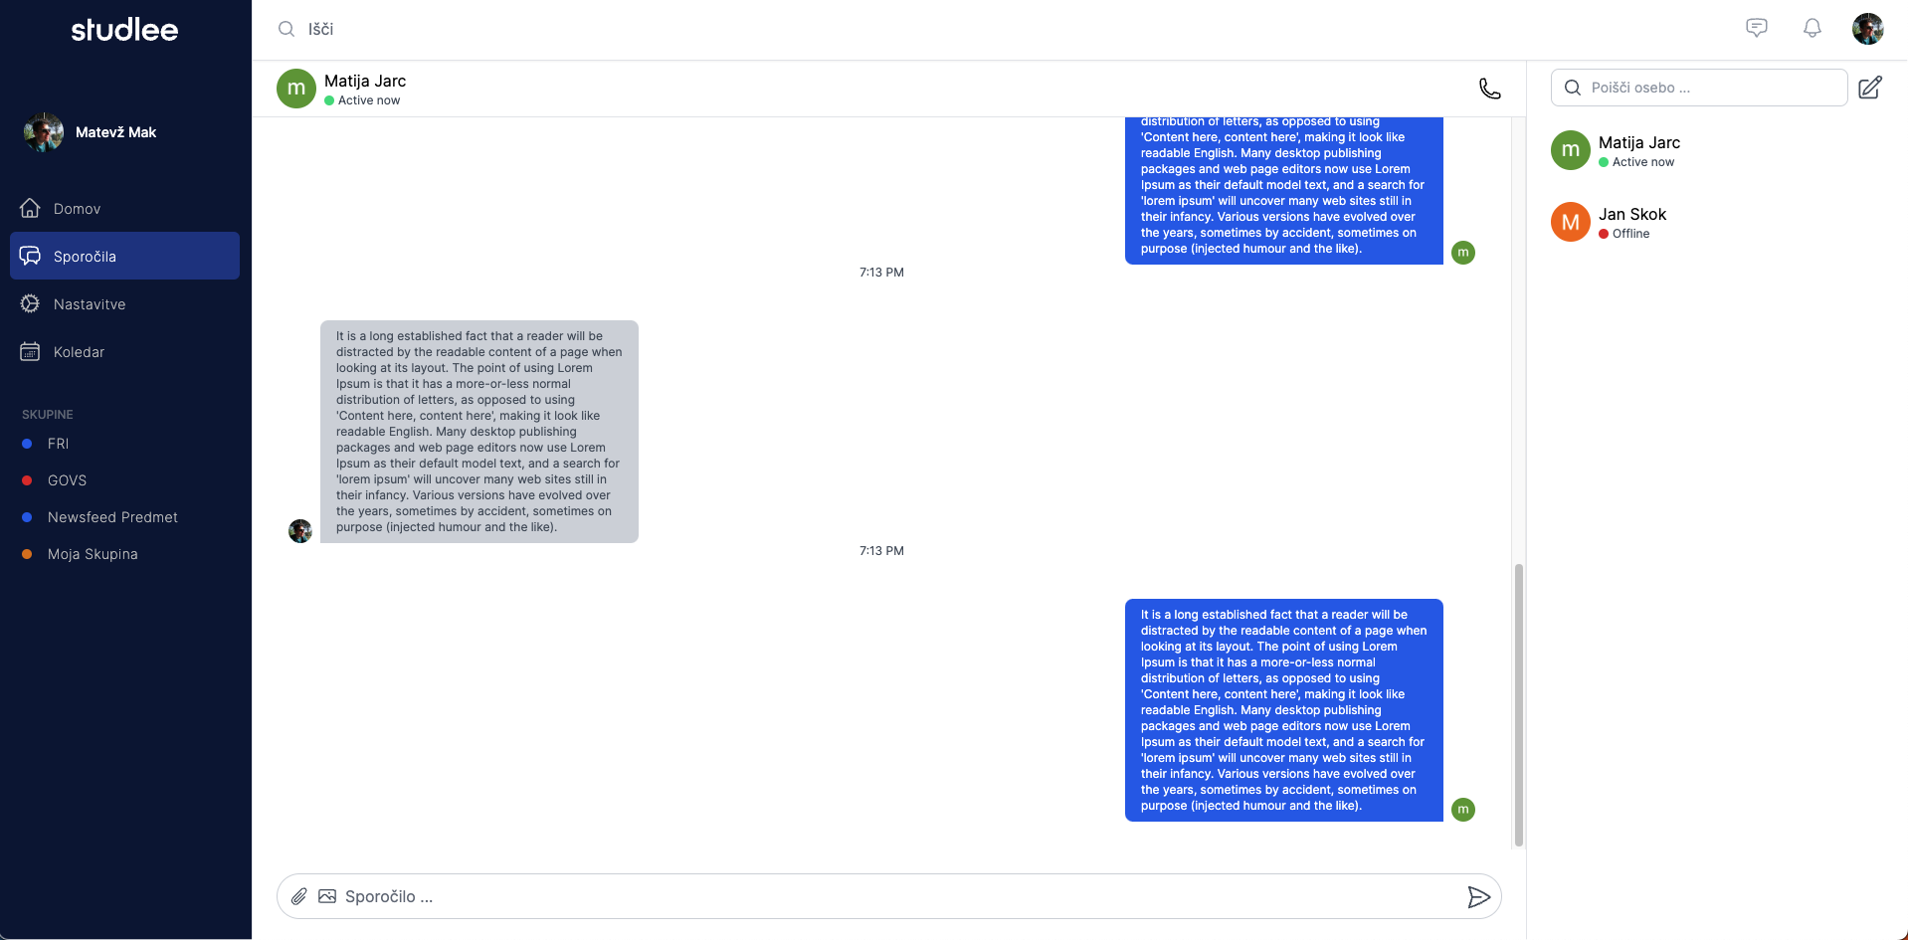

Slide 7
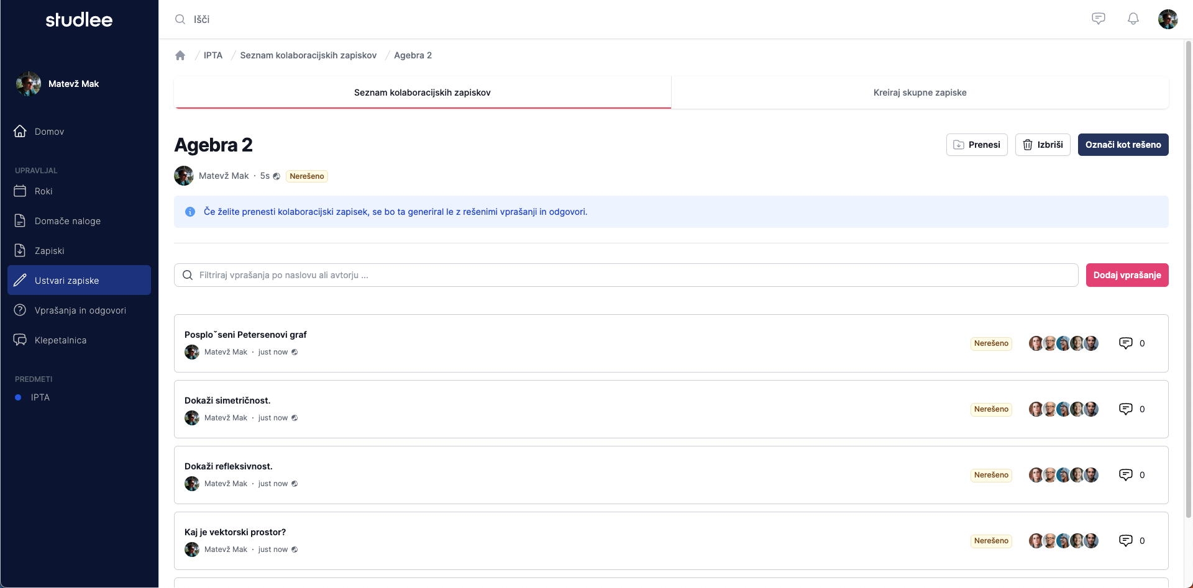

Slide 8
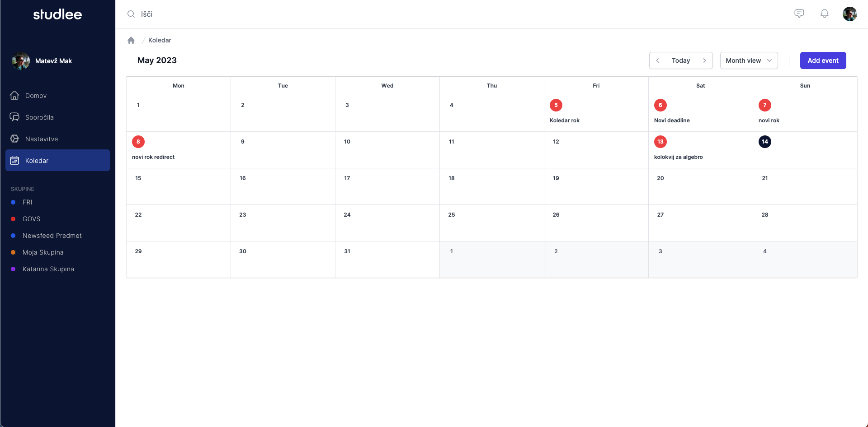

Slide 9
Analysis methods - Task flow analysis & task analysis
9 tasks (each has multiple steps)
Count the mistakes, on which step did he/she made a mistake
Listen for user feedback
Collect marks (1 to 5)
Ask if they used a similar system to perform the same task
Point out the pros and cons

Slide 10
10 usability heuristics
Visibility of system status
Match between system and the real world
User control and freedom
Consistency and standards
Error prevention
Recognition rather recall
Flexibility and efficiency of use
Aestethetic and minimalist design
Help users recognize, diagnose and recover from Error
Help and documentation

Slide 11
System usability scale (SUS)
I think that I would like to use this system frequently.
I found the system unnecessarily complex.
I thought the system was easy to use.
I think that I would need the support of a technical person to be able to use this system.
I found the various functions in this system were well integrated.
I thought there was too much inconsistency in this system.
I would imagine that most people would learn to use this system very quickly.
I found the system very cumbersome to use.
I felt very confident using the system.
I needed to learn a lot of things before I could get going with this system.

Slide 12
Project status
Finished with programming (the prototype)
Currently doing the system analysis (14 people and counting)
End of the analysis (this week)
Research paper in next 14 days

Slide 13
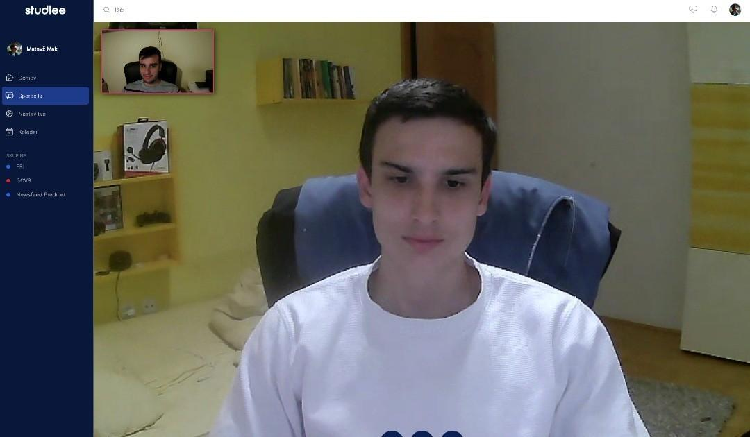
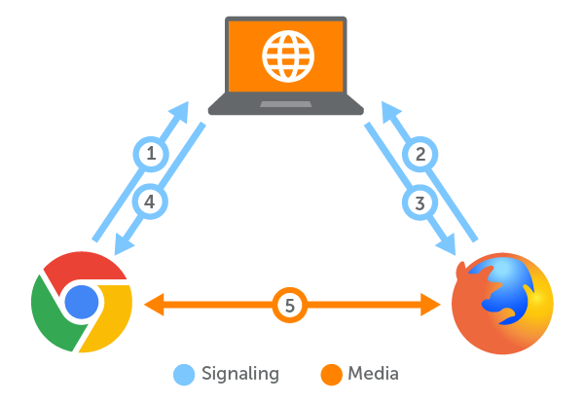
Web RTC

Slide 14
Thank you for the attention!

