Slide 1

Web app for private accommodation reservations
Albert Khaidarov
Enis Nuredini
Nedim Šišić

Slide 2
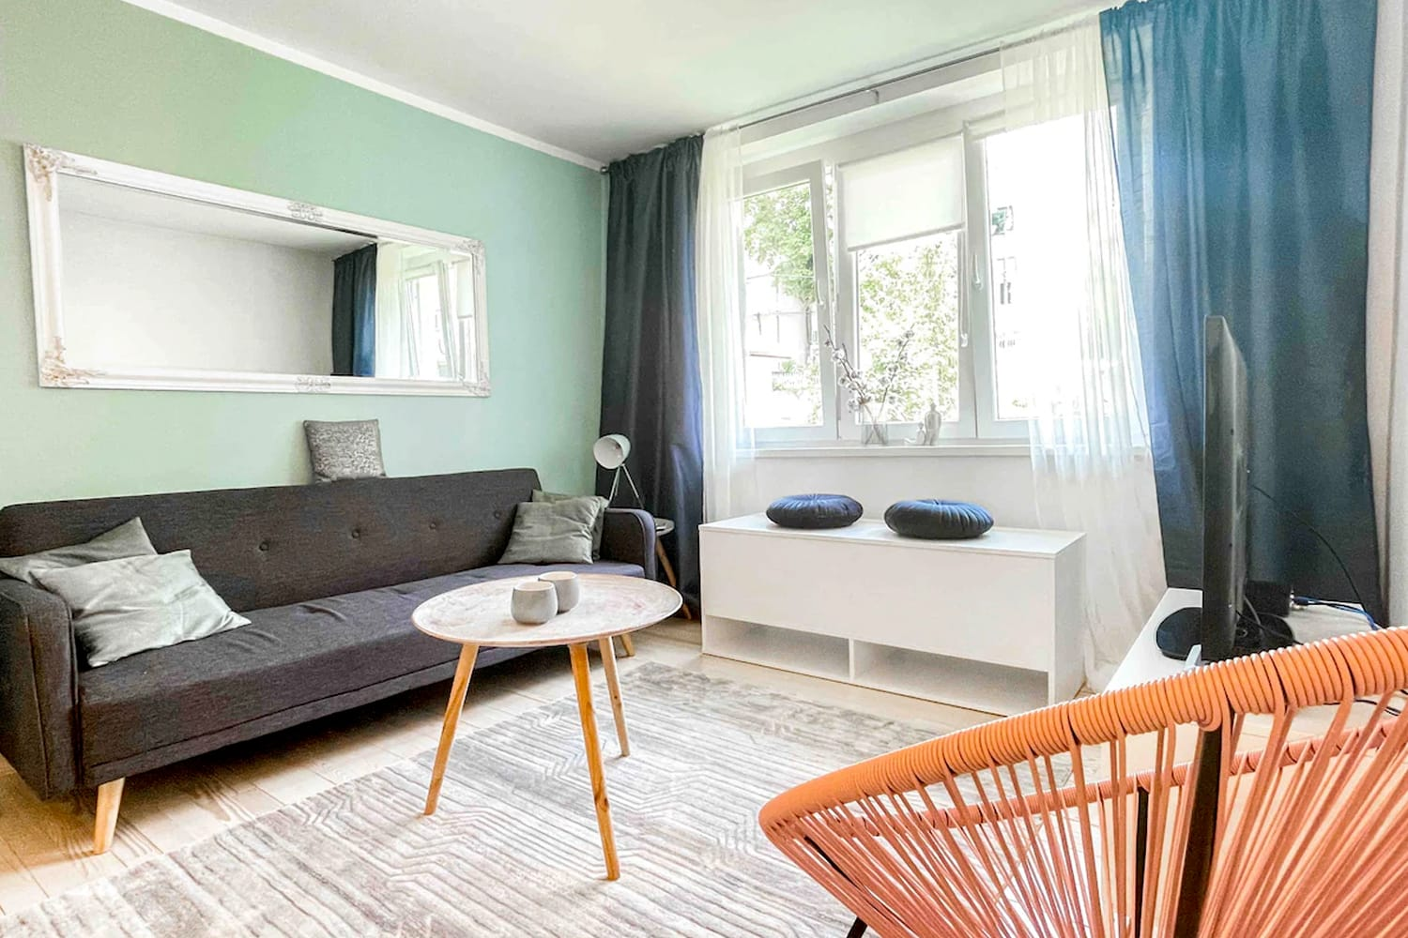
Motivation
Homestay - a private house offering
accommodation to paying guests
Increasingly popular in the last decades
We want to build an app that allows users
to find and book homestay reservations

Slide 3
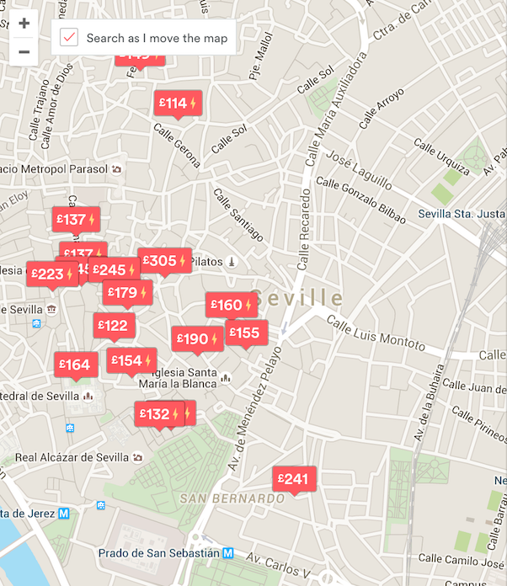
Features
Users will be able to:
  Create an account
  Search for and view accommodation offers
  Make reservations
  Use a map

Slide 4


Technologies
Option 1:
  Ruby on Rails React

Slide 5

Technologies
Option 2: MERN stack

Slide 6
Technologies
Database options:
  PostgreSQL
    has great compatibility
    highly scalable (serving up thousands of queries from hundreds of tables)
  SQLite
    more simple and robust
    lets store data in a structured manner
  MongoDB
    Data stored as separate JSON files (enables to manage data of any structure)
    Object-oriented database
    fits to MERN/MEAN stack

Slide 7
Plan
Phase 1 - Analysis and Design
  Requirements analysis All
  Determining use cases All
  Database design Albert, Enis
  User interface sketch Enis, Nedim
April 12th

Slide 8
Plan
Phase 2 – Basic implementation
  User registration Albert, Nedim
  Basic CRUD, routing Albert, Nedim
  Database Albert, Enis
  Simple user interface design Enis, Nedim
End of April

Slide 9
Plan
Phase 3 – Refined implementation
  Improving user interface
  Improving CRUD, routing, etc.
  Additional features
Middle of May

Slide 10
Plan
Phase 4 – Map
  Incorporating the map feature
Phase 5 – Evaluation
  Evaluation, testing, fixes
End of May

Slide 11
Thank you for listening!
Questions?

