Slide 1

Web app for Private Accommodation Reservations (PAR)
Albert Khaidarov
Enis Nuredini
Nedim Šišić

Slide 2
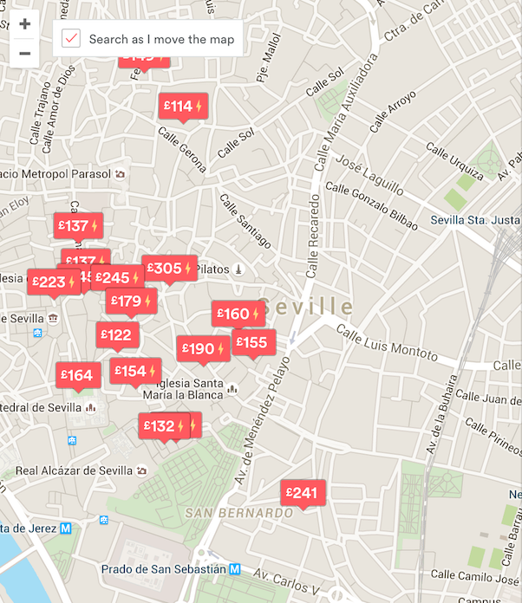
Features
Users will be able to:
  Create an account
  Make a room
  Search for and view room offers
  Make reservations
  Use a map

Slide 3




Technologies
← Back End Front End →

Slide 4
Completed
Create an account
Manage Profile
Manage Room
Design

Slide 5
Plan
In Progress:
  Adding photos to rooms
  Making reservations
Then:
  Searching for rooms
  Map

