Slide 1
Neural Network Based Classification of Brain Lesions
University of Primorska
FAMNIT Nedim Šišić
April, 2022 Mentor: Prof. Peter Rogelj

Slide 2
Agenda
Problem
Literature
Goals

Slide 3
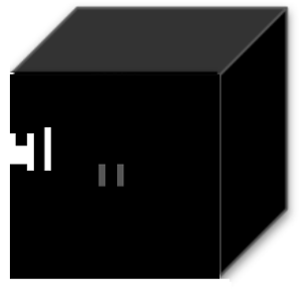
Problem
Brain lesion - an area of tissue injury or disease within the brain
Dataset - each image consists of three 3D images:
An interpretation - image with 3 spatial dimensions and 3 channels
FLAIR MRI
QSM MRI
MASK

Slide 4
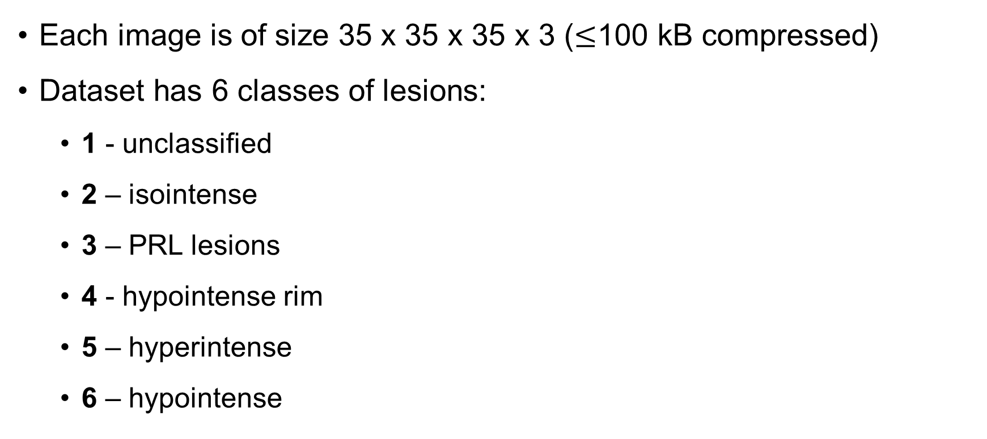
Problem - Dataset
Each image is of size 35 x 35 x 35 x 3 ($≤$100 kB compressed)
Dataset has 6 classes of lesions:
1 - unclassified
2 – isointense
3 – PRL lesions
4 - hypointense rim
5 – hyperintense
6 – hypointense

Slide 5
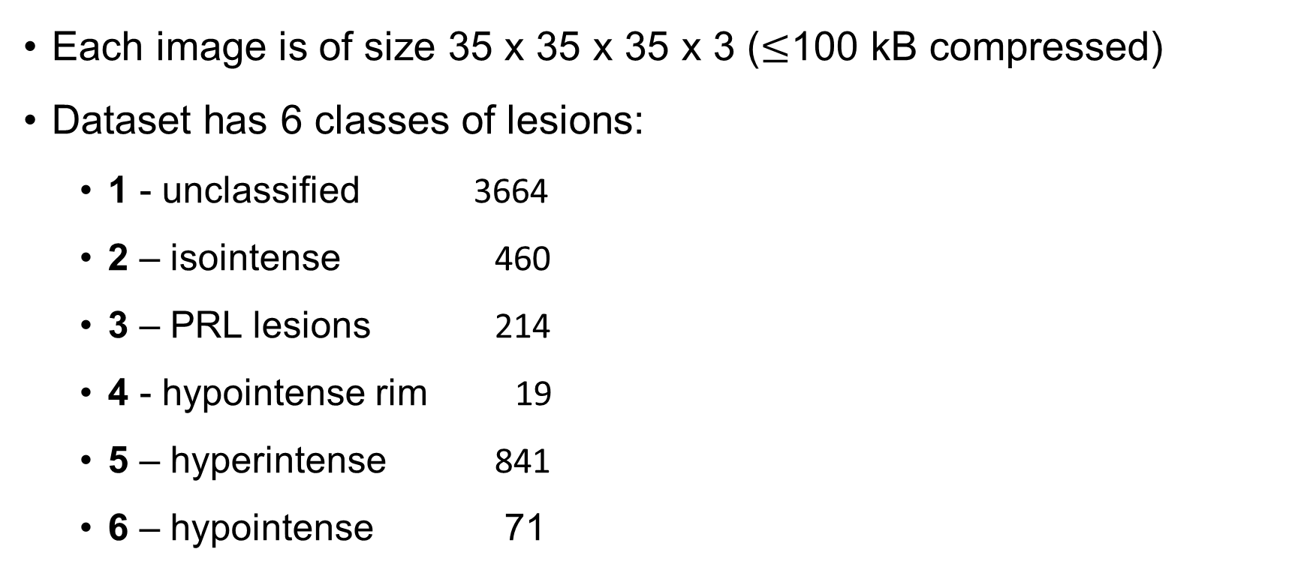
Problem - Dataset
Each image is of size 35 x 35 x 35 x 3 ($≤$100 kB compressed)
Dataset has 6 classes of lesions:
1 - unclassified 3664
2 – isointense 460
3 – PRL lesions 214
4 - hypointense rim 19
5 – hyperintense 841
6 – hypointense 71

Slide 6
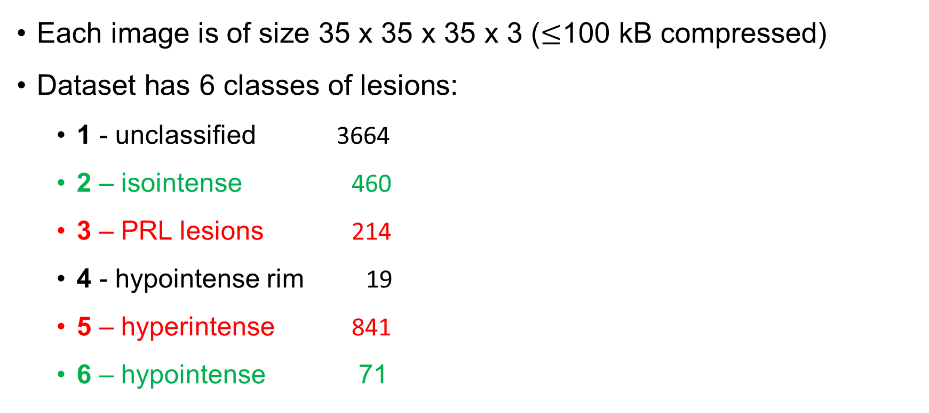
Problem - Dataset
Each image is of size 35 x 35 x 35 x 3 ($≤$100 kB compressed)
Dataset has 6 classes of lesions:
1 - unclassified 3664
2 – isointense 460
3 – PRL lesions 214
4 - hypointense rim 19
5 – hyperintense 841
6 – hypointense 71

Slide 7
Problem - Dataset
Each image is of size 35 x 35 x 35 x 3 ($≤$100 kB compressed)
Dataset has 6 classes of lesions:
1 - unclassified 3664
2 – isointense 460
3 – PRL lesions 214
4 - hypointense rim 19
5 – hyperintense 841
6 – hypointense 71
”Good” lesions: 531
”Bad” lesions: 1055

Slide 8
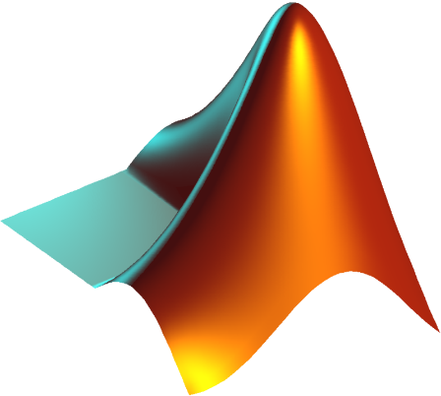
Problem - Goal
Task: given an instance, our model should correctly classify it as good or bad
We split the dataset into a training set and a test set, and train a convolutional neural network
Python + Tensorflow for augmentation, MATLAB for training

Slide 9
Literature
Our problem is specific – 3D images, multimodal
Krizhevsky, A., Sutskever, I., & Hinton, G.E. (2012). ImageNet classification with deep convolutional neural networks.
Niyas, S., Pawan, S., Kumar, M.A., & Rajan, J. (2021). Medical Image Segmentation using 3D Convolutional Neural Networks: A Review.

Slide 10
Some goals
Overcome dataset issues:
$\sim$Twice more bad (1055) than good (531) lesions
Class 6 (71) especially small
A relatively small dataset in general
See how different channels (Flair, QSM, Mask) influence classification

Slide 11
Thank you for listening!
Questions?

