Slide 1
Neural Network Based Classification of Brain Lesions
University of Primorska
FAMNIT Nedim Šišić
April, 2022 Mentor: Prof. Peter Rogelj

Slide 2
Agenda
Introduction
Dataset and problem specification
Previous work
Methods and results
Conclusion

Slide 3
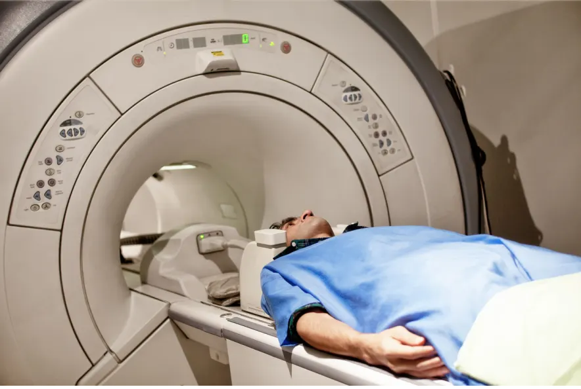
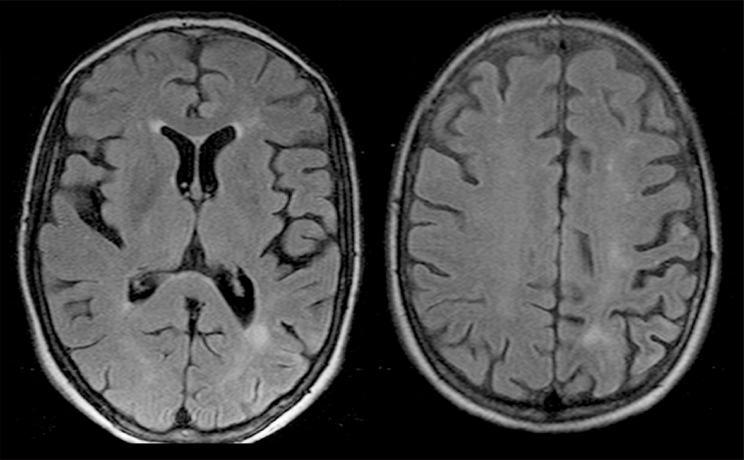
Introduction
MRI – magnetic resonance imaging
→

Slide 4
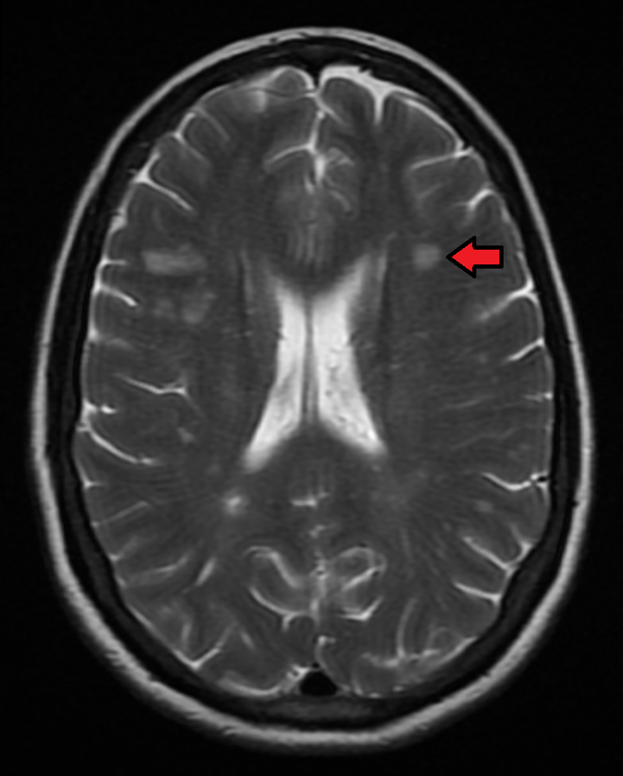
Introduction
Multiple sclerosis (MS) is a chronic demyelinating disease involving the central nervous system
Range of symptoms; no known cure
Estimated 2 million cases worldwide
MS lesions (tissue injuries) can be detected by MRI
Manual medical image processing is a burdensome taks – opportunity for computer aided systems

Slide 5
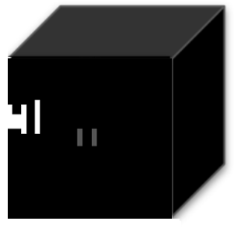
Dataset
Dataset – 5250 MS MRI images, each consisting of three 3D images center around a lesion:
An interpretation - image with 3 spatial dimensions and 3 channels
Image dimensions: 35 x 35 x 35 x 3
FLAIR MRI
QSM MRI
MASK

Slide 6
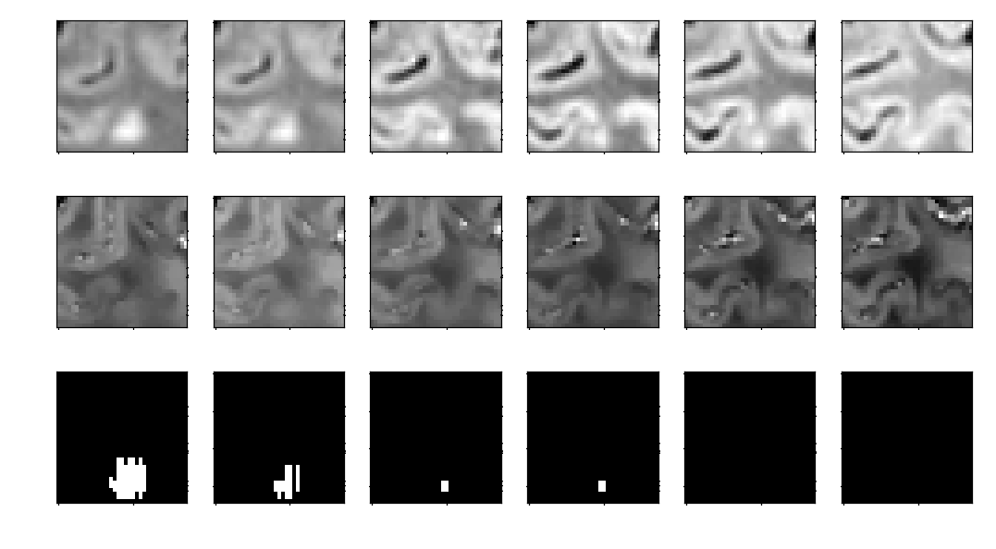
Problem - Dataset
Flair:
QSM:
Mask:

Slide 7
Problem - Dataset
Dataset has 6 classes of lesions:
1 - unclassified
2 – isointense
3 – PRL lesions
4 - hypointense rim
5 – hyperintense
6 – hypointense

Slide 8
Problem - Dataset
Dataset has 6 classes of lesions:
1 - unclassified 3664
2 – isointense 460
3 – PRL lesions 214
4 - hypointense rim 19
5 – hyperintense 841
6 – hypointense 71

Slide 9
Problem - Dataset
Dataset has 6 classes of lesions:
1 - unclassified 3664
2 – isointense 460
3 – PRL lesions 214
4 - hypointense rim 19
5 – hyperintense 841
6 – hypointense 71

Slide 10
Problem - Dataset
Dataset has 6 classes of lesions:
1 - unclassified 3664
2 – isointense 460
3 – PRL lesions 214
4 - hypointense rim 19
5 – hyperintense 841
6 – hypointense 71
”Good” lesions: 531
”Bad” lesions: 1055

Slide 11
Problem - Goal
Task: design a model that, given an image, correctly classifies it as good or bad
We use a convolutional neural network (CNN)
We train the CNN on one part of the dataset (70%), test on another (30%)
We train the network using different channels, and compare the results
i.e., we train on all subsets of $\left\{Flair, QSM, Mask\right\}$

Slide 12
Previous work
Convolutional neural network:
Machine learning model
Neural network architecture designed specifically for images
Main feature: convolutional layers instead of fully connected ones
Learns: local features → larger features → even larger features...
https://cs231n.github.io – CS231n Convolutional Neural Networks for Visual Recognition Course

Slide 13
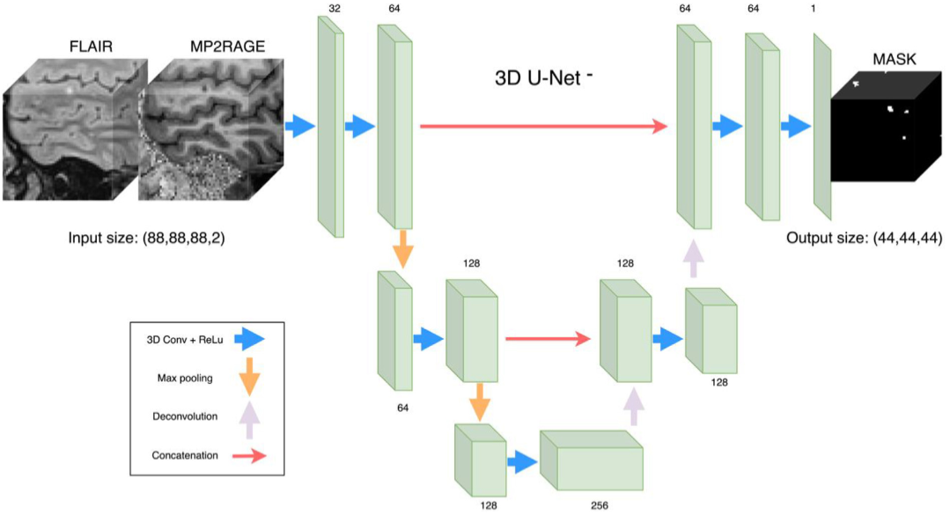
Previous work
Mask obtained by automatic segmentation and manual correction
„Multiple sclerosis cortical and WM lesion segmentation at 3T MRI: a deep learning method based on FLAIR and MP2RAGE” – La Rosa et al., 2020
„3D U-Net: Learning Dense Volumetric Segmentation from Sparse Annotation” – Çiçek et al., 2016

Slide 14
Previous work
Convolutional neural network:
Machine learning model
Neural network architecture designed specifically for images
Main feature: convolutional layers instead of fully connected ones
Learns: local features → larger features → even larger features...
https://cs231n.github.io – „CS231n Convolutional Neural Networks for Visual Recognition” Course

Slide 15
Methods - Data
Overcoming dataset issues:
$\sim$Twice more bad (1055) than good (531) lesions – oversampling
A relatively small dataset in general – data augmentation
Data augmentation for training set – rotate each image 24 times → flip each such image → 48 unique images

Slide 16
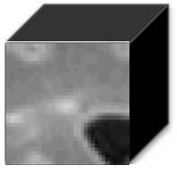
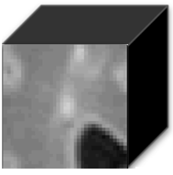
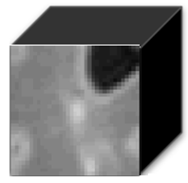
Methods - Data
Overcoming dataset issues:
$\sim$Twice more bad (1055) than good (531) lesions – oversampling
A relatively small dataset in general – data augmentation
Data augmentation – rotate each image 24 times → flip each such image → 48 unique images
→ , , , , ...

Slide 17
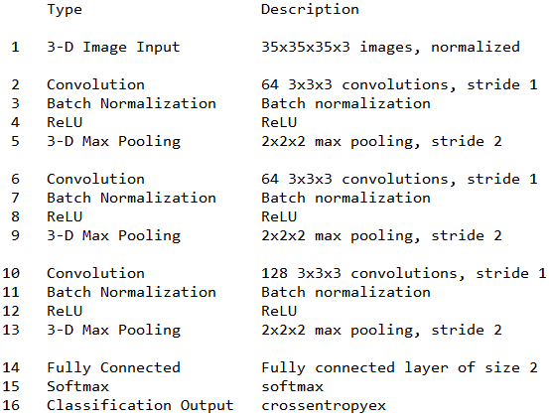
Methods – Network Architecture

Slide 18
Methods – Learning parameters
Learning algorithm: Adam
„Adam: A Method for Stochastic Optimization”, Kingma and Ba, 2014
Epochs: 15
Learning rate:
All training was performed on GPUs
$$Epoch$$ | 1 | 2 | 3 | 4 | 5 | 6 | 7 | 8 | 9 | 10 | 11 | 12 | 13 | 14 | 15
$$\frac{Rate}{0.01}$$ | 1 | 1 | 1 | 1 | 1 | 0.32 | 0.32 | 0.32 | 0.32 | 0.32 | 0.1 | 0.1 | 0.1 | 0.1 | 0.1

Slide 19
Results
Channels | Accuracy
None (baseline) | 66%
Flair | 70%
QSM | 89%
Mask | 69%
Flair, QSM | 88.5%
Flair, Mask | 71%
QSM, Mask | 89%
Flair, QSM, Mask | 89%

Slide 20
Results - Discussion
Network has high accuracy when and only when QSM is used!
Flair and Mask do not help the network
Note:
Mask was used for image centering
Flair was used for obtaining mask
Channels | Accuracy
None (baseline) | 66%
Flair | 70%
QSM | 89%
Mask | 69%
Flair, QSM | 88.5%
Flair, Mask | 71%
QSM, Mask | 89%
Flair, QSM, Mask | 89%
→

Slide 21
Future work
The optimal network obtained 89% accuracy – promising direction for aiding medical doctors in MS diagnosis
Evaluating the model using cross validation
Further increasing accuracy – might require more data?
Most of lesions are unclassified – problem for using the model
Segmentation using QSM?

Slide 22
Conclusion
We trained a convolutional neural network for MS lesion classification on MRI images
Network achieves 89% accuracy when QSM is used – potential for practical use
Using Flair and Mask channels does not help the network itself
Solving the unclassified lesions problem?

Slide 23
Thank you for listening!
Questions?

