Slide 1
Polygonization of connected areas in binary images
Nedim Šišić
FAMNIT
University of Primorska

Slide 2
Overview
Introduction
Preliminary definitions
Subtasks
Methods
Conclusion

Slide 3
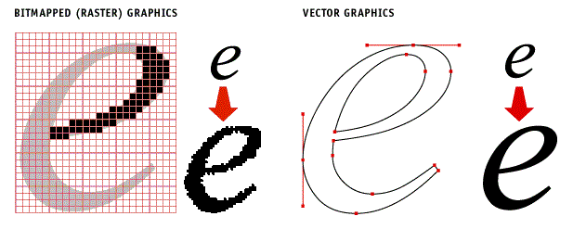
Two kinds of images

Slide 4
Vectorization and Polygonization
In image processing, vectorization is the conversion of raster images to vector images
Polygonization is a special type of vectorization, which deals with finding polygonal approximations of raster images
The polygons can later be used in different applications: image analysis, image matching, image and video retrieval, image registration, etc.

Slide 5


Vectorization and Polygonization
Vectorization example
Image from: Kopf, J. and Dani Lischinski. “Depixelizing pixel art.” ACM SIGGRAPH 2011 papers (2011)

Slide 6
Motivation
To our knowledge, all existing vectorization methods process entire images
This is unnecessary if we are only interested in just one part of an image
By restricting the scope of vectorization, we could reduce its time and space requirements
We propose a novel approach to polygonizing connected areas in binary images

Slide 7
Results
We present the Polygonize method, which finds a polygonal approximation of a single part of an image, without the need to process the rest of the image
We then present the Reduce method as a preprocessing step to Polygonize, which further reduces the space complexity of solving the problem
We analyze the time and space complexities of the methods

Slide 8
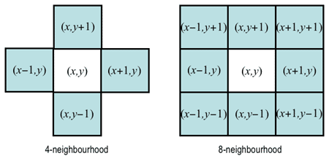

Definitions
Pixels Pixels $P_{1}=\left(x_{1},y_{1}\right)$ and $P_{2}=\left(x_{2},y_{2}\right)$are:
  - 4-neighbors if $\left(x_{1},y_{1}\right)=\left(x_{2}±1,y_{2}\right)$ or $\left(x_{1},y_{1}\right)=\left(x_{2},y_{2}±1\right)$;
  - 8-neighbors if they are 4-neighbours or $\left(x_{1},y_{1}\right)=\left(x_{2}±1,y_{2}±1\right)$.

Slide 9
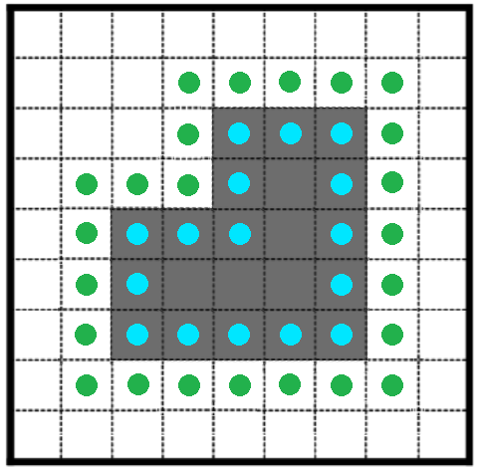

Definitions
Let B be the set of all pixels of color $C_{i}$ which have at least one 8-neighbor of color ${\overline{C}}_{i}$. Let R be the transitive closure of the 4-neighbor relation on B. Then each equivalence class of B with respect to R is a $C_{i}$-border.

Slide 10
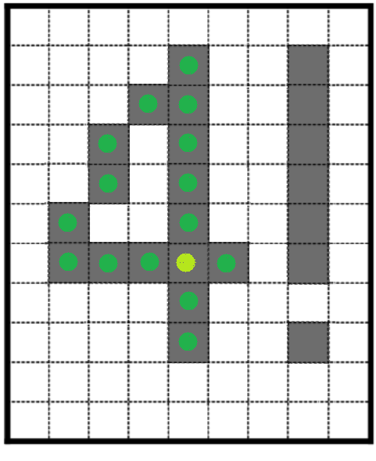

Definitions
Let B be the set of all pixels of color $C_{i}$. Let R be the transitive closure of the 8-neighbor relation on B. Then each equivalence class of B with respect to R is a connected component.

Slide 11
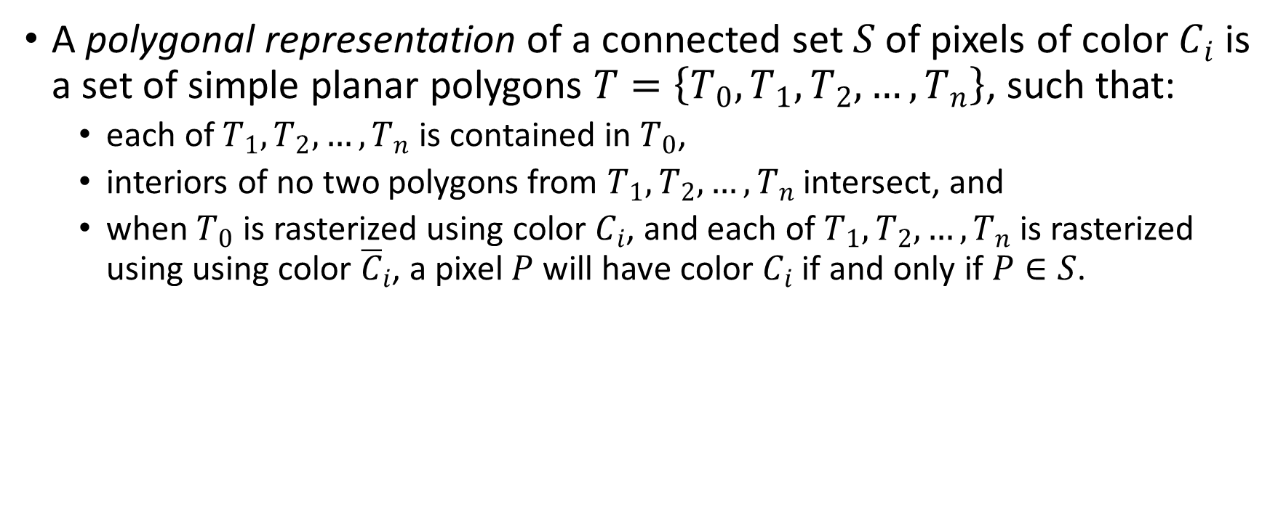
Definitions
A polygonal representation of a connected set $S$ of pixels of color $C_{i}$ is a set of simple planar polygons $T=\left\{T_{0},T_{1},T_{2},…,T_{n}\right\}$, such that:
  each of $T_{1},T_{2},…,T_{n}$ is contained in $T_{0}$,
  interiors of no two polygons from $T_{1},T_{2},…,T_{n}$ intersect, and
  when $T_{0}$ is rasterized using color $C_{i}$, and each of $T_{1},T_{2},…,T_{n}$ is rasterized using using color ${\overline{C}}_{i}$, a pixel $P$ will have color $C_{i}$ if and only if $P∈S$.

Slide 12
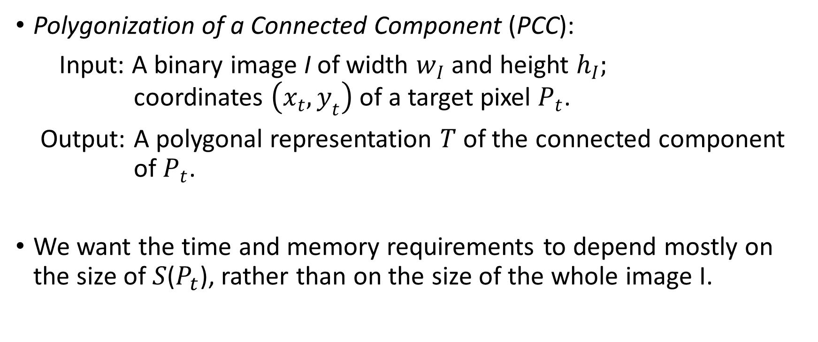
Definitions
Polygonization of a Connected Component (PCC):
Input: A binary image I of width $w_{I}$ and height $h_{I};$
coordinates $\left(x_{t},y_{t}\right)$ of a target pixel $P_{t}$.
Output: A polygonal representation $T$ of the connected component
of $P_{t}$.
We want the time and memory requirements to depend mostly on the size of 𝑆($P_{t}$), rather than on the size of the whole image I.

Slide 13
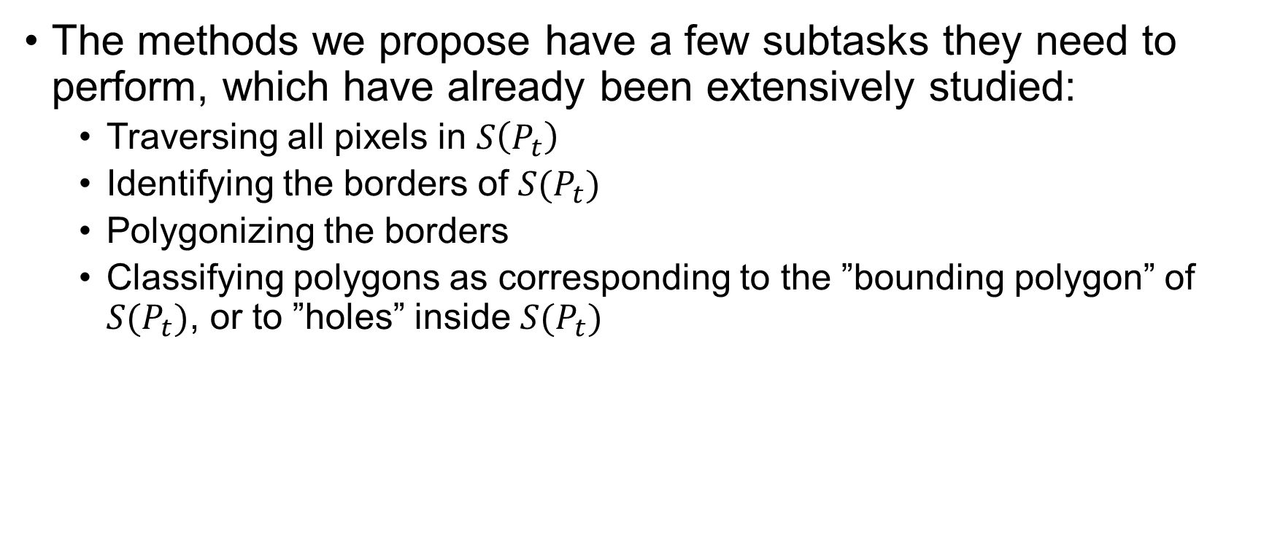
Subtasks
The methods we propose have a few subtasks they need to perform, which have already been extensively studied:
  Traversing all pixels in $S\left(P_{t}\right)$
  Identifying the borders of $S(P_{t})$
  Polygonizing the borders
  Classifying polygons as corresponding to the ”bounding polygon” of $S(P_{t})$, or to ”holes” inside $S(P_{t})$

Slide 14
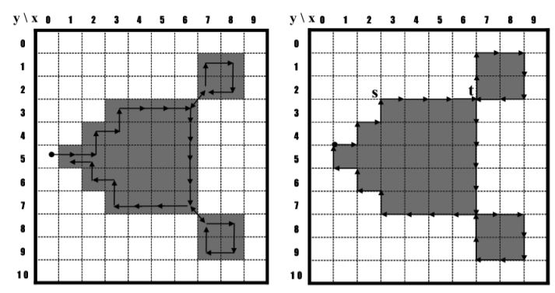
  Contour tracing
Contour tracing algorithms follow along the pixels of a border
Three types: pixel following, vertex following, and
run-data-based following algorithms

Slide 15
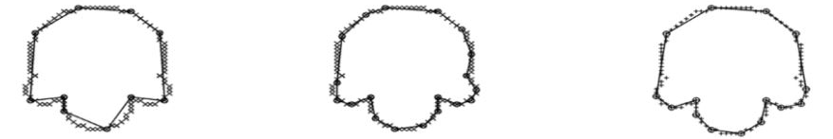
Polygonizing borders
  Polygonizing a border – constructing a polygon that „corresponds” to a border
  Due to discretization, different polygons can correspond to the same border
  Different polygonization accuracies have different complexities

Slide 16
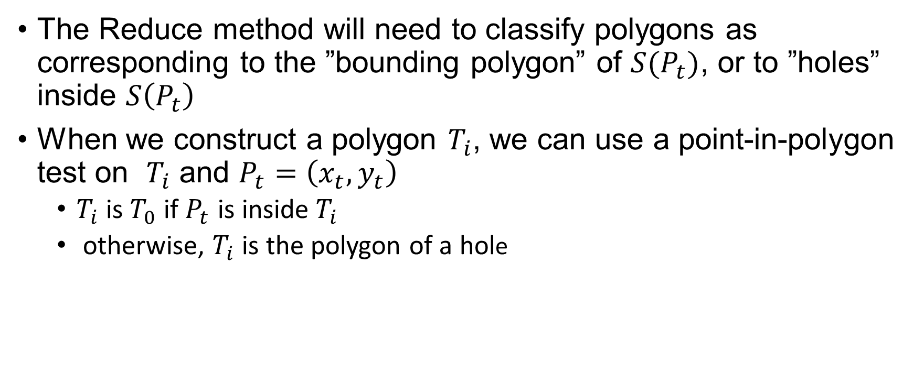
Polygon classification
The Reduce method will need to classify polygons as corresponding to the ”bounding polygon” of $S(P_{t})$, or to ”holes” inside $S\left(P_{t}\right)$
When we construct a polygon $T_{i}$, we can use a point-in-polygon test on $T_{i}$ and $P_{t}=\left(x_{t},y_{t}\right)$
  $T_{i}$ is $T_{0}$ if $P_{t}$ is inside $T_{i}$
  otherwise, $T_{i}$ is the polygon of a hole

Slide 17
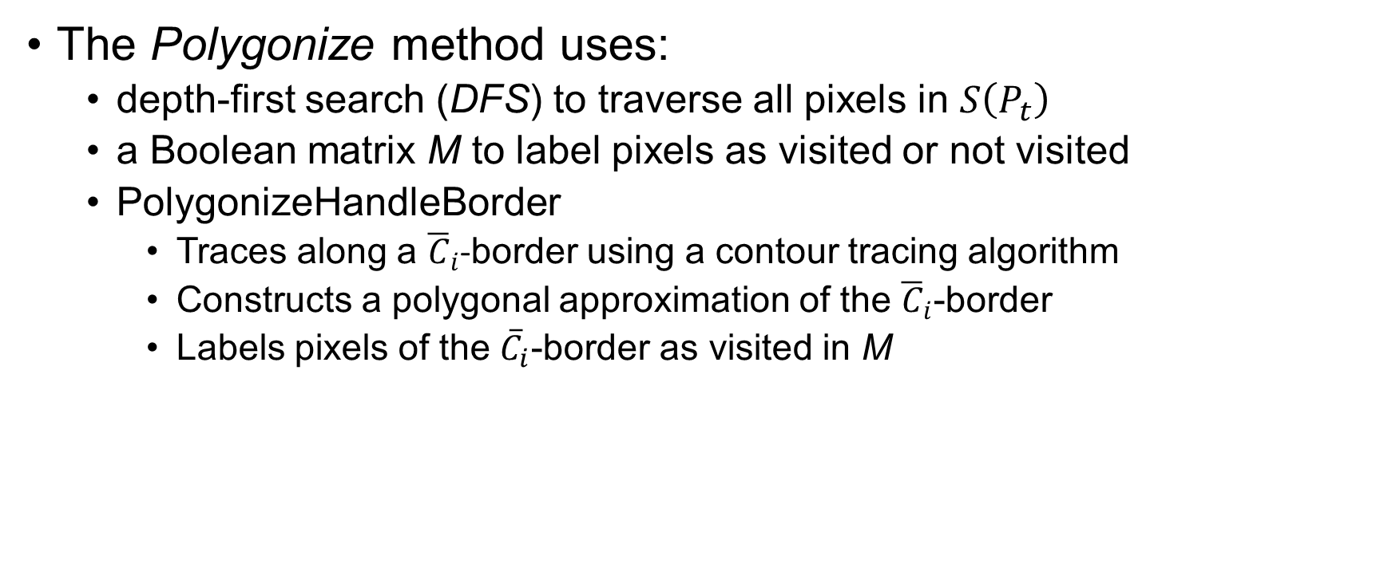
Polygonize
The Polygonize method uses:
  depth-first search (DFS) to traverse all pixels in $S\left(P_{t}\right)$
  a Boolean matrix M to label pixels as visited or not visited
  PolygonizeHandleBorder
    Traces along a ${\overline{C}}_{i}$-border using a contour tracing algorithm
    Constructs a polygonal approximation of the ${\overline{C}}_{i}$-border
    Labels pixels of the ${\overline{C}}_{i}$-border as visited in M

Slide 18
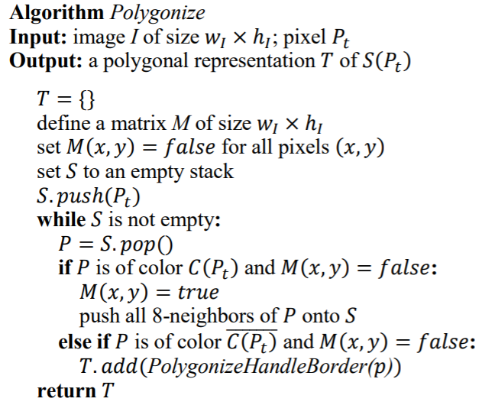
Polygonize

Slide 19
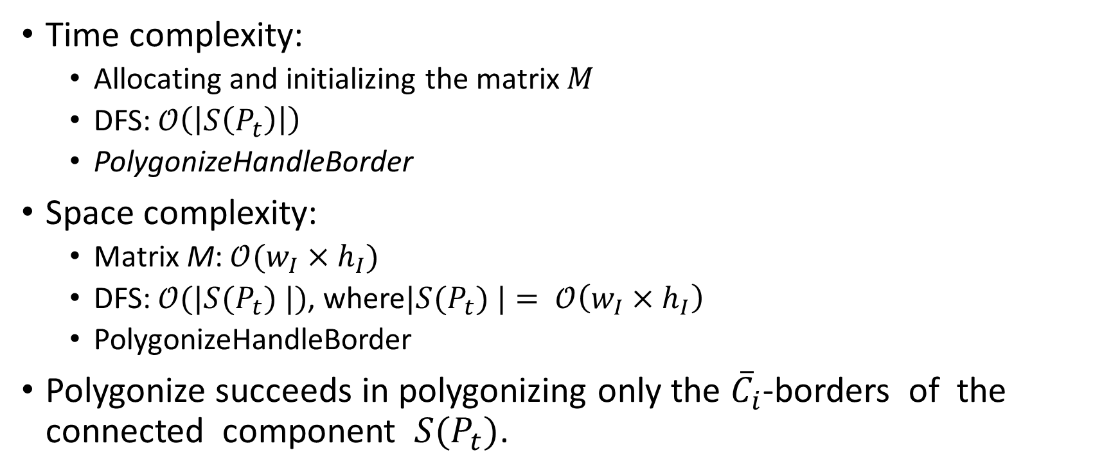
Complexity analysis of Polygonize
Time complexity:
  Allocating and initializing the matrix $M$
  DFS: $𝒪\left(\left|S\left(P_{t}\right)\right|\right)$
  PolygonizeHandleBorder
Space complexity:
  Matrix M: $𝒪(w_{I}×h_{I})$
  DFS: $𝒪(|S(P_{t}) |)$, where$|S(P_{t}) |= 𝒪\left(w_{I}×h_{I}\right)$
  PolygonizeHandleBorder
Polygonize succeeds in polygonizing only the ${\overline{C}}_{i}$-borders of the connected component $S(P_{t})$.

Slide 20
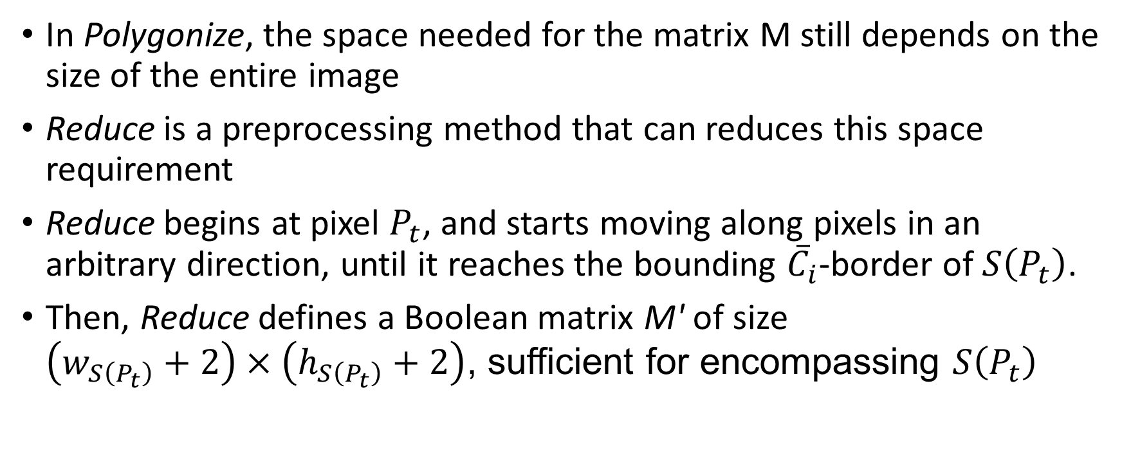
Reduce
In Polygonize, the space needed for the matrix M still depends on the size of the entire image
Reduce is a preprocessing method that can reduces this space requirement
Reduce begins at pixel $P_{t}$, and starts moving along pixels in an arbitrary direction, until it reaches the bounding ${\overline{C}}_{i}$-border of $S\left(P_{t}\right)$.
Then, Reduce defines a Boolean matrix M' of size
$\left(w_{S\left(P_{t}\right)}+2\right)×\left(h_{S\left(P_{t}\right)}+2\right)$, sufficient for encompassing $S\left(P_{t}\right)$

Slide 21
Concluding remarks
We have formally defined the problem PCC
We have proposed two methods, Polygonize and Reduce
The methods limit the scope of polygonization, and thus reduce the time and space requirements of the process
Future work:
  generalizing the approaches to color images
  generalizing the approaches to arbitrary types of vectorization
  apply parallel techniques

Slide 22
Thank you for listening!
Questions?

