Slide 1
Polygonization of connected areas in binary images
Research Seminar Nedim Šišić

Slide 2
Agenda
Introduction
Motivation
Preliminary definitions
Problem statement
Our approach

Slide 3
Two kinds of images

Slide 4
Polygonization
In image processing, vectorization is the conversion of raster images to vector images
A special kind of vectorization is polygonization, which deals with finding polygonal approximations of a raster image
Resulting polygons can later be used in different applications: image analysis, image matching, image and video retrieval, image registration
A nice review of existing methods is given in „Fast and Direct Polygonization for Gray-Scale Images Using Digital Straightness and Exponential Averaging” , Pratihar and Bhowmick, 2014

Slide 5
Motivation
Most existing vectorization methods process entire images
This is unnecessary if we are only interested in just one part of an image
By restricting the scope of vectorization, we could reduce its time and space requirements
We want to research how this can be done when polygonizing binary images

Slide 6
Binary images
Binary images:
- consist of pixels that can have one of exactly two colors
- are often sufficient for storing shapes with precise outlines
- are often used for demonstrations of image processing ideas
Our polygonization methods will be generalizable to color images with precise borders

Slide 7
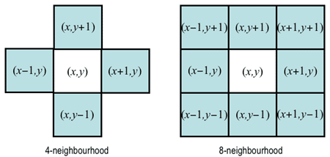
Definitions (1)
Pixels $P=\left(p_{x},p_{y}\right)$ and $Q=\left(q_{x},q_{y}\right)$ are:
- 4-neighbors if $\left(p_{x},p_{y}\right)=\left(q_{x}±1,q_{y}\right)$ or $\left(p_{x},p_{y}\right)=\left(q_{x},q_{y}±1\right)$;
- 8-neighbors if they are 4-neighbours or $\left(p_{x},p_{y}\right)=\left(q_{x}±1,q_{y}±1\right)$.

Slide 8
Definitions (2)
A walk from pixel $P_{1}$ to pixel $P_{n}$ is a sequence of pixels $P_{1},P_{2},…,P_{n}$ such that pixel $P_{k}$ is a neighbour of pixel $P_{k+1}$ $∀k, 1≤k≤n−1$.
Pixels $P$ and $Q$, both of color $C$, are connected if there exists a walk from$P$ to $Q$ containing only pixels of color $C$.
The set $S\left(P\right)$ of all pixels connected to $P$ is called the connected component of $P$.

Slide 9
Definitions (3)
„The set $S\left(P\right)$ of all pixels connected to $P$ is called the connected component of $P$.”

Slide 10
Problem statement
Polygonization of Connected Sets (PCS):
Input: A binary image I of width W and height H, coordinates $\left(p_{x},p_{y}\right)$ of a target pixel $P$
Output: A polygonal representation of the connected component $S(P)$
We want our the time and memory requirements to depend mostly on the size of $S(P)$, rather than on the size of the whole image I.

Slide 11
Problem statement

Slide 12
Goal
We will present a few different methods of solving the problem
The methods will vary in time and memory requirements, and simplicity
All methods share a few common tasks they have to perform
Traversing all pixels in $S\left(P\right)$
Identifying the borders of $S(P)$
Polygonizing the borders

Slide 13
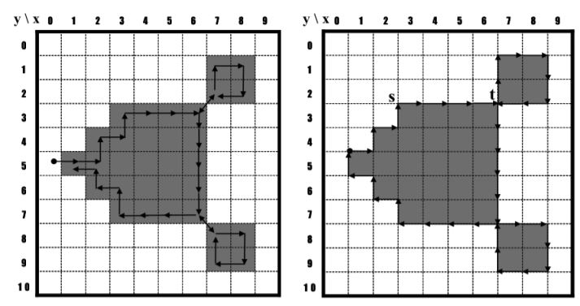
Identifying the borders of $S(P)$
We will use contour tracing
An extensive review is given in Fast Contour-Tracing Algorithm Based on a Pixel-Following Method for Image Sensors, Seo et al., 2016

Slide 14
Polygonizing borders
Polygonizing a border - finding a polygon that „corresponds” to that border
Due to discretization, different polygons can correspond to one border
Different polygonization accuracies have different time requirements
A review is given in Fast and Direct Polygonization for Gray-Scale Images Using Digital Straightness and Exponential Averaging”, Pratihar and Bhowmick, 2014

Slide 15
Traversing all pixels in $S\left(P\right)$
The most interesting/original part of this research
Different approaches require different time and memory resources
Some approaches could be efficiently used for purposes besides polygonization

Slide 16
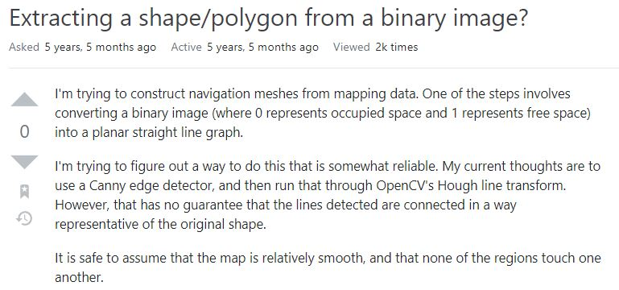
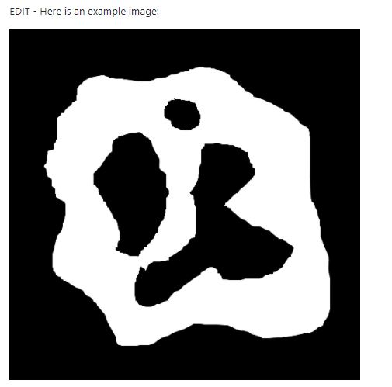
Examples
https://stackoverflow.com/questions/34021497/extracting-a-shape-polygon-from-a-binary-image

Slide 17
Thank you for listening!
Questions?

