Slide 1
NON-INTRUSIVE FALL RECOGNITION USING SMART FLOOR
Niki Hrovatin
UP-FAMNIT
Mentors: Jernej Vičič, Aleksandar Tošić
20.08.2020

Slide 2
Contents
Initial project
Non-intrusive fall recognition
Prototype structure
System architecture
Data collection process
Machine learning model
Future work

Slide 3
Initial project
The idea behind the project originates from the prototype developed in the contribution:
Privacy preserving indoor location and fall detection system
Authors: Aleksandar Tošić, Jernej Vičič, Michael David Burnard
They propose the further development of the prototype as a system for
Non-intrusive fall recognition
Optimization of future building based on the data collected using the smart floor
Tracking of patient in health institutions
Notes:
In this presentation we will present the further development of the prototype as a fall recognition system.

Slide 4
Non-intrusive fall recognition
Falls are events that affect almost every human above the age of 65
A fall can lead physical, psychological and socio-economical consequences
The fall event is a very actual problem
Fall prevention
Fall recognition
There are many solutions for fall recognition
Wearable technology
Ambiance technology
Notes:
The fall event is an actual problem which can be studied from the fall prevention and fall recognition problem
which with it’s presence can create some disconfort in the monitored person

Slide 5
Non-intrusive fall recognition
The aim of the project:
Differentiate ordinal daily activities from the fall event
To provide immediate help and prevent further injuries as consequences of the elapsed time
The system must be non-intrusive
To not create psychological discomfort for the monitored person
Notes:
To not create psychological discomfort for the person that is constantly monitored
The person must not percieve the system
The system must be hidden in something

Slide 6
Non-intrusive fall recognition
Smart floor as a non-intrusive system
Not perceived as a monitoring system
Is hard to use the recorded data to uniquely identify a person
Fall recognition as a classification problem
Solution: machine learning using supervised learning
Notes:
We will use the smart floor as a non-intrusive system because it is not percieved as a monitoring system and with the recorded data is very hard to uniquely identify a person.
The fall recognition problem can be addressed as a classification problem
Where we try to classify the activity on the floor as a fall event or just ordinal daily activity
This problem can be solved with a machin learning approach using supervised learning

Slide 7
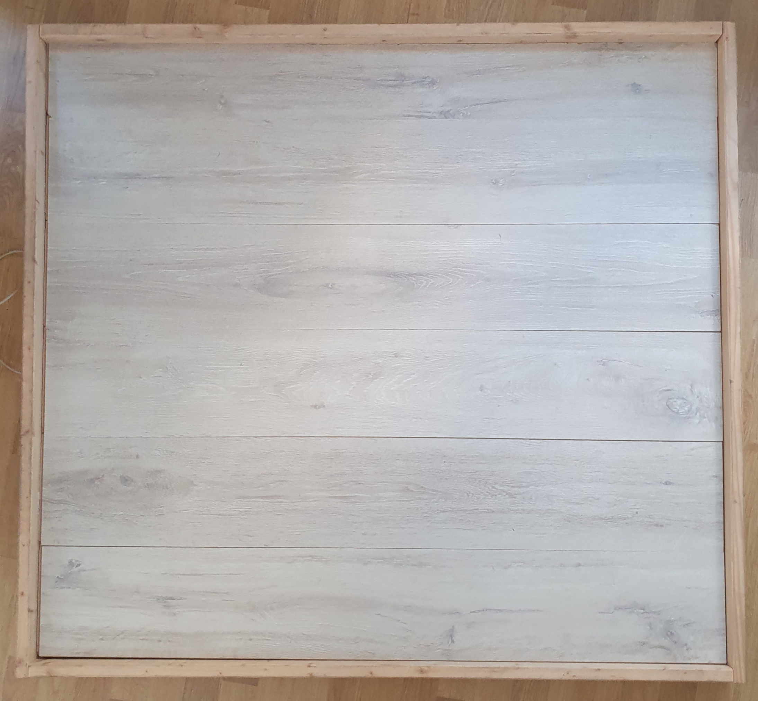
Prototype structure
The prototype is measuring 120x120cm
Composed of two layers:
Upper layer: standard laminate flooring surface
Lower layer: extruded polystyrene
Between the layers a system of 16 force sensors wired to an Arduino micro-controller.
Notes:
The prototype were tested also with a wooden upper layer, but suddenly it bended very badly for humidity
The laminate surface is very suited for this use because it is resistent ,very rigid and cheap

Slide 8
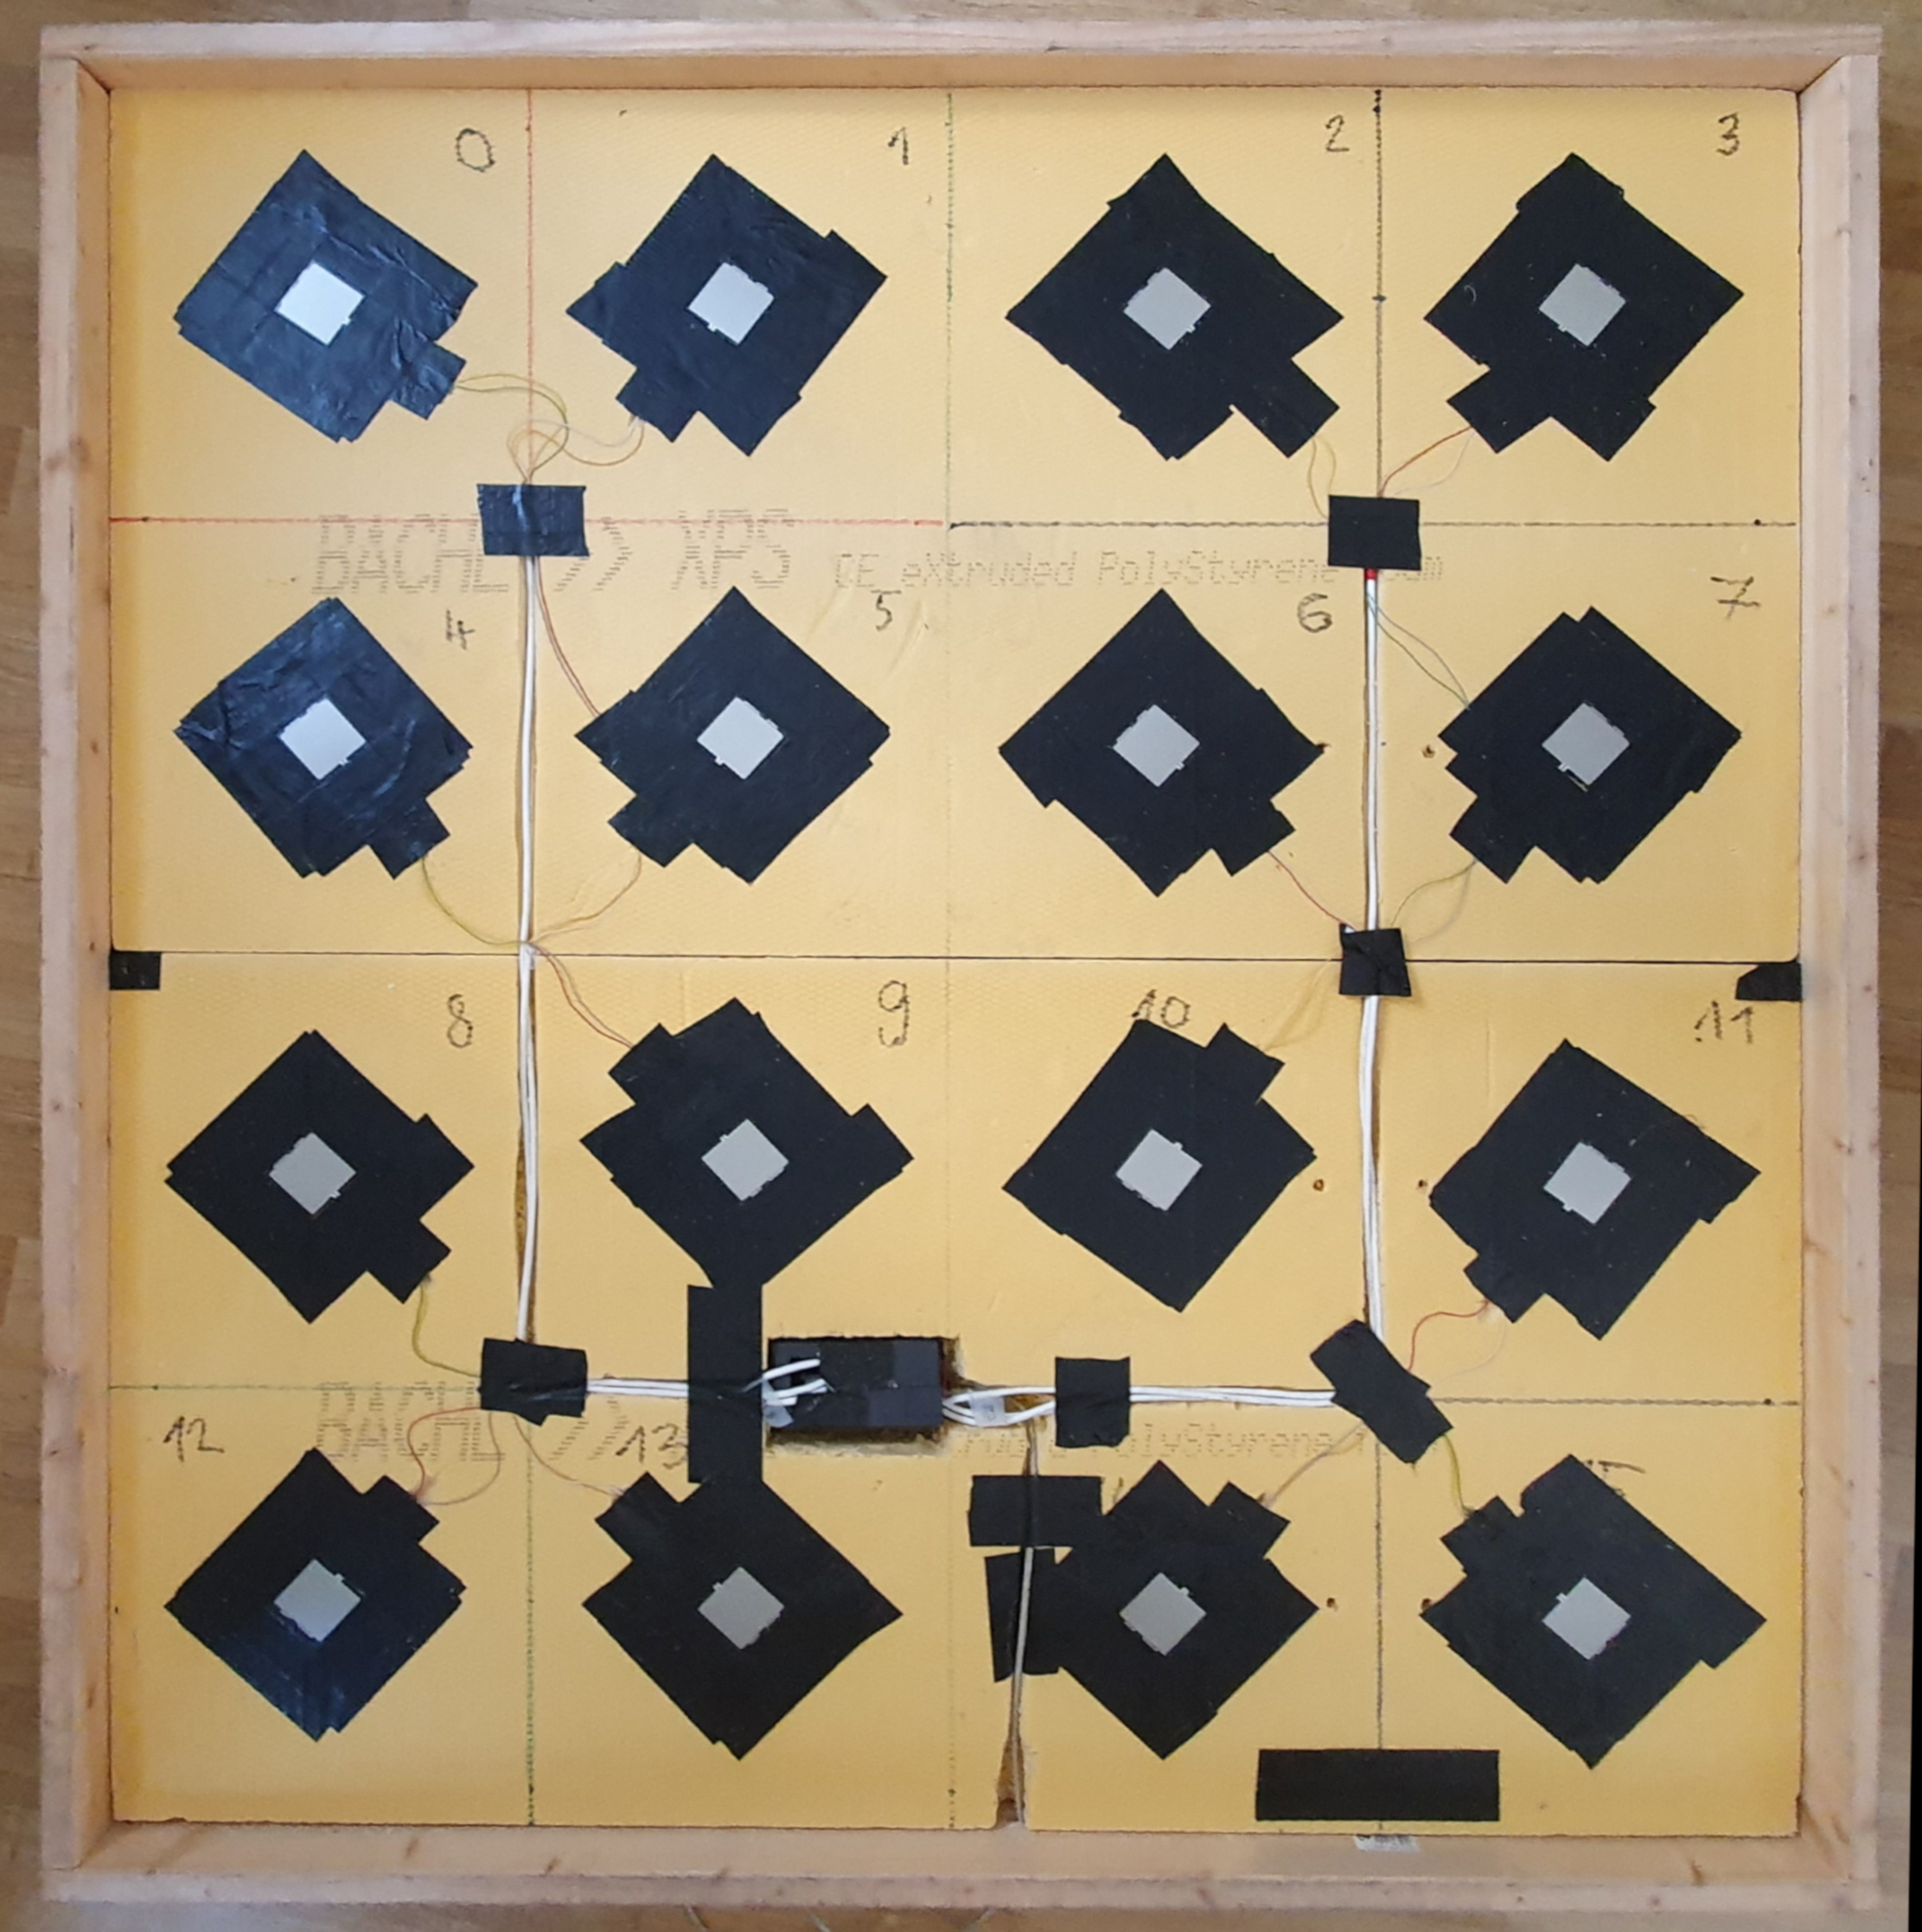
Prototype structure
Sensor type: Force Sensing Resistor
Sensor resistance is in inverse proportion with the applied force
Each sensor is linked to his own analog input on the ArduinoMega
The microcontroller is performing measurements with a 50Hz frequency
Every measurement is sent via serial communication to the processing unit
Notes:
As we can see sensors are set in a matrix like pattern
The black layer around the sensor is made of plastic tape and is used to reduce the force induced by the laminate surface on the empty floor
-> pokaži kje je arduinoMega

Slide 9
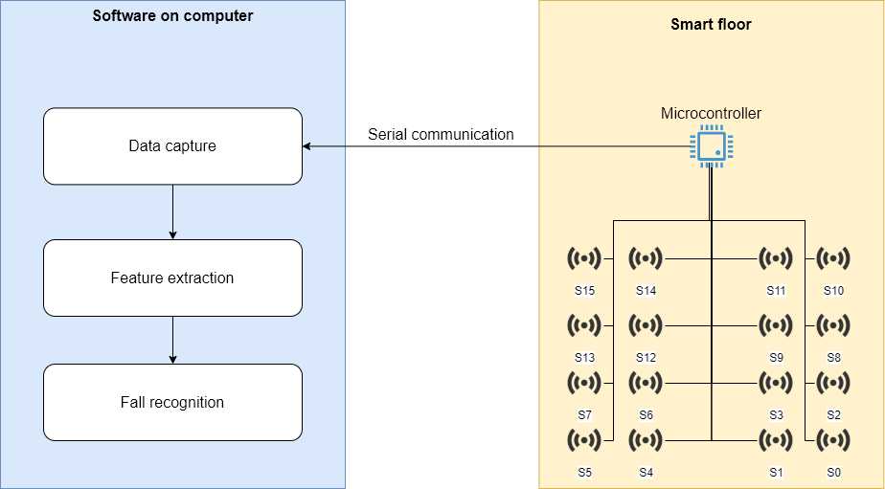
System architecture

Slide 10
Data collection process
By definition a fall is an unintentional event
A fall simulation is in direct contrast with the definition of fall event
The issue of fall simulation was widely discussed in this contribution
Stack, E. (2017). Falls are unintentional: Studying simulations is a waste of faking time. Journal of Rehabilitation and Assistive Technologies Engineering. https://doi.org/10.1177/2055668317732945
We structured our data collection process on activities proposed in this contribution
N. Noury et al., "Fall detection - Principles and Methods," 2007 29th Annual International Conference of the IEEE Engineering in Medicine and Biology Society, Lyon, 2007, pp. 1663-1666, doi: 10.1109/IEMBS.2007.4352627
Notes:
By definitio a fall is an unintentional event and by this the data collection process …
So Based on this findings we structured our data…. Contribution where they proposed how to evaluate fall recognition systems

Slide 11
Data collection process
The positive dataset is composed of seven distinct fall events:
Forward fall on the knees
Forward fall with forward arm protection
Forward fall ending laying flat
Forward fall on the knees with rotation, ending in the lateral position
Lateral fall ending lying flat
Lateral fall ending lying flat with recovery
Forward fall ending laying flat with recovery

Slide 12
Data collection process
The negative dataset is composed of the following activities:
Sit on a chair
Stand up from the chair
To bend down, catch something on the floor, then to rise up
Jump on the floor
Random walk
Waiting in place
Empty floor
Notes:
The negative data was collected only on one volounteer and the first 4 activities are used just to test the model, the other 3 are used for training

Slide 13
Data collection process
The data collection process was performed in collaboration with volunteers from InnoRenew CoE
Was carried out on Wednesday 29.07.2020 in a gym in arena Bonifika Koper
18 volunteers took part in the event
9 female volunteers
9 male volunteers
140 simulation of fall event were recorded

Slide 14
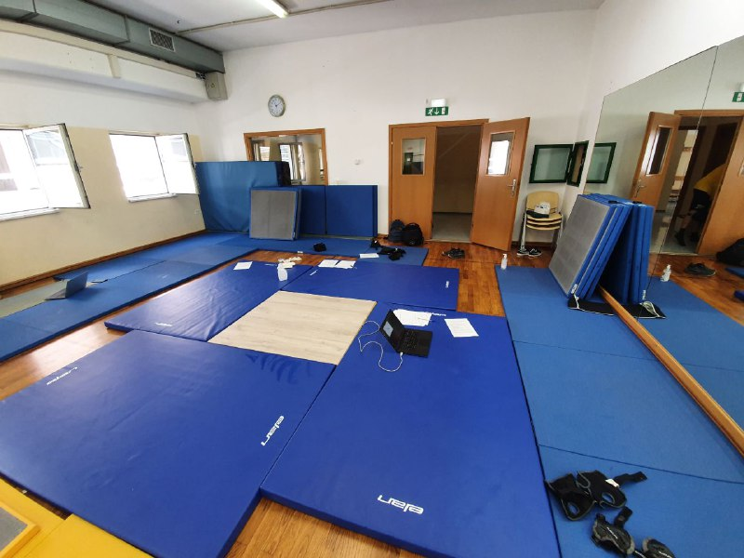
Data collection process

Slide 15
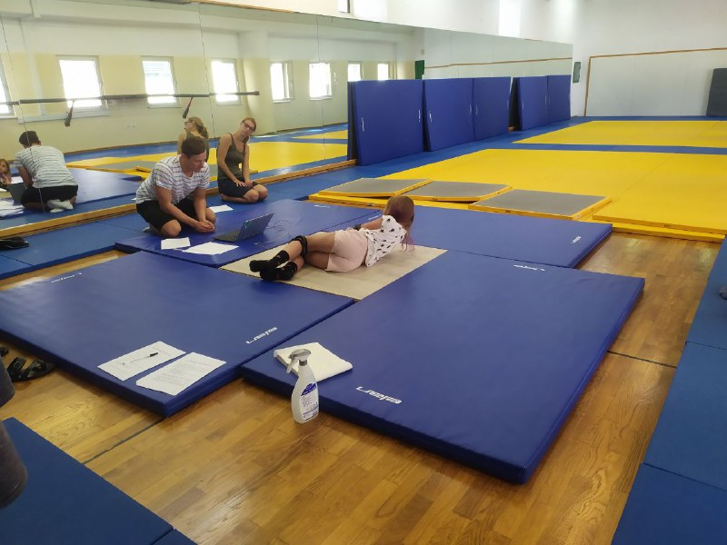
Data collection process

Slide 18
Machine learning model
Preprocessing:
min-max normalization over sensor values in a moving window of 100 measurements
Machine learning model:
Convolutional neural network
Two 2D convolution layers
One hidden layer

Slide 19
Machine learning model
Results from the evaluation of the model on the test set:
Notes:
Accuracy is the ability of the model to correctly classify falls and ordinal daily activities
Specificity is the ability of the model to correctly classify ordinal daily activities
Sensitivity is the ability of the model to correctly classify falls
As we can see the specificity is higher than the sensitivity
But in a fall recognition system we want a sensitivity of 100% because we must detect every fall and this is very hard to achieve

Slide 20
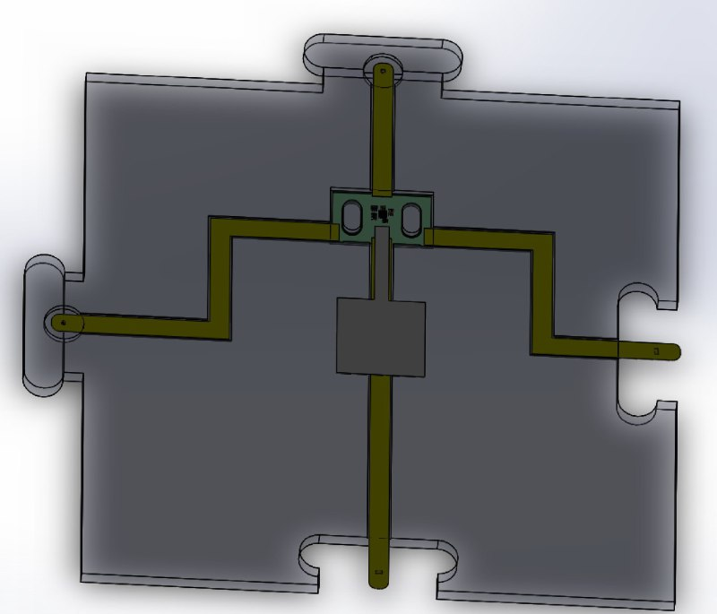
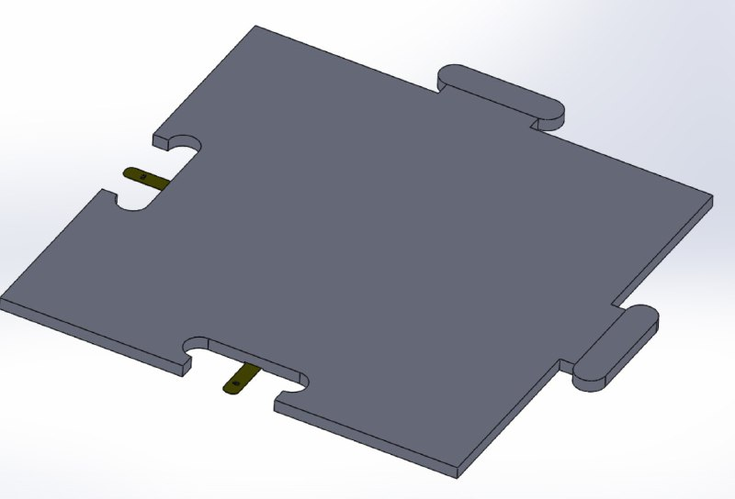
Future work
Build a stronger model, that ensures fall recognition
Increase the prototype size, to develop a sensor network communicating with a 1-wire protocol
The development of tiles with embedded sensors
Notes:
The tiles in the pictures are a prototype designed to enclose our pressure sensor
We didn’t choose already the tile material but we need something very rigid and resistant that can be used as a floor

Slide 21
Questions ?

